Slide 1

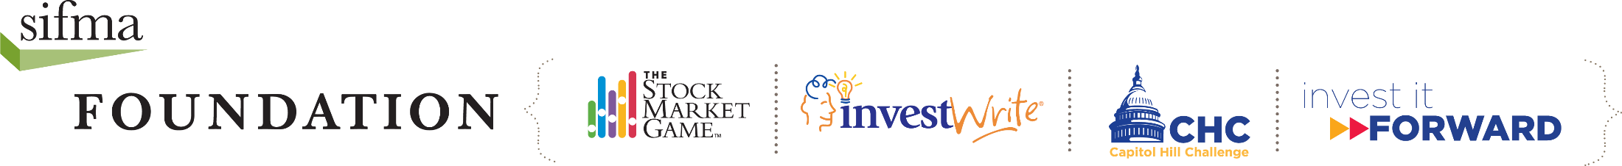
Life Goals
INSERT PRESENTER INFORMATION HERE
(Name, Title, Firm)
Notes:
Presenter’s introduction should include:
Greeting:
Hello and how are you doing today. I am NAME from COMPANY. I am the TITLE, which means I am responsible for AREA.
Company Profile:
My firm conducts business spanning GEOGRAPHIC FOOTPRINT and TYPE OF BUSINESS.
Responsibilities:
My responsibilities include DUTIES. A typical work day for me would start with ACTIVITY and end with ACTIVITY.
Insights:
The most challenging part of my job is … and the most exciting part of my job is …

Slide 2

Image Source: http://www.bitmondo.com/hola.png
Notes:
Presenter greets the class and reviews the objectives of the visit:
Today, we’re going to discuss the Life Goals.
We will look at how saving can help you reach your dreams.
We will also look at how individuals can use the Capital Markets to reach their long term goals. .

Slide 3

Notes:
Presenter asks: What do want to do for work when you get older?
Student responses will include examples of careers.
Presenter asks: Will you attend vocational school, college or another school?
Students will share their plans for education.
Presenter explains: Students have endless possibilities including working for a large company or owning a small business. No matter what they want to do they will have to pay for it and savings is a great way to start.

Slide 4

Notes:
Presenter introduces the video: Here’s a short video that highlights some people’s Life Goals and how the capital markets helped them to reach their goals. Play the video.
After the video, Presenter sums up the content: In the video, you saw how Jessica and Oscar used the capital markets in various ways. You learned the importance of saving early for the future and earning interest. In addition, you saw how the capital markets can help you potentially earn more by taking more risk. You learned that a 529 college savings plan can reduce the need for student loans and how a mortgage can help a person buy their own home.
Presenter asks students to:
Give an example from the video of someone saving for a goal (Answer: Elena saving for college and dental school; OR Jessica saving restaurant profits; OR Oscar’s parents saving for his college in a 529 account; OR Oscar saving for a down payment on a house and for his retirement in his company’s 401k).
Give an example from the video of a type of account for savings (Answer: savings; OR CDs; OR money market account)
What are the two parts of the capital markets? (Answer: the stock market and the bond market)
If you do not use the video, discuss this using the slide in the Appendix.

Slide 5

Let’s Review
1. How do you start saving for the future?
2. When are you ready to open a CD or money market account?
3. What are potential benefits and drawbacks of a CD or money market account?
Notes:
Presenter asks: How do you start saving for the future?
Possible response from students:
Opening a savings account
Presenter asks: When are you ready to open a CD or money market account?
Possible response from students:
If you are confident that you have enough money saved to cover emergencies.
Presenter asks: What are potential benefits and drawbacks of a CD or money market account?
Possible responses from students:
They pay higher interest rates than most accounts.
There are rules about how much money you must put aside
There are rules about how long your money is held.

Slide 6
4. What are examples of life goals?
5. What are the Capital Markets and Tools to Reach Your Goals
6. What are some tools along with the capital markets that can help you reach your financial goals?
Notes:
Presenter asks: What are examples of life goals?
Possible responses from students:
saving for education
investing in a business idea
buying a car or a home
retiring
Presenter asks: What are the Capital Markets and Tools to Reach Your Goals?
Possible responses from students:
The stock market and the bond market are a part of the capital markets.
Through investing you can potentially earn more money (or returns) than through a savings accounts or CDs, but there’s also greater risk that you might lose your money.
When it comes to investing higher risk offers higher possible returns and lower risk offers lower possible returns.
Presenter asks: What are some tools along with the capital markets that can help you reach your financial goals?
Possible responses from students:
529 Plan
mortgage
401(k) plan
Capital markets help people with ideas become entrepreneurs and help small businesses grow into big companies, while giving investors the opportunity to earn more interest (returns). Let’s review the tools and resources people in the video used to reach their goals.

Slide 7

Notes:
Presenter asks: When Elena was a sophomore in high school planning to become a dentist, how did she prepare to reach goal?
Possible responses from students:
She saved as much of her earnings as she could.
During summers, she worked full time and put even more into her savings account.

Slide 8
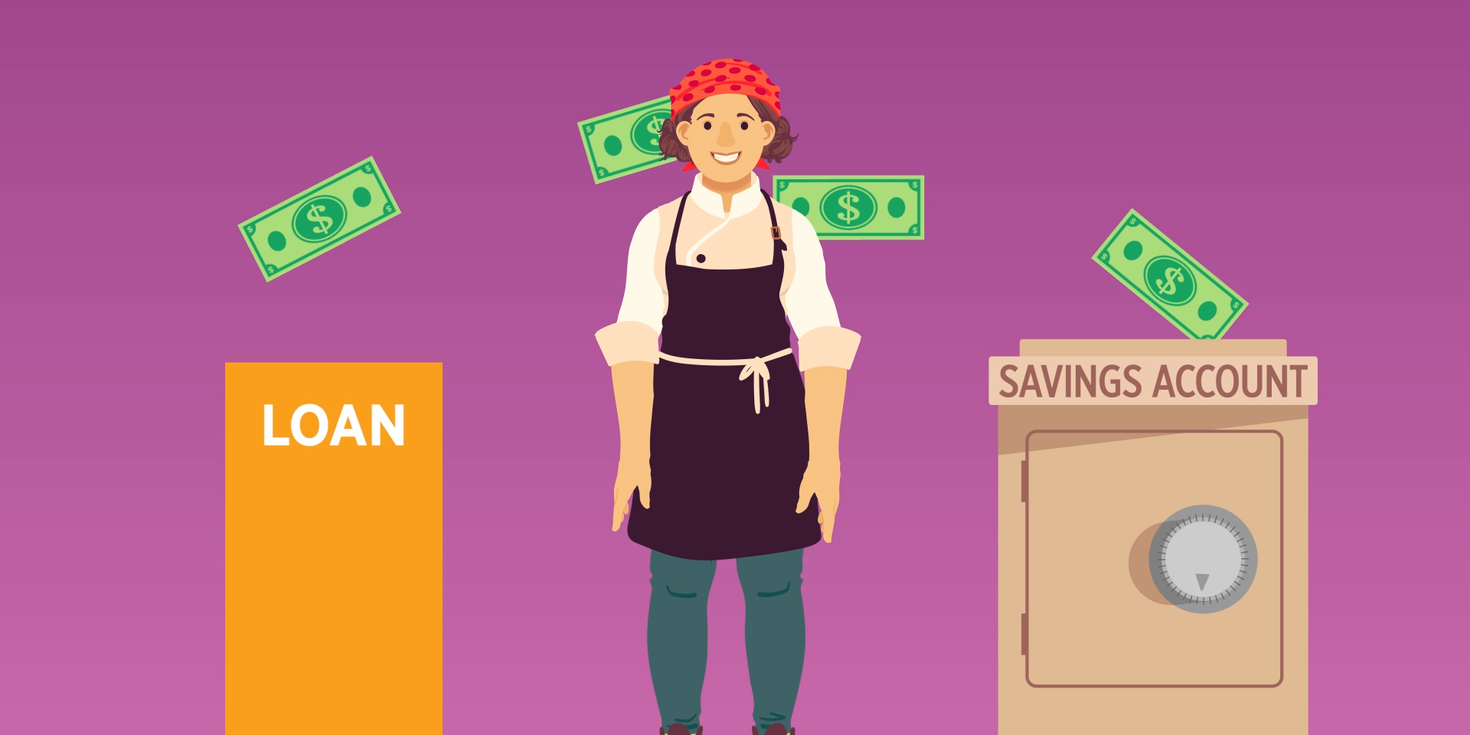
Notes:
Presenter asks: Jessica paid back the loan for her restaurant and saved money at the same time. Why is she investing in stocks and mutual funds?
Possible responses from students:
She plans on expanding her business in five years.
She doesn’t plan on spending any of this money for at least five years,
These investments have a greater risk that she might lose her money than with a savings account, but they may provide higher returns.
Jessica plans to continue depositing part of her income into her savings account and investing part of her income.

Slide 9

Notes:
Presenter asks: How did his parents starting a 529 Plan help Oscar when he was older?
Possible responses from students:
When Oscar was ready to start college, he did not depend as much on student loans and financial aid.

Slide 10

Notes:
Presenter asks: How did a mortgage help Oscar reach his dream and become a new homeowner?
Possible response from students:
A bank gave Oscar a home loan, called a “mortgage,” because he wasn’t able to pay for a house all at once.
He hadn’t saved enough for a 20 percent down payment on a house.
Oscar was also saving for another long term goal; retirement.

Slide 11

Notes:
Presenter asks: How is Oscar saving for retirement?
Possible responses from students:
Putting his money into his company’s 401(k) plan.
401(k)s include investments in different stocks, bonds, and mutual funds.
His company matches every dollar that he saves, up to $1,200 a year.

Slide 12

Notes:
The presenter wraps up: Thank you for your attention and time today.
I hope you now have a better understanding of how life goals and the capital markets are related; what capital markets do for us, and why that’s important.
I asked you a lot of questions today. Now it’s your turn to ask me questions.

Slide 13
APPENDIX reference slides to use if video is not available

Slide 14
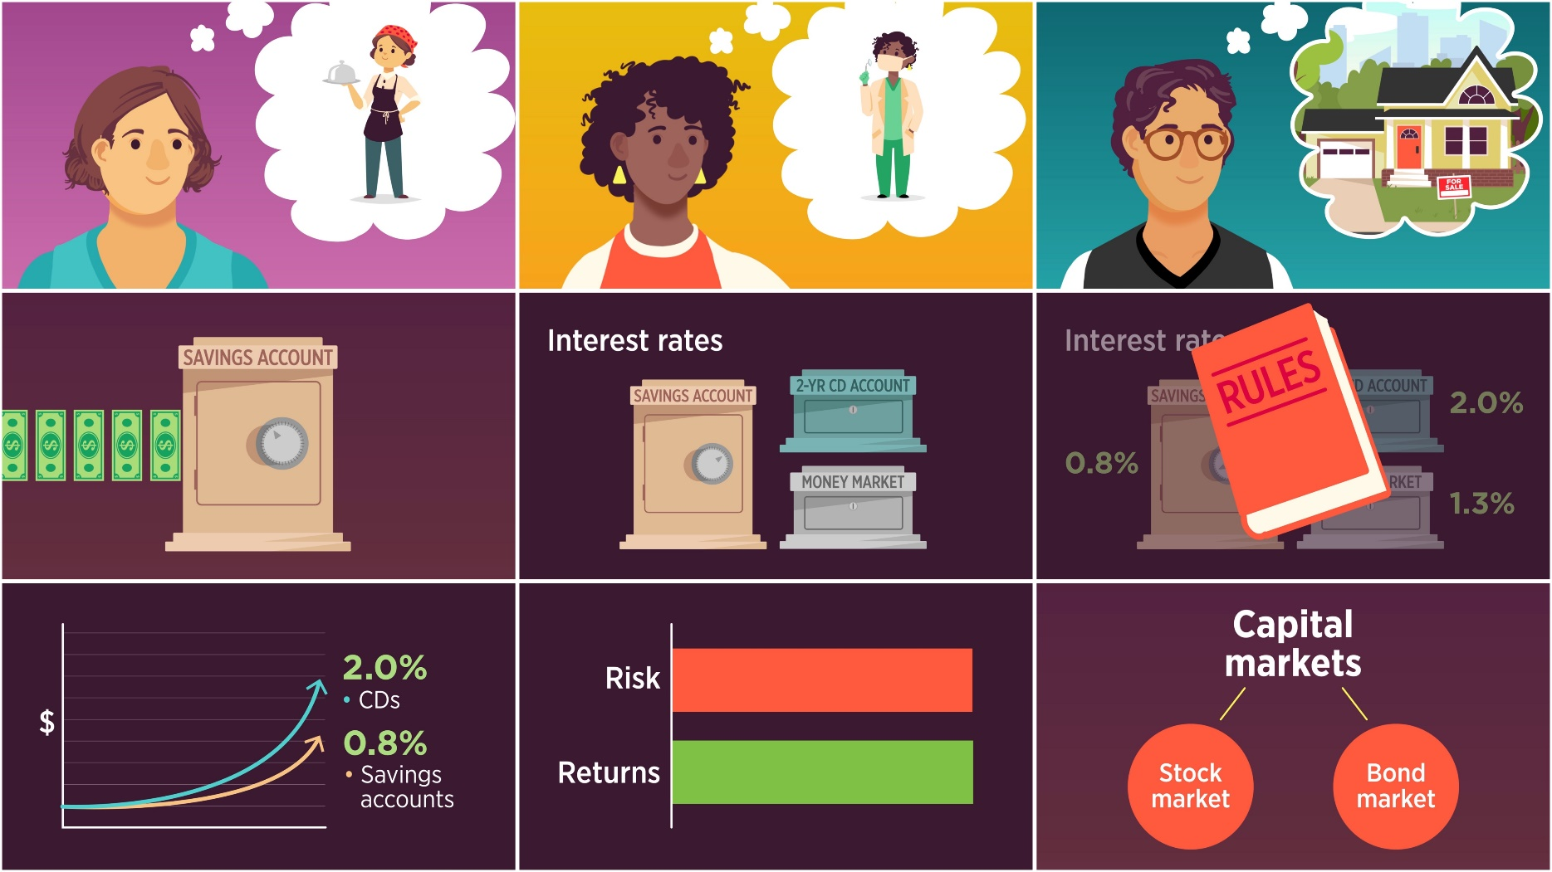
Notes:
If you did not use the video, discuss the lesson content:
Whatever you dream about doing, you will need to find a way to pay for it. Putting money into your savings account regularly will help you earn even more. If you are confident that you have enough money saved to cover emergencies, you can open a money market or CD account. These types of accounts offer higher interest rates than most accounts, but they also have rules about how much money you must put aside and how long your money is held. When it comes to saving, higher interest rates mean that your money grows more quickly. Investing through the capital markets is another way your money can earn more. Investing can earn you more money (or returns) than savings accounts or CDs, but it also increases the risk that you might lose your money. When it comes to investing, it’s quite simple -- higher risk offers higher possible returns and lower risk offers lower possible returns.
Capital markets are financial markets that bring buyers and sellers together to trade stocks, bonds, currencies, and other financial assets. The capital markets include the stock market and the bond market.
Throughout your life you will have different financial goals from saving for education, to investing in a business idea, to buying a car or a home, to retiring. There are different tools and resources available through the capital markets to help you.
For example:
If a student dreamt of becoming a dentist it would require a plan. Knowing college and dental school would be expensive, a student could save as much of her earnings from her part-time job as she could. In the summer, she could work full time and put even more into her savings account. In addition, a CD account would earn more interest than her savings account, but she couldn’t withdraw the money for two years!
Consider a small successful restaurant owner. She was lucky to receive a small business loan with a low interest rate. She repaid the loan and plans on expanding her business in five years. While paying back her loan, she also saved some of her restaurant’s profits in a savings account. Because she doesn’t plan on spending any of this money for at least five years, she has decided to invest some of it into stocks and mutual funds. These investments are riskier than keeping the money in a savings account, but they may provide higher returns. The restaurant owner plans to continue depositing part of her income—the profit from her business—into her savings account and investing part of her income into stocks and mutual funds.

Slide 15
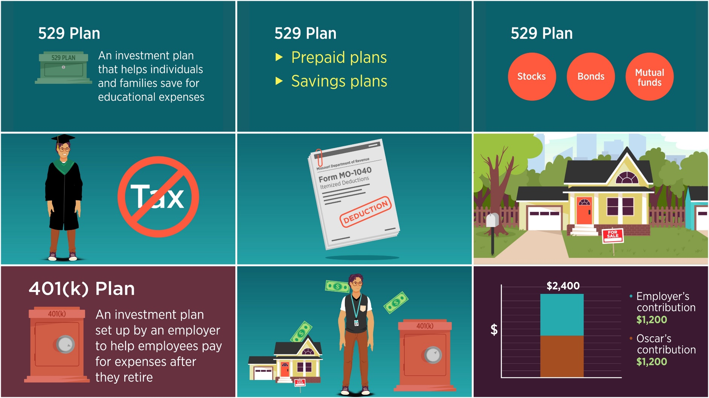
Notes:
(Continued) If you did not use the video, discuss the lesson content:
A 529 Plan can help students reach their educational goals. A 529 is an investment plan that helps individuals and families save for educational expenses. Some plans are “prepaid” tuition plans and others are savings plans. A prepaid tuition plan allows a family to pay today, at today’s prices, for future school tuition. A savings plan allows a family to invest its money for future educational expenses and earn interest on which tax is not charged. Contributions to a 529 Plan are typically invested in stocks, bonds, and mutual funds. If a child’s parents invested $5,000 in his 529 plan and the investment earned $800. The child might end up with, say, $5,800 to help pay for college and no tax was charged for the $800 in earnings. The parents might also able to deduct contributions from their state income taxes. Because the parents started early, when the child is ready to start college, he would not depend as much on student loans and financial aid to help him
Another financial tool helps people buy homes. It is a mortgage. Most people aren’t able to pay for a house all at once.
A mortgage is a loan from a bank that you use to buy a house.
Many people also save for retirement by putting money into a company 401(k) plan. A 401(k) plan is an investment plan set up by an employer to help employees pay for expenses after they retire. Most 401(k)s include investments in different stocks, bonds, and mutual funds. Employees decide how much they want to contribute to their 401(k) each paycheck. Usually there is a limit on how much employees can deposit, but some companies match every dollar up to a certain amount, like $1,200 a year. In that case, an employee who contributes $1,200 this year, will end up with $2,400 at the end of the year!
Conclusion:
Whatever you dream about doing, you will need to find a way to pay for it.
When it comes to saving, higher interest rates means that your money grows more quickly.
Investing through the capital markets is another way your money can earn more..
Capital markets help people with ideas become entrepreneurs and help small businesses grow into big companies, while giving investors the opportunity to earn more interest (returns)
Higher risk offers higher possible returns and lower risk offers lower possible returns.
Three tools to help you reach your goals include a 529 Plan, a mortgage, and a 401(k) plan.
There are many ways to save and invest to reach dreams and the capital markets get people there. As you think about your future, what are your dreams? How will the capital markets help you?

