Slide 1
Credit History and Equal Opportunity
Who gets credit and why?

Slide 2
Credit
Credit defined-
The granting of money or something of value in exchange for a promise of future repayment.
Today’s focus is on who gets financial credit and why.
Why do people want credit?
Notes:
Credit allows people to buy something now and pay in the future.

Slide 3
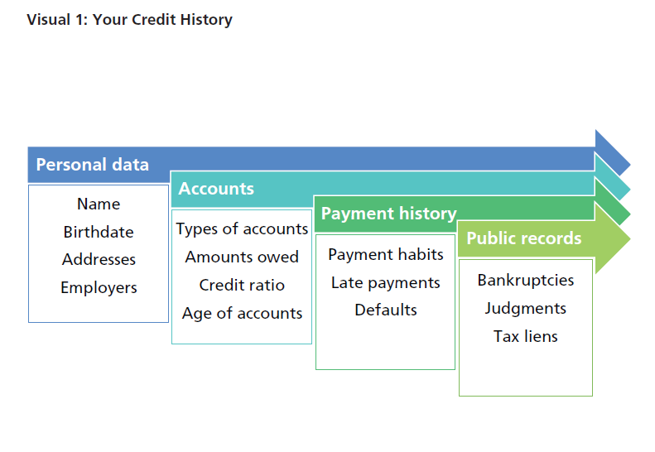
Creditworthiness
Notes:
Credit history is compiled by rating agencies also known as credit bureaus. They collect the information and in turn, sell it to businesses so the business can assess risk and decide whether to issue credit and how much to charge for that credit.

Slide 4
Credit Report
Credit Bureaus gather the credit history of individuals and compile it into a credit report.
Notes:
Big Three credit bureaus- Equifax, Experian, TransUnion. They gather payment information and sell the reports to businesses who have a legally valid reason to view it. For example if you apply for a credit card, car loan or want to rent an apartment your credit report will be pulled.

Slide 5
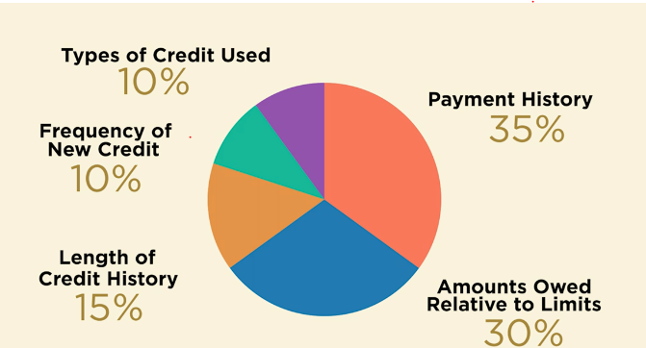
FICO Categories
These numbers are a rough estimate generally used in generating FICO credit scores
Notes:
This chart is taken from the STL Fed video- https://www.stlouisfed.org/education/continuing-feducation-video-series/episode-1-understanding-how-a-fico-credit-score-is-determined If time allows show the video prior the activity- Video lasts 5:58.

Slide 6
Credit Reporting Agencies
Who are the big three credit bureaus?
Equifax, Experian, TransUnion
Character, capacity and collateral are known as?
3 Cs of Credit

Slide 7

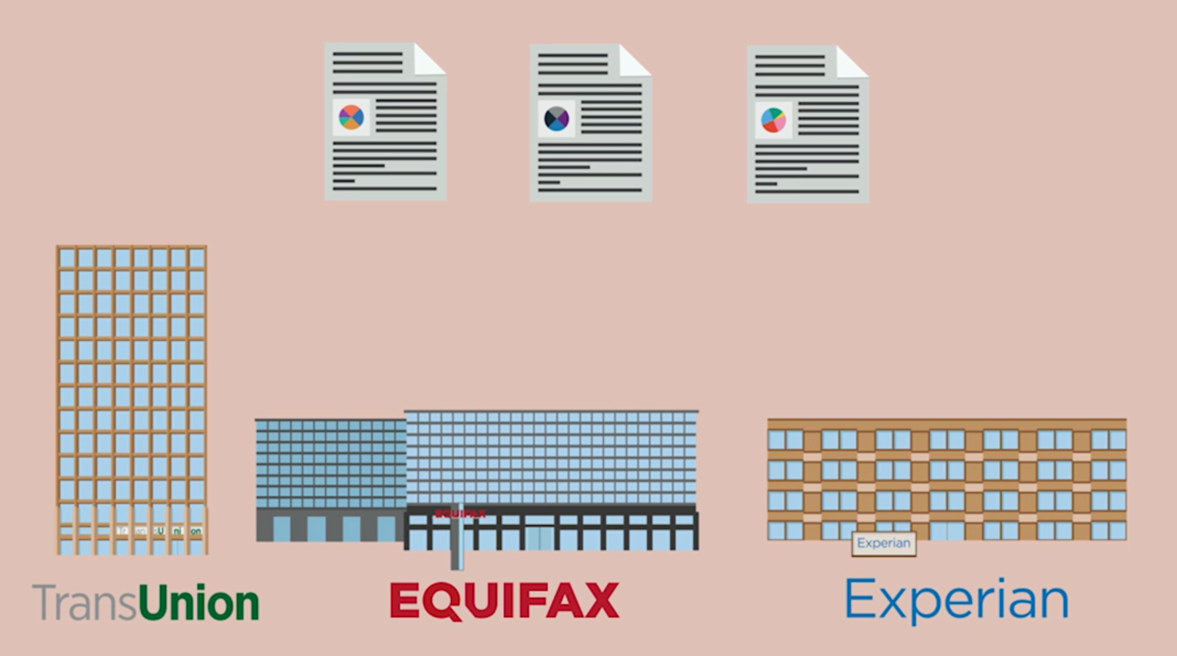
You can order a copy of your report once a year for FREE!
Notes:
This image is taken from the STL Fed video- https://www.stlouisfed.org/education/continuing-feducation-video-series/episode-1-understanding-how-a-fico-credit-score-is-determined

Slide 8
Credit Advisory Team
Team members evaluate borrower cards
Use your knowledge and refer to the Credit Cheat Sheet
Cross out information that can’t be used, give evidence why

Slide 9
Evaluate and Explain
Who gets credit and why?
What challenges did your team face in making the evaluations?
Whom did your team select and why?
Report out & look for overlaps
Notes:
Pass out borrower cards to each group. Allow them time to mark out what can’t be used, and discuss who should get credit and why. Then show each slide and ask each group to report out as their list of people are presented. Note that there are overlaps. Tell all students to look for names their group has in common with other groups and see if they came to the same decision.

Slide 10
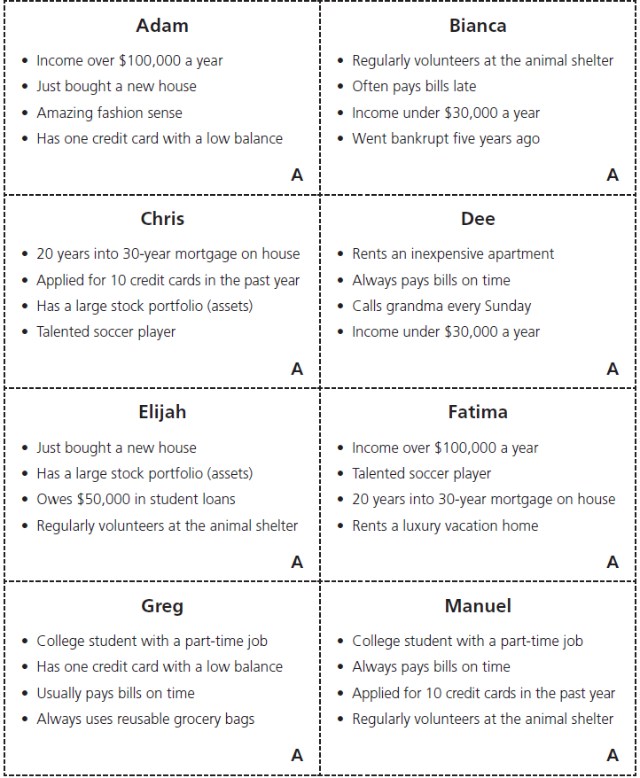

Slide 11
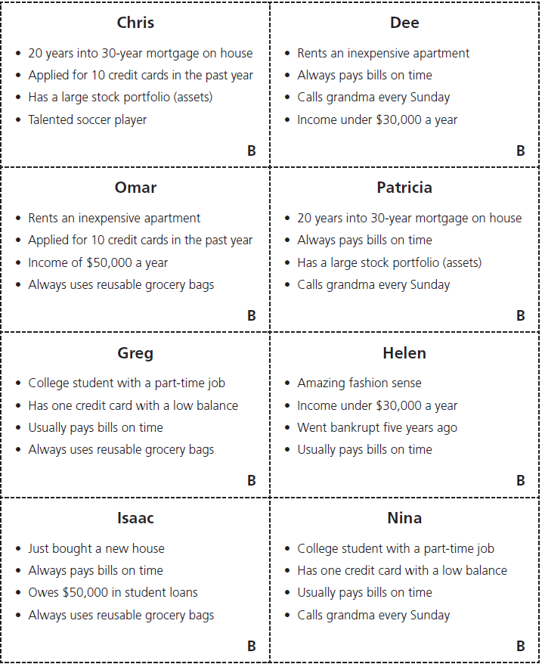

Slide 12
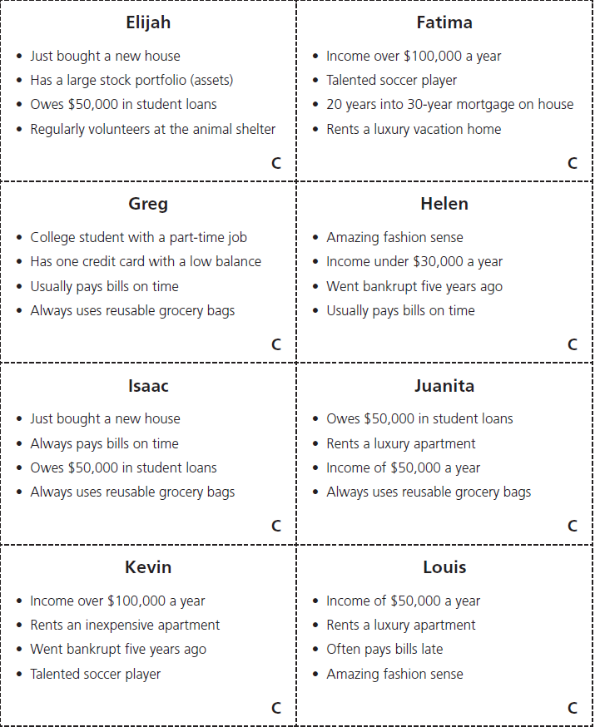

Slide 13
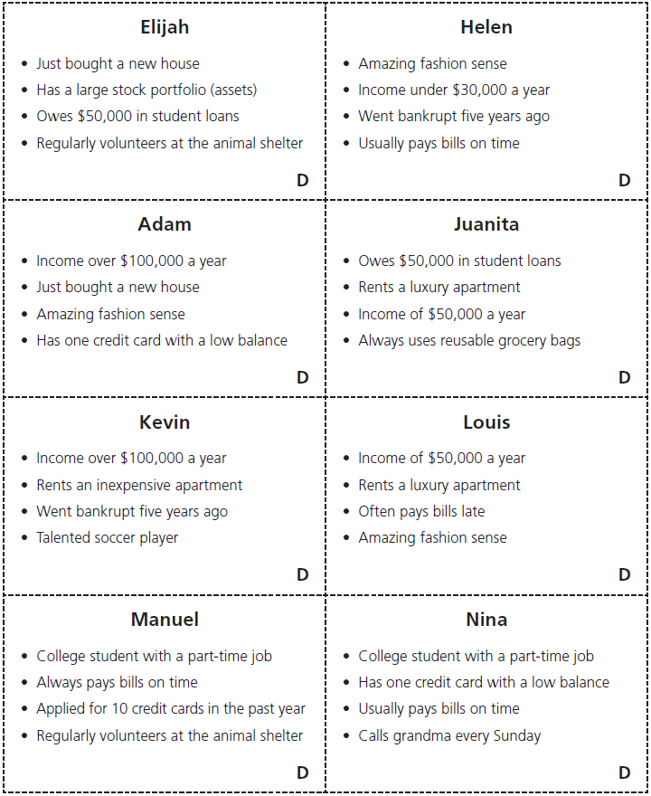

Slide 14
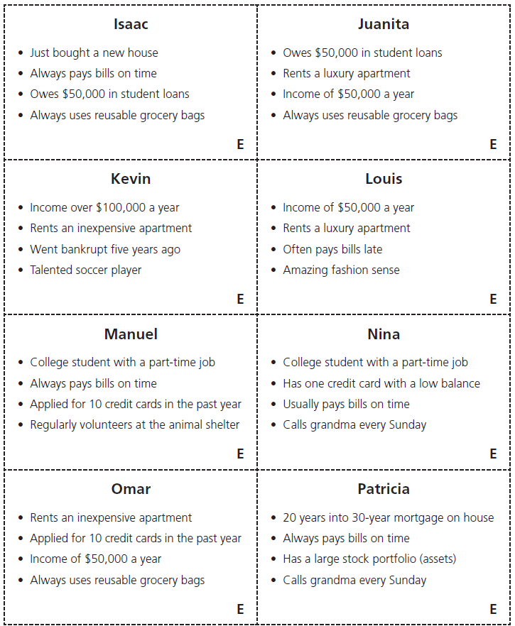

Slide 15
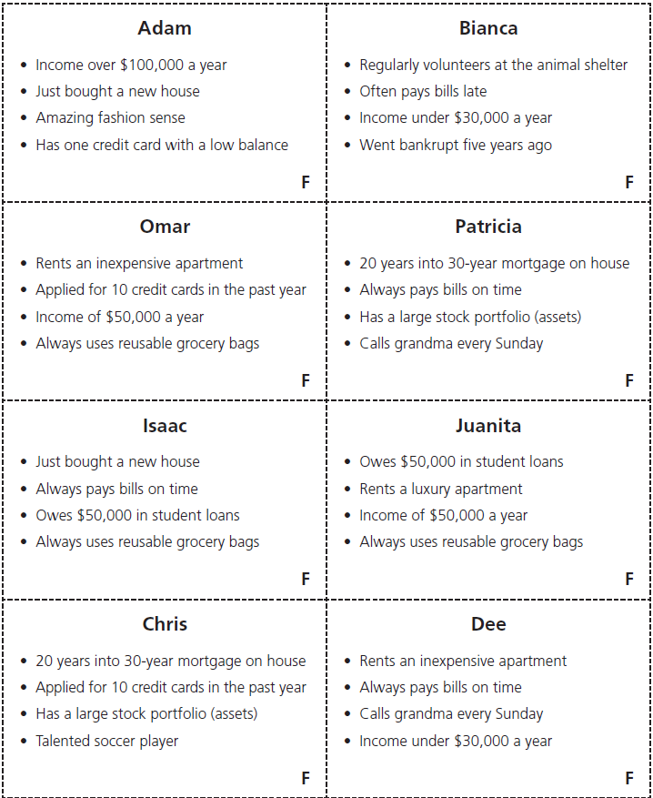

Slide 16
Discussion Questions
Was anyone surprised about what info you could not use?
Why do you suppose sex and marital status can’t be used?
Would you be surprised to learn that all the info on Handout 1 used to be legal to use in deciding who gets credit?

Slide 17
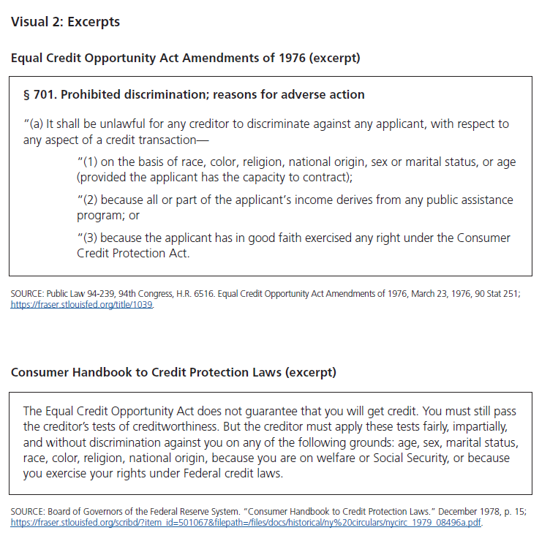
Which passage is easier to understand, the one above or below? Why?
Notes:
Factors used to evaluate credit have changed over time and fairly recently. Congress passed laws in 1974 and 1976 (more than a decade after the Civil Rights Act) to prevent discrimination in lending on the basis of sex, marital status, race, religion, ethnicity, or national origin. These are together known as the Equal Credit Opportunity Act.

Slide 18
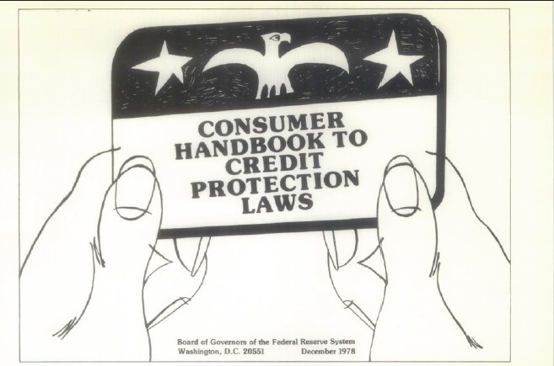
Notes:
Tell students each group will now receive a page from this booklet. Pass out pages and have students read and discuss.

Slide 19
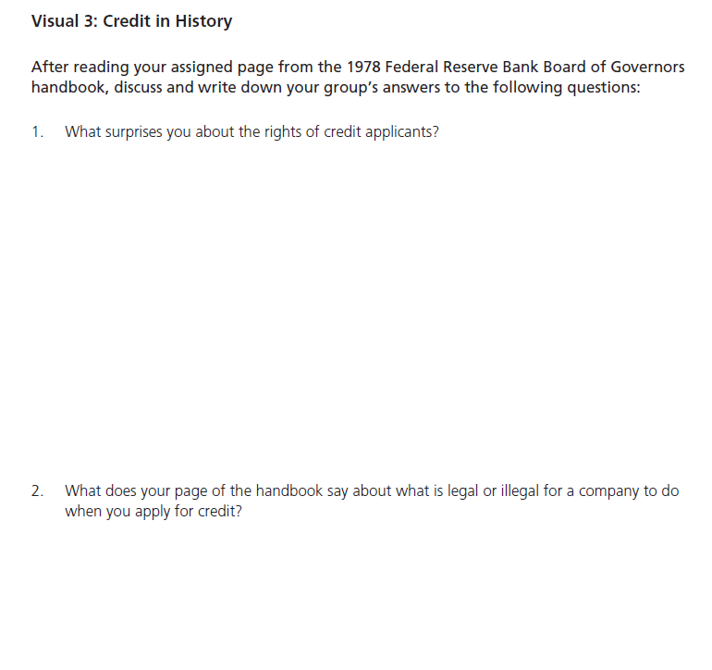
Notes:
Have groups report out the topic addressed on their page and answer the questions on visual 3. Answers will vary for question 1 but may discuss how discrimination based on marital status or pregnancy or possible pregnancy was once allowed. Possible answers for question 2- Illegal to discriminate based on race/ legal to consider income

Slide 20
Who produced this handbook? Who is the likely target audience?
Notes:
Board of Governors of the Federal Reserve System for the general public/consumers
One of the duties of the Federal Reserve System is to regulate banks. This handbook was meant to educate the public about their rights. Know your rights.

Slide 21

Credit and Cosigning
Groups now switch jobs- instead of working for a credit bureau they now work for a Major Auto Finance company focused on selling as many cars as possible.
Notes:
This slide is for the optional extension regarding cosigning.

Slide 22
Sell More Strategy
Grant loans to pairs of people
Review Borrower Cards
Choose 4 pairs of people to get loans (each pair get 1 loan)
Maximize number of loans- (pair a strong credit history with a weak one)

Slide 23
Discussion
Do companies ever allow one person to “pair up” with another to get a loan in real life?
Cosigner- a person with a better credit score and sometimes a longer credit history agrees to be a second signer or back up and takes responsibility for the debt.

Slide 24
Cosigning
Pros
Cons
Allows one access to credit
Helps one build credit
Makes one libel for another’s debt
Can wreck a person’s credit if loan is not repaid

