Slide 1
Teacher instructions:
1. Print the lesson,
2. Display slides 2 through 4 with Procedure step 5 in the lesson.
3. Display slide 5 with Procedure step 6.
4. Display slides 6 through 8 with Procedure step 6.
5. Display slides 9 and 10 with Procedure step 9.
6. Display slide 11 with Procedure step 12.
7. Display slide 12 with Procedure step 15.
8. Display slide 13 with Procedure step 16.
9. Display slide 14 with Procedure step 17.
10. Display slides 15 and 16 with Procedure step 18.
What Really Caused the Great Depression?

Slide 2
In 1933, when your income decreased, why did the percentage of your income spent on housing and perhaps other items increase?
Because income decreased, even if the dollar amount spent on a category remained constant, the percent of income spent on that category increased.
Raise your hand if your group spent the same dollar amount on food in 1928 as you did in 1933.

Slide 3
What tradeoffs did you make in order to feed yourself and/or your family?
How would these spending decisions affect the economy?
There would be an overall reduction in spending on goods and services.

Slide 4
Although in your role you retained your job, one in every four (25%) of the workforce was unemployed. What effect did this have on spending?
decreased spending
If you were unemployed, what choices might you have had to make?
You might stop making house payments or you might sell farmland and equipment.
If you had additional family members come to live with you in 1933, what happened to the income per person - per capita income - for your family?
It decreased.

Slide 5
Deflation is a decline in the average price level.

Slide 6
What are some of the theories that have been advanced over the years regarding the cause of the Great Depression?
stock market crash, protectionist trade policies, failure of capitalism, excess of the 1920s, falling money stock
What explanation regarding the of the Great Depression has stood the test of time?
The explanation that has stood the test of time is one that focuses on the collapse of the U.S. banking system and the contraction of the nation's money stock.

Slide 7
What was the main reason that explains why the money stock fell during the Great Depression?
Banking panics were the main reason why the money stock fell during the Great Depression.

Slide 8
Bank reserves are the amount of deposits not loaned out by banks.

Slide 9
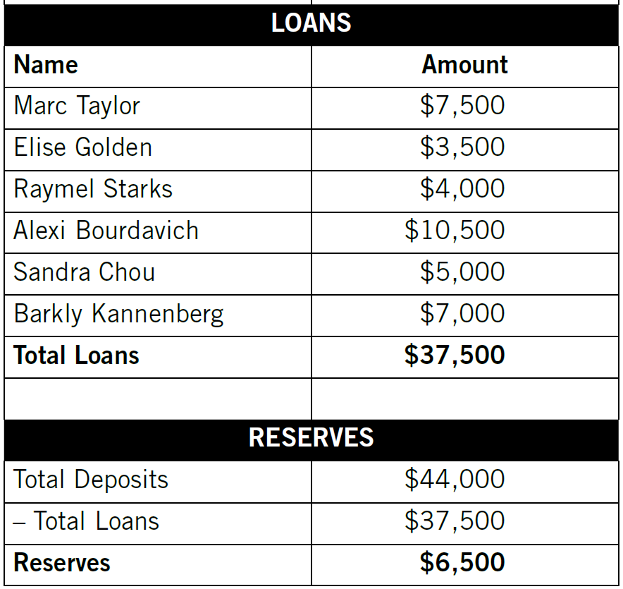
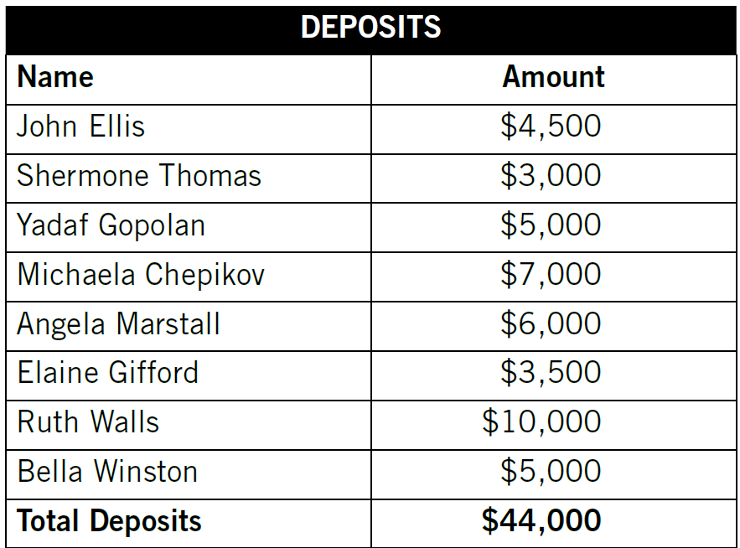
Deposits, Loans and Reserves for the Community Bank

Slide 10
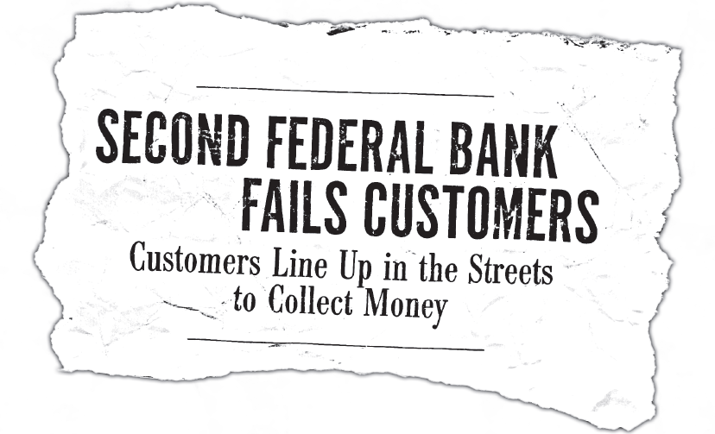

Slide 11
Bank failures occur when banks are unable to meet depositors' demands for their money.

Slide 12
Bank Run
Bank Panic
Bank Failures

Slide 13
People and businesses
borrow less
from banks.
People buy fewer goods and services.
Businesses sell fewer goods and services because people have less to spend.
Prices decline.
Business
Revenues
decline.
Businesses
are able to
buy fewer supplies and equipment.
Businesses are unable to employ as many workers, they must pay workers less or a combination of both.
Workers who are paid less or lose their jobs may buy fewer goods and services and may be unable to repay bank loans.
More banks fail, so the economy's supply of money and credit shrinks. This causes a decline in business revenues, which leads to more unemployment and/or decreases in wages.

Slide 14
Review
What is a bank failure?
A bank failure occurs when banks are unable to meet depositors' demands for their money.
What is a bank run?
A bank run occurs when many depositors attempt to withdraw all of their funds from their bank at the same time.

Slide 15
Review
How did bank panics contribute to the collapse of the nation's banking system and a reduction on the money stock?
As people withdrew their money from the banks, the amount banks had to lend - the money stock - decreased. Bank panics caused additional bank failures, which contributed to the panic and lack of confidence in the banking system. As the money stock fell, spending on goods and services decreased. This caused firms to cut prices and output and to lay off workers.

