Slide 1
How the Federal Reserve Implements Monetary Policy How does the Fed conduct monetary policy to achieve price stability and maximum employment?
The Fed’s Toolbox

Slide 2
The Fed’s Toolbox
Dual mandate – The Federal Reserve’s responsibility to use monetary policy to promote maximum employment and price stability.
Maximum employment – The highest level of employment that an economy can sustain while maintaining low and stable inflation. The Fed’s policy decision is informed by its assessments of the shortfalls of employment from its maximum level.
Price stability – A low and stable rate of inflation maintained over an extended period of time. The Fed seeks to achieve inflation that averages 2 percent over time.

Slide 3
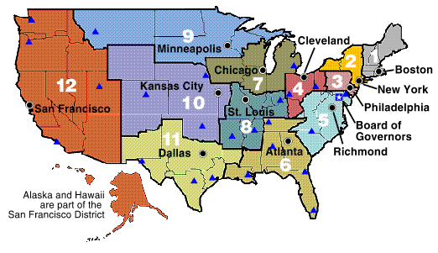
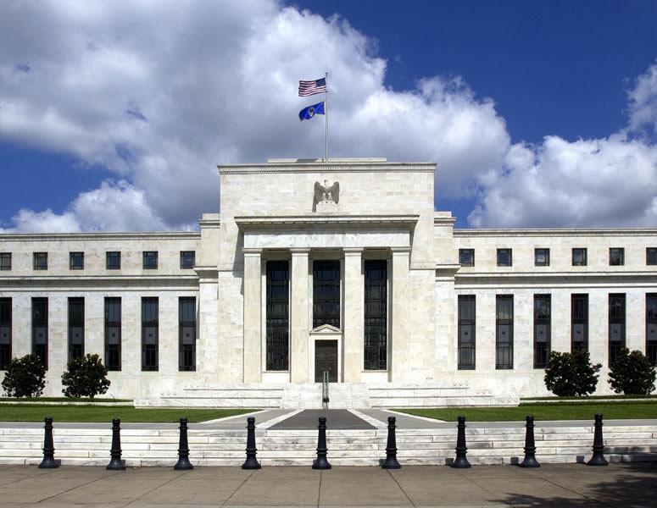
Federal Open Market Committee (FOMC)
The Fed’s Toolbox
Committee = 12 Reserve Bank Presidents + 7 Governors = 19
Voting = 5 Reserve Bank Presidents + 7 Governors = 12

Slide 4
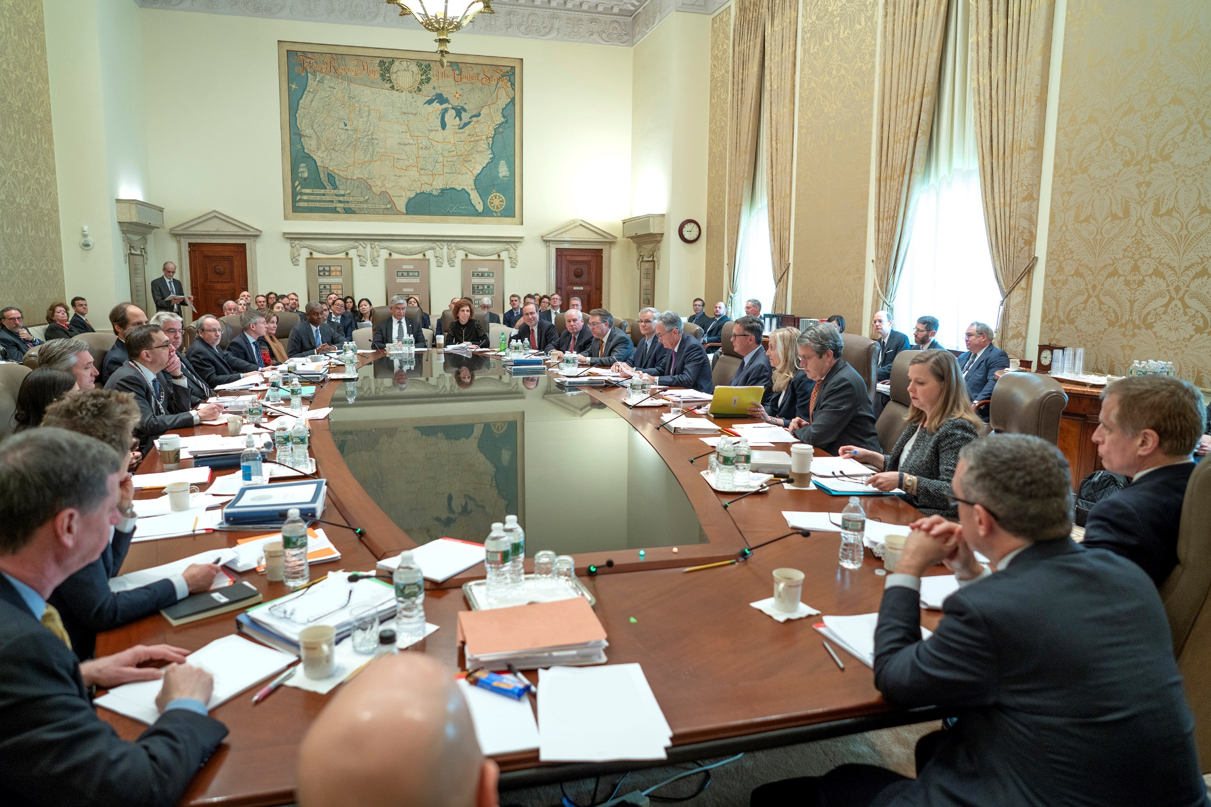
The Fed’s Toolbox
FOMC Meeting at the Federal Reserve Board of Governors in Washington, D.C.

Slide 5
The Fed’s Toolbox
Summary of path from the FOMC policy rate target to the Fed’s dual mandate
The FOMC sets the target range for the federal funds rate.
This affects market interest rates and overall financial conditions.
This also influences the decisions of households and businesses.
It ultimately affects employment and inflation.
5

Slide 6
The Fed’s Toolbox
The Federal Funds Rate is the Fed’s Policy Rate
Banks hold cash in their “checking accounts” at the Fed, called reserve balance accounts.
Banks that need funds can borrow from banks that have excess funds.
The transfer of funds from one bank’s reserve account to another bank’s reserve account is termed a federal funds transaction, and the agreed interest rate in this transaction is the federal funds rate (FFR).
6

Slide 7
The Fed’s Toolbox
The Federal Funds Rate is the Fed’s Policy Rate
The federal funds market is where banks that need reserves go to borrow cash from banks that have excess reserves.
For each transaction, reserves are transferred from the lender’s reserve account at the Fed to the borrower’s reserve account.

Slide 8
The Fed’s Toolbox
The Federal Funds Rate is the Fed’s Policy Rate
The Fed sets a target range for the FFR, which is where it wants federal funds transactions to take place.
The FFR influences other interest rates in the economy, as well as the spending and investing decisions made by consumers and producers.

Slide 9
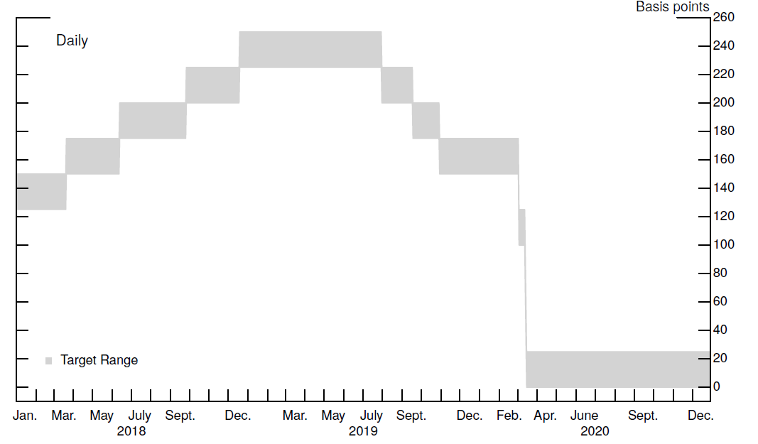
The Fed’s Toolbox
The FOMC Target Range, 2015-2020
The FOMC sets a target range for the FFR; this range has been 25 basis points (or 0.25%) wide.

Slide 10
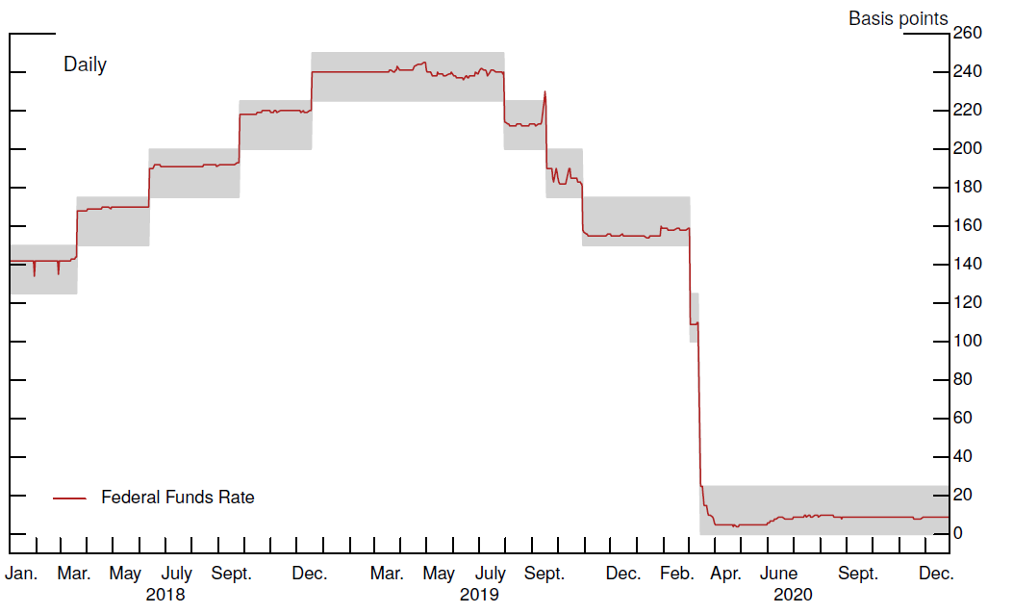
The Fed’s Toolbox
The FFR Is In the FOMC’s Target Range
The Fed uses its monetary policy implementation tools to ensure that the federal funds rate stays within the target range.

Slide 11
The Fed’s Toolbox
Question: How does the Fed ensure its target range for the federal funds rate transmits to market interest rates?
Answer: The Fed implements the FOMC’s policy decisions using its monetary policy implementation tools.

Slide 12
The Fed’s Toolbox
The Fed’s Toolbox
Policy Implementation Tools
Interest on Reserve Balances
Overnight Reverse Repurchase Agreement Facility
Discount Window
Open market operations
Administered Rates
IORB rate
ON RRP rate
Discount Rate

Slide 13
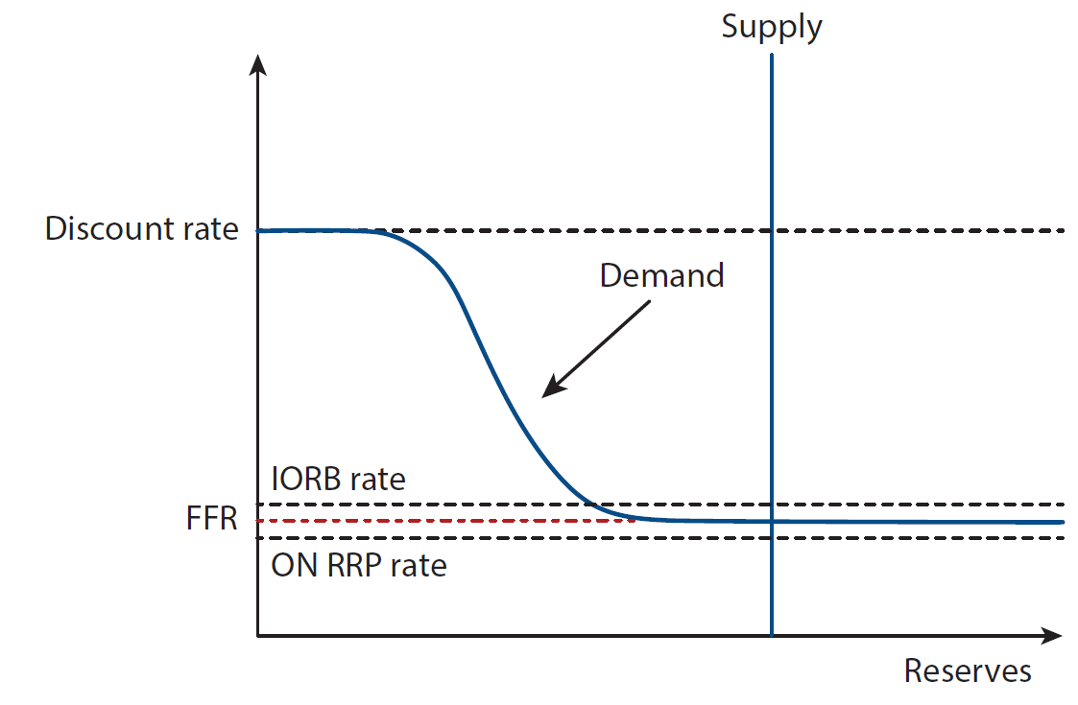
The Fed’s Toolbox
Monetary Policy with Ample Reserves

Slide 14
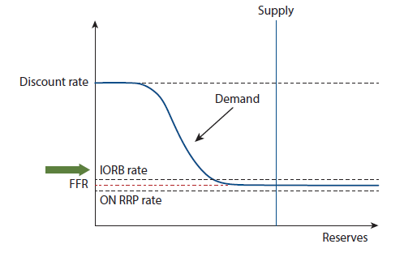
The Fed’s Toolbox
Tool #1: Interest on reserve balances (IORB) is the primary tool.
The interest on reserve balances rate is the interest rate that banks earn from the Fed on the funds they deposit in their reserve balance accounts.
The interest on reserve balances rate steers the federal funds rate into the FOMC’s target range.

Slide 15
The Fed’s Toolbox
Interest on reserve balances (IORB) relies on two concepts.
1. Reservation rate
Reservation rate: The lowest rate that banks are likely willing to accept for lending out their funds.

Slide 16
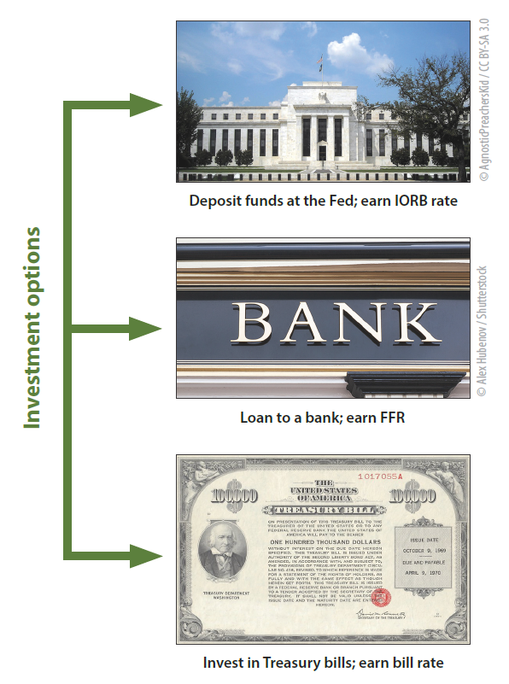
The Fed’s Toolbox
Banks seek to earn a return on their money, and they have several options.
Deposit excess funds at their Federal Reserve Bank and earn the IORB rate.
Lend the excess funds out in the federal funds market and earn the FFR.
Invest the funds in Treasury bills and earn the given Treasury bill rate.

Slide 17
What would a bank do with excess funds if the Fed’s IORB rate is higher than market rates?
IORB is a risk-free investment option that is always available to banks.

Slide 18
What would a bank do with excess funds if the Fed’s IORB rate is higher than market rates?
IORB is a risk-free investment option that is always available to banks.

Slide 19
The Fed’s Toolbox
Interest on reserve balances (IORB) relies on two concepts.
2. Arbitrage
Arbitrage: The simultaneous purchase and sale of funds (or goods) in order to profit from a difference in price.

Slide 20
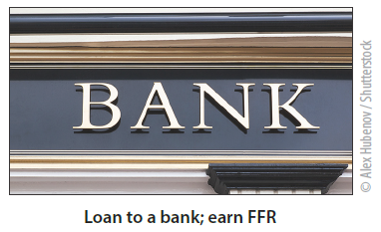
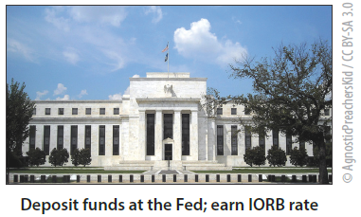
Market for Bank Reserves
(Federal Funds Market)
The Fed Pays Interest on Reserve Balances (IORB)
2.5%
Reserves
2.0%
Reserves
Bank

Slide 21
Market for Bank Reserves
(Federal Funds Market)
The Fed Pays Interest on Reserve Balances (IORB)
2.5%
Reserves
2.0%
Reserves
Borrow at 2.0%
Bank
Deposit at 2.5%
Profit = 50 basis points

Slide 22
Market for Bank Reserves
(Federal Funds Market)
The Fed Pays Interest on Reserve Balances (IORB)
2.5%
Reserves
2.5%
Reserves
Increase in demand for borrowing
reserves in the fed funds market
2.0%
Reserves
Borrow at 2.0%
Bank
Deposit at 2.5%
Other banks also see the opportunity to earn profits by borrowing in the fed funds market, which drives up the cost of borrowing in the fed funds market, and profits go to zero.

Slide 23
Market for Bank Reserves
(Federal Funds Market)
The Fed Pays Interest on Reserve Balances (IORB)
3.0%
Reserves
2.5%
Reserves
Bank
How will a bank invest its funds with these interest rates?

Slide 24
Market for Bank Reserves
(Federal Funds Market)
The Fed Pays Interest on Reserve Balances (IORB)
3.0%
Reserves
2.5%
Reserves
Lend at 3.0%
Bank
Withdraw from reserve account
Profit = 50 basis points

Slide 25
Market for Bank Reserves
(Federal Funds Market)
The Fed Pays Interest on Reserve Balances (IORB)
3.0%
Reserves
Increase in supply of reserves
2.5%
Reserves
2.5%
Reserves
Lend at 3.0%
Bank
Withdraw from reserve account
Other banks also see the opportunity to lend in the fed funds market, which reduces the cost of borrowing in the fed funds market, and profits from arbitrage go to zero.

Slide 26
The Fed’s Toolbox
When the FOMC sets the target range for the federal funds rate, the Fed then chooses a level of the interest on reserve balances rate that will encourage the market determined federal funds rate to be within the target range.
When the FOMC raises the target range for the federal funds rate, the Fed raises the interest on reserve balances rate, which moves the federal funds rate up into the new target range. | When the FOMC lowers the target range for the federal funds rate, the Fed lowers the interest on reserve balances rate, which moves the federal funds rate down into the new target range.
Interest on reserves balances is the Fed’s primary tool for influencing the federal funds rate.

Slide 27
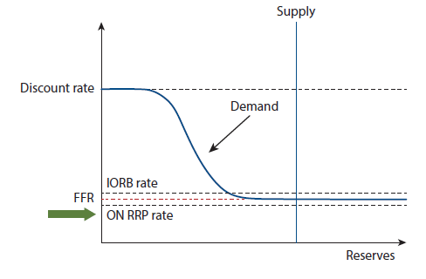
The Fed’s Toolbox
Tool #2: Overnight reverse repurchase facility, with its ON RRP offering rate, is a supplemental tool.
The ON RRP offering rate is an administered rate that acts like a reservation rate for a large number of financial institutions. The overnight reverse repurchase agreement offering rate sets a floor on the federal funds rate.

Slide 28
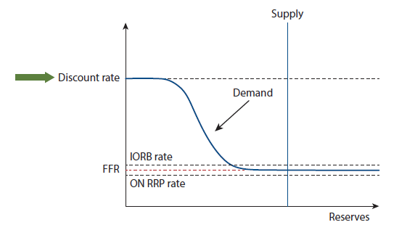
The Fed’s Toolbox
Tool #3: The Discount Window, with its Discount Rate
The discount rate is an administered rate that is set above the FOMC’s target range, with the intention to serve as a ceiling for the FFR.

Slide 29
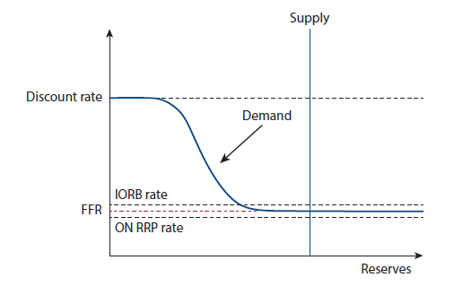
The Fed’s Toolbox
Tool #4: Open Market Operations
Open market operations are conducted periodically to maintain ample reserves.
To shift the supply curve to the right, the Fed purchases securities and pays for them by adding reserves to the banking system.

Slide 30
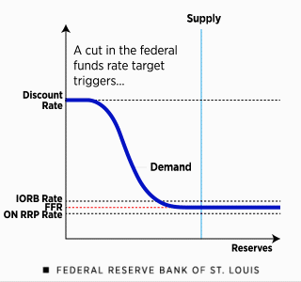
The Fed’s Toolbox
The Fed lowers the FFR by decreasing its administered rates.
The Fed’s primary tool for moving the FFR is interest on reserve balances, with its IORB rate.
The ON RRP facility, with the ON RRP offering rate, is a supplementary tool.
The Fed ensures the FFR moves higher or lower by moving these two administered rates higher or lower; the discount rate is typically adjusted in a similar manner.

Slide 31
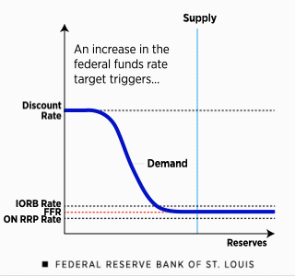
The Fed’s Toolbox
The Fed raises the FFR by increasing its administered rates.
The Fed’s primary tool for moving the FFR is interest on reserve balances, with its IORB rate.
The ON RRP facility, with the ON RRP offering rate, is a supplementary tool.
The Fed ensures the FFR moves higher or lower by moving these two administered rates higher or lower; the discount rate is typically adjusted in a similar manner.

Slide 32
The Fed’s Toolbox
Headline: The economy weakens
Employment falls below maximum employment.
The inflation rate is steady around or slightly below 2 percent but is showing signs of decreasing.
How can the Fed use its monetary policy tools to achieve maximum employment and price stability?

Slide 33
The Fed’s Toolbox
Fed lowers
its
administered
rate
Market rates decrease; the FFR shifts down into the lower target range.
Lower borrowing costs encourages more spending and investment.
Higher spending results in more production and higher employment.
FOMC decreases the FFR target range.
Fed lowers
its
administered
rates.

Slide 34
The Fed’s Toolbox
Headline: Inflation is rising
Inflation has been above the Fed’s 2 percent target for considerable time.
And inflation is increasing.
The unemployment rate is very low.
How can the Fed use its monetary policy tools to achieve maximum employment and price stability?

Slide 35
The Fed’s Toolbox
Fed lowers
its
administered
rate
Market rates rise; the FFR shifts up into the higher target range.
Higher borrowing costs discourages spending and investment.
Fed raises
its
administered
rates.
Less spending decreases inflationary pressures.
FOMC increases the FFR target range.

Slide 36
The Fed’s Toolbox
Tool | Description | In Practice
Interest on reserves balances (IORB) | Interest paid on funds that banks hold in their reserve balance accounts at a Federal Reserve Bank. | IORB is the Fed’s primary tool for guiding the FFR.
Overnight reverse repurchase agreement (ON RRP) facility | The Federal Reserve’s standing offer to a broad set of financial institutions to deposit funds at the Fed and earn interest. | The ON RRP facility is a supplementary tool; the ON RRP offering rate acts like a floor for the FFR.
Discount window | The Federal Reserve’s lending to banks (the "discount window") at the discount rate. | The discount window helps put a ceiling on the FFR.
Open market operations | The buying and selling of government securities by the Federal Reserve. | Open market operations are an important tool for ensuring that reserves remain ample.

Slide 37
The Fed’s Toolbox
Review Questions
What are the Fed’s dual mandate goals?
What does it mean to conduct monetary policy?
What does it mean to implement monetary policy?
What is the Fed’s primary tool for implementing monetary policy?
How does the interest on reserve balances rate serves as a reservation rate?
Give an example of banks arbitraging between the federal funds market and interest on reserve balances.
How does arbitrage ensure that the federal funds rate does not fall far below the interest on reserve balances rate?
What is the discount rate?
How does the discount rate act a ceiling for federal funds rate?
How does the Fed use open market operations to ensure reserves remain ample?
What would the FOMC do if the economy is in a recession and not meeting its maximum employment and price stability dual mandate?

