Slide 1

Unit 4: Paying Taxes
Lesson 4B: Understanding Taxes
©2017, Minnesota Council on Economic Education. Developed in partnership with the Federal Reserve Bank of St. Louis. 2016 Revised Edition.

Slide 2
Compelling Question
How do various types of taxes
affect people differently?
Lesson 4B

Slide 3
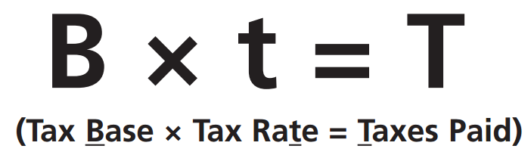
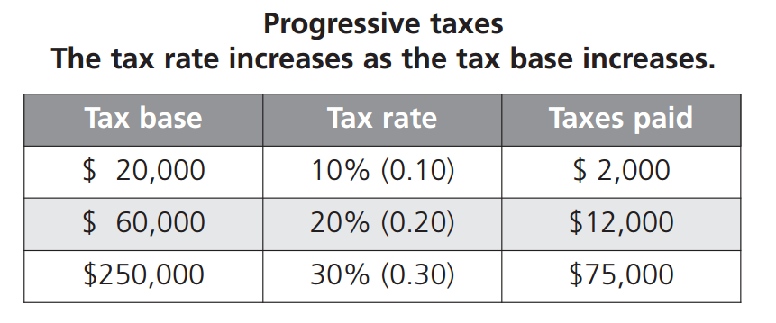
Visual 4B.1: Tax Structures
Slide 1 of 3
Lesson 4B

Slide 4
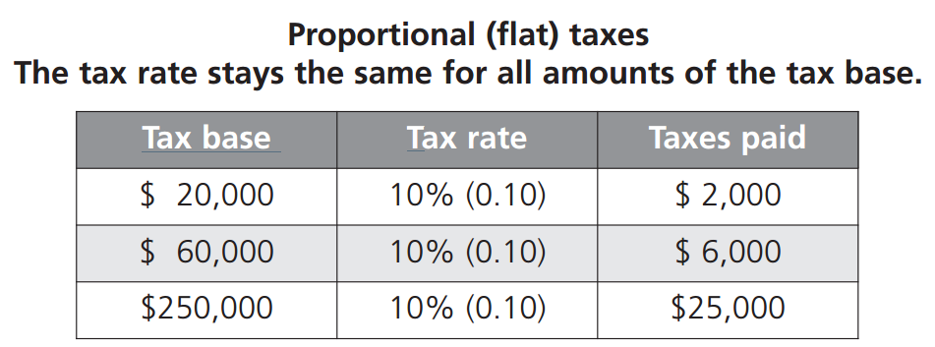
Visual 4B.1: Tax Structures
Slide 2 of 3
Lesson 4B

Slide 5
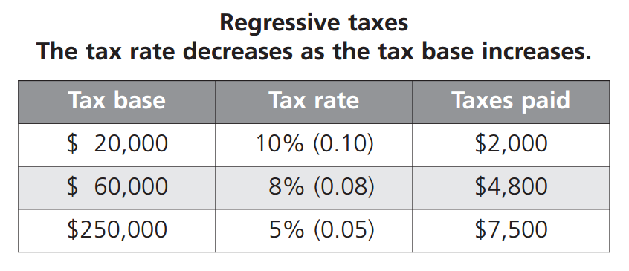
Visual 4B.1: Tax Structures
Slide 3 of 3
Lesson 4B

Slide 6
Visual 4B.1: Characteristics of Common Taxes
Tax | Base | Rate structure | How collected | Government level(s)
Income tax | All income | Progressive | Withheld over the year; file tax form once a year | Federal, most states, some local
Payroll tax | Wage/salary income | Social Security: regressive due to income cap; Medicare: proportional | Withheld from each paycheck | Federal
Sales tax | Value of goods and services purchased | Proportional based on purchase price; regressive relative to income | Paid at time of purchase | Most states, some local
Property tax | Property value (house/land) | Proportional based on property value | Paid in one or two payments per year or as part of the owner’s mortgage payment | Mostly local
Lesson 4B

