Slide 1

Unit 2: Planning and Tracking
Lesson 2B: Meeting Financial Goals—
Rate of Return
©2017, Minnesota Council on Economic Education. Developed in partnership with the Federal Reserve Bank of St. Louis. 2016 Revised Edition.

Slide 2
Compelling Question
How is an asset’s rate of return measured?
Lesson 2B

Slide 3
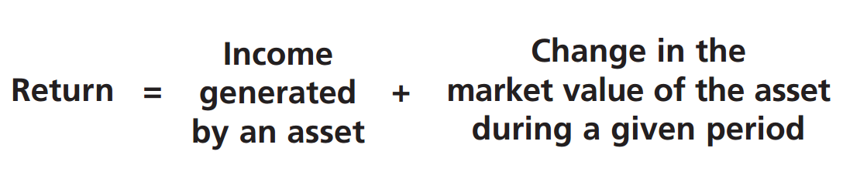
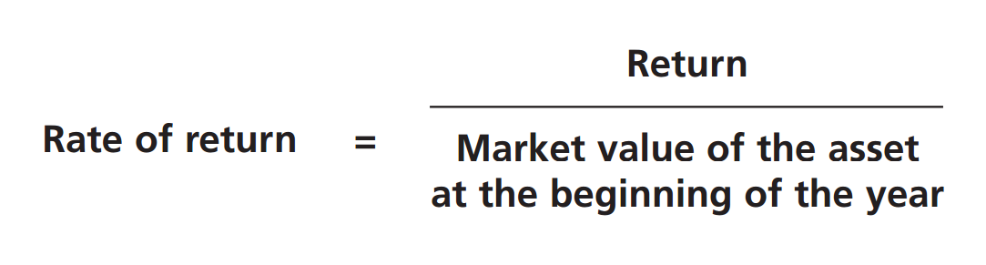
Visual 2B.1: Calculating the Annual Rate of Return
Lesson 2B

Slide 4
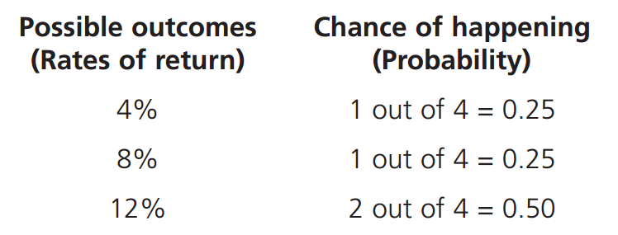
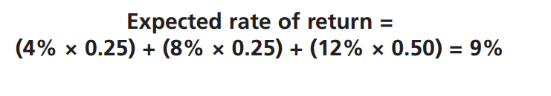
Visual 2B.2: Expected Rate of Return
Lesson 2B

