Slide 1
Unit 1: Thinking Economically
Lesson 1B: Making Choices and Identifying Costs
©2017, Minnesota Council on Economic Education. Developed in partnership with the Federal Reserve Bank of St. Louis. 2016 Revised Edition.

Slide 2
Compelling Question
How can a decisionmaking process
help you make informed decisions?
Lesson 1B

Slide 3
Visual 1B.1: PACED Decisionmaking Model
Step 1: P—Define the Problem. Why must you make a choice?
Step 2: A—List the Alternatives. What are your possible options?
Step 3: C—Determine the Criteria. What standards are important to you?
Step 4: E—Evaluate the Alternatives. How well does each alternative meet
each criterion?
Step 5: D—Make the Decision. Which option has the most favorable
trade-offs?
Lesson 1B

Slide 4
PACED Grid
Lesson 1B
Slide 4

Slide 5
What to Do on a Friday Night
 | Criterion 1 | Criterion 2 | Criterion 3 | TOTAL
Alternative 1
Alternative 2
Alternative 3
Step 1 State the Problem
Step 2 List Alternatives
Step 3 Identify Criteria
Step 4 Evaluate the Alternatives
Step 5 Make a Decision
Criteria
Alternatives
Be home by 10pm (curfew)
Costs $20 or less
Everyone will enjoy
Stay home and have food delivered
Movies and eat there
School football game, and eat at the game
Lesson 1B
Slide 5

Slide 6
What to Do on a Friday Night- Completed
 | Criterion 1 | Criterion 2 | Criterion 3 | TOTAL
Alternative 1
Alternative 2
Alternative 3
Step 1 State the Problem
Step 2 List Alternatives
Step 3 Identify Criteria
Step 4 Evaluate the Alternatives
Step 5 Make a Decision
Criteria
Alternatives
Be home by 10pm (curfew)
Costs $20 or less
Everyone will enjoy
+
+
-
2
Stay home and have food delivered
-
-
-
0
Movies and eat there
+
+
+
3
School football game, and eat at the game
Lesson 1B
Slide 6

Slide 7
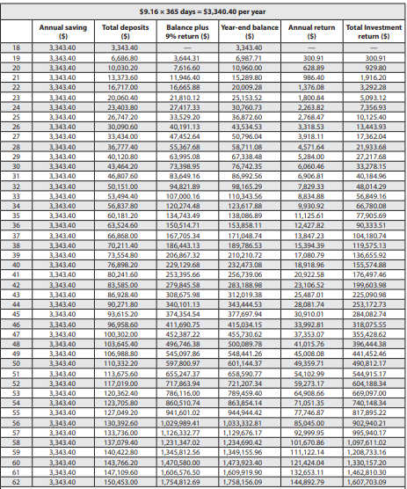
Visual 1B.2: Smoke or Be a Millionaire?
Age | Annual deposit ($) | Total deposit ($) | Annual 9% interest ($) | Total interest/ Return ($) | Year-end balance ($)
18 | 3,343.40 | 3,343.40 | — | — | 3,343.40
19 | 3,343.40 | 6,686.80 | 300.91 | 300.91 | 6,987.71
20 | 3,343.40 | 10,030.20 | 628.89 | 929.80 | 10,960.00
27 | 3,343.40 | 33,434.40 | 3,918.11 | 17,362.04 | 50,796.04
60 | 3,343.40 | 143,766,20 | 121,424.04 | 1,330,157.20 | 1,473,923.00
61 | 3,343.40 | 147,109.60 | 132,653.11 | 1,462,810.30 | 1,609,919.90
62 | 3,343.40 | 150,453.00 | 144,892.79 | 1,607,703.09 | 1,758,156.09
NOTE: APR, annual percentage rate. As of April 1, 2016, the average price of cigarettes was $5.96 per pack. The average stock market return over the past 50 years (1966-2015) was 9.61 percent.
SOURCE: Cigarette prices: https://www.tobaccofreekids.org/research/factsheets/pdf/0202.pdf, accessed April 1, 2016. Stock return average: http://pages.stern.nyu.edu/~adamodar/New_Home_Page/datafile/histretSP.html, accessed April 1, 2016.
Lesson 1B

