Slide 1
Teacher instructions:
1. Print the lesson,
2. Display slide 2 with Procedure step 2 in the lesson.
3. Display slides 3 through 6 with Procedure step 5.
4. Display slides 7 and 8 with Procedure step 6.
5. Display slides 9 and 10 (answer key) with Procedure step 8. Draw a line from each statement to the correct arrow.
6. Display slides 11 through 14 with Procedure step 8.
7. Display slide 15 with Procedure step 11.
8. Display slide 16 with Procedure steps 12 through 18.
9. Display slide 17 with Procedure step 15.
10. Display slides 18 and 19 with Procedure step 19. Slides 20 and 21 provide the answers.
11. Display slides 22 through 24 with Procedure step 20.
12. Display slide 25 with Procedure step 25.
13. Display slide 26 with Procedure step 27.
14. Display slide 27 with Procedure step 31.
15. Display slide 28 with Procedure step 34.
16. Display slides 29 through 33 with Procedure step 36.
Could it Happen Again?

Slide 2
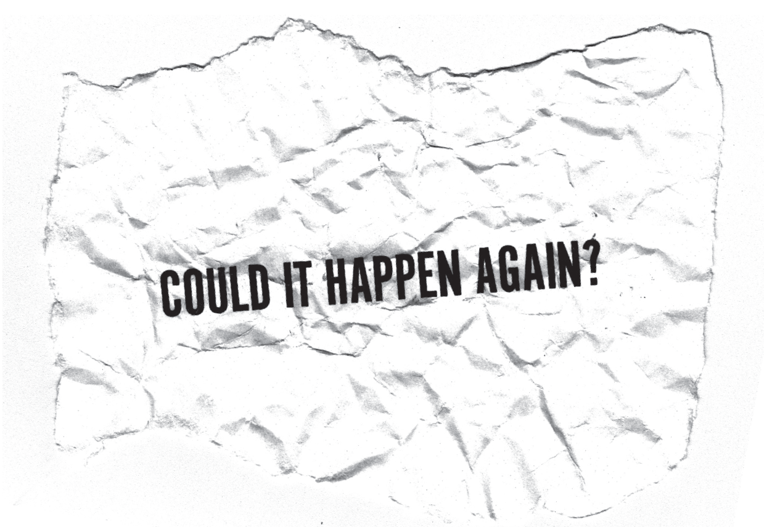

Slide 3
What is the Federal Reserve System, and when was the Federal Reserve System established?
The Federal Reserve is the central bank of the United States. It was established in 1913.
What are three functions of the Fed?
The Fed is responsible for monetary policy, managing the payments system, and banking supervision and regulation.
What is monetary policy?
Monetary policy involves actions the Fed takes to affect the supply of money and credit in the economy.

Slide 4
If the Fed was established in 1913, why didn't it do something to stop the Great Depression?
The Fed was a young institution, and it was using the economic understandings of the time to stabilize the economy in order to achieve goals such as stable prices and sustainable growth.

Slide 5
What was the predominant economic thinking in the 1920s that influenced the Fed and other economists' thinking during the Great Depression?
Economic understandings included the following: The U.S. government should have a balanced budget. A balanced budget would prevent the government from using fiscal policy to stimulate the economy. The economic understanding also emphasized the need to avoid inflation, and there wasn't much concern about deflation. The gold standard was also stressed as important to the money system.

Slide 6
What does "laissez-faire" mean?
"Laissez-faire" means that the market economy should stabilize itself over time without the involvement of government fiscal policy and, by extension, monetary policy.

Slide 7
Price stability means the absence of inflation and the absence of deflation.
Inflation is a rise in the average price level over time.
Deflation is a decrease in the average price level over time.

Slide 8
If you were planning to buy the latest MP3 player, and the price of MP3 players had increased by $10 each day that you looked at an advertisement or visited the store, what might you do?
If the prices for most goods and services were rising every month, how would people respond?
If you were planning to buy a new car, and the price of the car fell by $500 each day that you looked at an advertisement or visited the car dealer, what might you do?
If the prices for most goods and services were falling every month, how would people respond?

Slide 9
People wait to buy until tomorrow.
People buy today rather than wait.
People and businesses have difficulty planning for the future.
People have less income to spend and, therefore, purchase less.
DEFLATION
It robs the purchasing power of people's savings.
Demand for goods and services continues to decline, as do prices.
INFLATION
"Buying now" increases demand and pushes prices up.
People continue to buy rather than wait as prices continue to rise.
Businesses do not earn as much revenue and may have to lay off workers, which contributes to higher unemployment.
If wages don't rise at the same rate as prices, people can't buy as many goods and services as they could in the past.

Slide 10
People wait to buy until tomorrow.
People buy today rather than wait.
People and businesses have difficulty planning for the future.
People have less income to spend and, therefore, purchase less.
DEFLATION
It robs the purchasing power of people's savings.
Demand for goods and services continues to decline, as do prices.
INFLATION
"Buying now" increases demand and pushes prices up.
People continue to buy rather than wait as prices continue to rise.
Businesses do not earn as much revenue and may have to lay off workers, which contributes to higher unemployment.
If wages don't rise at the same rate as prices, people can't buy as many goods and services as they could in the past.

Slide 11
When average price level is rising, why would people buy now instead of waiting to buy in the future?
The expect prices to be even higher in the future, so they buy now while the price is lower.
How does this response perpetuate the problem of inflation?
"Buying now" increases demand and bids up prices - much like bidders at an auction.
What happens if people's wages don't rise at the same rate (as fast) as prices rise?
People can't buy as many goods and services as they could in the past.

Slide 12
Why do businesses and households have difficulty planning for future expenditures during inflationary periods?
They are uncertain about future prices, they don't know how much they will need for future purchases; so, they try to purchase now when the price is lower.
How does inflation rob the purchasing power of people's savings?
If people save money and prices rise, the money they have saved won't buy as much in the future.
When the average price level is falling, why do people postpone purchases?
They expect prices to fall in the future. They think that if they wait, the good or service will cost even less than it does today.

Slide 13
How does this response perpetuate the problem?
Because people are waiting to buy, fewer goods and services are sold today. Inventories accumulate and prices fall more as businesses try to reduce prices to sell their goods.
Why do business revenues fall during deflationary periods?
Businesses are selling fewer goods and services because people are waiting to purchase - and when people do purchase, the goods are at lower prices. Selling less and selling at lower prices cause business revenues to fall.

Slide 14
Why do businesses lay off workers?
When their revenues fall, businesses can't afford to hire as many workers at the same wages, or they must lower wages.
If fewer people are employed and/or those who are employed earn less, what happens to people's incomes and the amount of goods and services they buy?
Their incomes fall, and they buy fewer goods and services.
What happens to prices as a result?
Prices fall even more.

Slide 15
The money supply is the amount of money available in an economy.

Slide 16
Money Supply in the Classroom Economy
 | Round 1 | Round 2
Cash in Students' Hands
Deposits in Students' Checking Accounts
TOTAL

Slide 17
Monetary policy refers to what the Federal Reserve does to influence the amount of money and credit in the U.S. economy.

Slide 18
The Flow or Things
If people in the society have less money in their checking accounts and less cash in their pockets, what happens to the amount of goods and services they purchase?
increases decreases
If people buy fewer goods and services, would it encourage producers to produce more or fewer goods and services?
more fewer

Slide 19
The Flow of Things
If producers produce fewer goods and services, what will happen to their needs for natural, human and capital resources?
increase decrease
If producers need fewer workers, what may happen to unemployment rates and people's ability to purchase goods and services?
unemployment rates: increase decrease
wages: increase decrease
people's purchases: more fewer

Slide 20
The Flow or Things
If people in the society have less money in their checking accounts and less cash in their pockets, what happens to the amount of goods and services they purchase?
increases decreases
If people buy fewer goods and services, would it encourage producers to produce more or fewer goods and services?
more fewer

Slide 21
The Flow of Things
If producers produce fewer goods and services, what will happen to their needs for natural, human and capital resources?
increase decrease
If producers need fewer workers, what may happen to unemployment rates and people's ability to purchase goods and services?
unemployment rates: increase decrease
Wages: increase decrease
people's purchases: more fewer

Slide 22
Reversing the Flow
What would happen to the money supply if the Federal Reserve were to buy pencils from the class, rather than sell pencils to the class?
The money supply would increase because the Fed would pay the people who sell pencils by placing money in the sellers' checking accounts at banks.
As a result, would people be able to buy more or fewer goods and services?
Because people sold pencils in exchange for money, they would have more to spend and would be able to buy more goods and services.

Slide 23
Reversing the Flow
If people buy more goods and services, would producers be encouraged to produce more or fewer goods and services?
As people purchase more goods and services, businesses are encouraged to produce more goods and services.
To produce more goods and services, will producers need more or fewer natural resources---things found in or on the earth; human resources---people working in the economy; and capital resources---things produced by people and used to produce other goods and services?
more of all resources

Slide 24
Reversing the Flow
If producers need more workers, what may happen to unemployment rates, wages and people's ability to purchase goods and services?
If producers need more workers (human resources), then they will employ more workers. As a result, the unemployment rate will likely fall, wages will likely rise and people will be able to buy more goods and services.

Slide 25
Open market operations is the process of selling and buying Treasury securities.

Slide 26
Expansionary monetary policy refers to the Fed buying securities in order to increase the growth of the money supply and the amount of credit available.
Contractionary monetary policy refers to the Fed selling securities in order to decrease the growth of the money supply and the amount of credit available.

Slide 27
Great Depression Statistics
The amount of goods and services produced in the United States fell by one-third.
The unemployment rate rose to 25 percent of the labor force.
The stock market lost 80 percent of its value.
Some 7,000 banks closed temporarily or failed.
The economy experienced deflation - i.e., generally falling prices.

Slide 28
What the Federal Reserve System Learned
As a result of the experience of the Great Depression and an analysis of its events, the Federal Reserve System learned:
--the importance of money, credit and a safe and sound financial system in maintaining a stable economy;
--that ensuring a strong economy requires sound economic policies to make certain that fluctuations in price, output and employment do not grow into major economic catastrophes; and
--that price stability is the key goal for monetary policy because fluctuations in the price level---either deflation or inflation---can cause financial instability and hinder economic growth.

Slide 29
Review
What is the Federal Reserve, and when was it established?
The Fed is the nation's central bank. It was established in 1913.
What are three roles of the Federal Reserve?
The Fed writes regulations and supervises banks, the Fed manages the payments system and the Fed conducts monetary policy.
What is monetary policy?
Monetary policy refers to actions by the Fed that involve the use of open market operations to affect the amount of money and credit in the economy.

Slide 30
Review
Why does the Fed conduct monetary policy?
The Fed conducts monetary policy to stabilize prices.
What is inflation?
Inflation is a rise in the average price level.
What is deflation?
Deflation is a decline in the average price level.

Slide 31
Review
How does the Fed conduct monetary policy?
The Fed conducts monetary policy by buying and selling U.S. Treasury securities.
What happens to the amount of money and credit in the economy if the Fed buys securities?
When the Fed buys securities, the amount of money and credit in the economy increases.
Is this expansionary or contractionary monetary policy?
Buying securities is expansionary.

Slide 32
Review
What open market operation would the Fed use to reduce the amount of money and credit in the economy?
The Fed would sell securities to reduce the amount of money and credit in the economy.
Is this expansionary or contractionary monetary policy?
Selling securities is contractionary monetary policy.
What did the economists who studied the Great Depression - and, as a result, the Federal Reserve System - learn about stabilizing the economy?
The Fed should use sound economic policies to make certain that changes in prices, production and employment do not grow into major economic problems.

Slide 33
Review
What is widely accepted as the key goal of monetary policy?
Price stability - the absence of inflation or deflation - is the key goal of monetary policy.

