Slide 1
Teacher instructions:
1. Print the lesson,
2. Display slides 2 through 4 with Procedure step 1 in the lesson.
3. Display slide 5 with Procedure step 3.
4. Display slide 6 with Procedure step 6.
5. Display slides 7 through 9 with Procedure steps 7 through 9.
6. Display slide 10 with Procedure step 11.
7. Display slides 11 and 12 with Procedure step 13.
8. Display slide 13 with Procedure step 14.
9. Display slides 14 through 17 with Procedure step 15.
10. Display slide 18 with Procedure step 16.
11. Display slide 19 with Procedure step 17.
12. Slides 20 and 21 with Procedure step 18.
13. Display slide 22 with Procedure step 23.
14. Display slides 23 through 27 with Procedure step 26. Answers will appear on click.
15. Use slide 28 in lieu of Procedure step 29.
16. Display slides 29 through 32 with Procedure step 30.
Measuring the Great Depression.

Slide 2
DEPRESSION

Slide 3
GREAT

Slide 4
GREAT
DEPRESSION

Slide 5
Economics Definitions
Consumer Price Index (CPI) is a measure of the average change over time in the prices paid by
urban consumers for a market basket of consumer goods and services.
Deflation is a general downward movement of prices for goods and services in an economy.
Depression is a very severe recession; a period of severely declining economic activity spread across the economy (not limited to particular sectors or regions) normally visible in a decline in real GDP, real income, employment, industrial production, wholesale-retail credit and the loss of the overall confidence in the economy.
Inflation is a general upward movement of prices for goods and services in an economy.
Nominal Gross Domestic Product (GDP) is the market value of all final goods and services produced within a country in a year.
Real Gross Domestic Product (GDP) is the production of all final goods and services within a
country valued at constant prices (i.e., adjusted for inflation or deflation.
Unemployment rate is the percentage of the labor force who are unemployed.

Slide 6
Inflation is a general upward movement in the price of goods and services in an economy.
Deflation is a general downward movement in the prices of goods and services in an economy.

Slide 7
Inflation
Deflation

Slide 8
Inflation
Deflation
Purchasing power decreases.
Purchasing power increases.
Businesses can't plan for the future.
Businesses don't generate enough revenue to pay workers.
The cost of doing business increases.
price level changes
Consumers spend, rather than save.
Businesses can't plan for the future.
People may use their savings to purchase jewelry, art or other collectibles that might retain their value in an inflationary period rather than place savings in banks.
Consumers postpone spending.
Prices increase.
The cost of borrowing increases.
People don't save.
Fill the center portion with characteristics shared by inflation and deflation. One characteristic is provided.

Slide 9
Inflation
Deflation
Purchasing power decreases.
Purchasing power increases.
Businesses can't plan for the future.
Businesses don't generate enough revenue to pay workers.
The cost of doing business increases.
price level changes
price instability
difficult to make financial decisions for future spending
affects spending behavior
creates winners and losers
Consumers spend, rather than save.
Businesses can't plan for the future.
People may use their savings to purchase jewelry, art or other collectibles that might retain their value in an inflationary period rather than place savings in banks.
Consumers postpone spending.
Prices increase.
The cost of borrowing increases.
People don't save.
Fill the center portion with characteristics shared by inflation and deflation. One characteristic is provided.

Slide 10
Consumer Price Index (CPI) is a measure of the average change over time in the prices paid by urban consumers for a market basket of consumer goods and services.

Slide 11
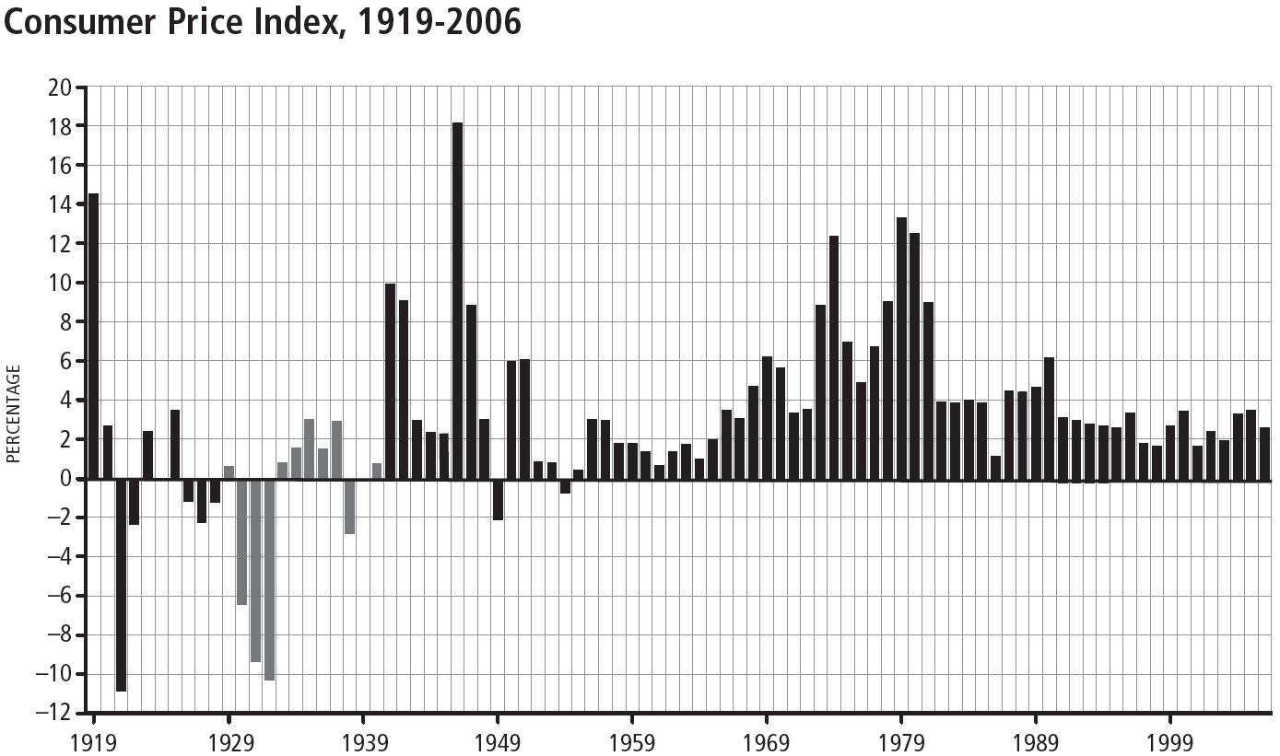

Slide 12
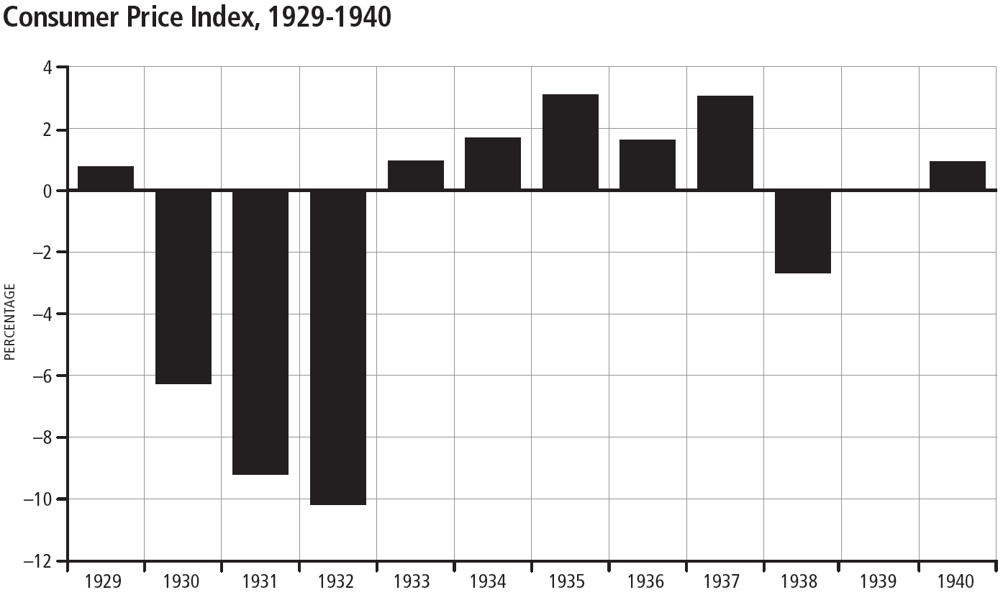

Slide 13
Gross Domestic Product (GDP) is the market value of all final goods and services produced in an economy in a given year.
Nominal GDP - GDP that is not adjusted for inflation
Real GDP - GDP that is adjusted for inflation

Slide 14
Nominal vs. Real GDP
You are a government statistician and have been asked to report on the GDP of Miniland, a small economy which produces only hot dogs and haircuts. Calculate the nominal GDP for year 1 and year 2 by multiplying the price of each good or service by the quantity of each good or service and adding the total production per year in dollars.

Slide 15
$60
$60
30
120
If you looked at information that stated GDP in year 1 was $30 and in year 2 was $120, you might conclude that the economy produced _____ times as many goods and services in year 2 compared to year 1.

Slide 16
To compare GDP over time, however, you need to determine real GDP. Being a professional statistician, you know that it's possible that part of the increase in GDP from year 1 to year 2 could be due to inflation (rising prices), rather than increased output. Calculate real GDP for year 2 using year 1 as the base year.
Nominal GDP =
Real GDP =

Slide 17
To compare GDP over time, however, you need to determine real GDP. Being a professional statistician, you know that it's possible that part of the increase in GDP from year 1 to year 2 could be due to inflation (rising prices), rather than increased output. Calculate real GDP for year 2 using year 1 as the base year.
$20
$25
Nominal GDP =
$30
Real GDP =
$45

Slide 18
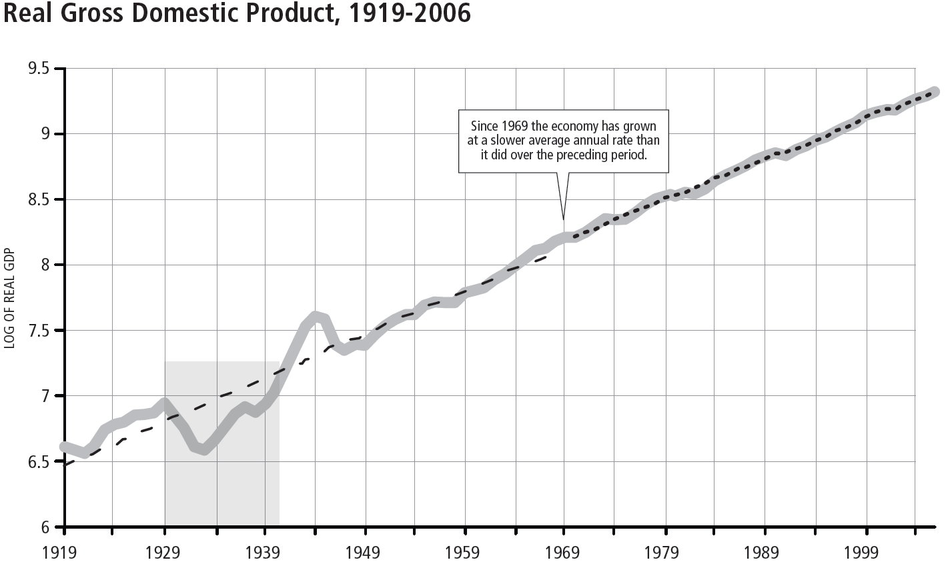

Slide 19
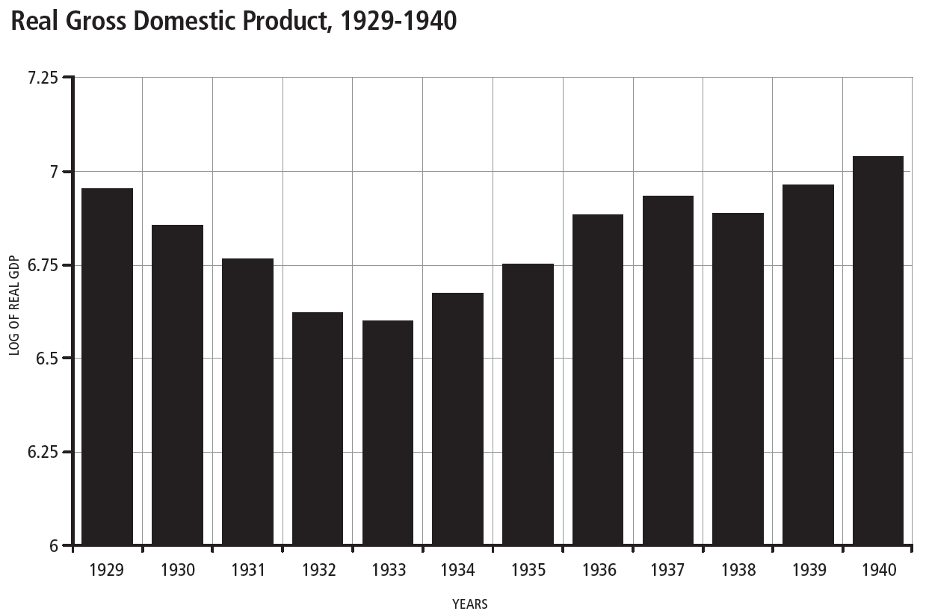

Slide 20
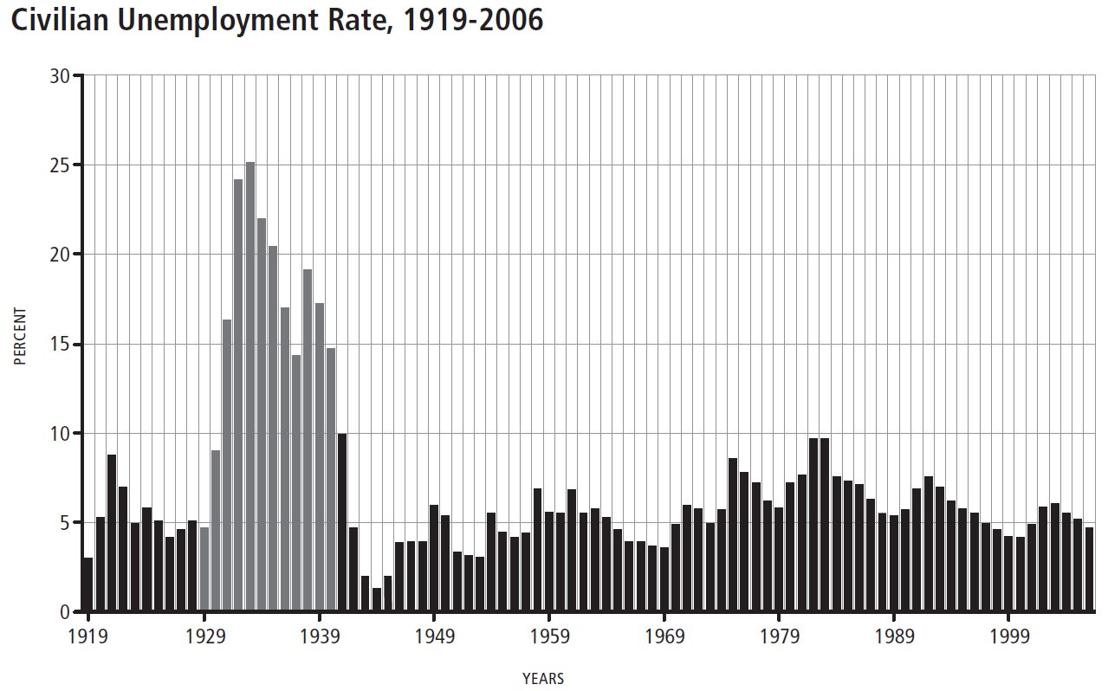

Slide 21
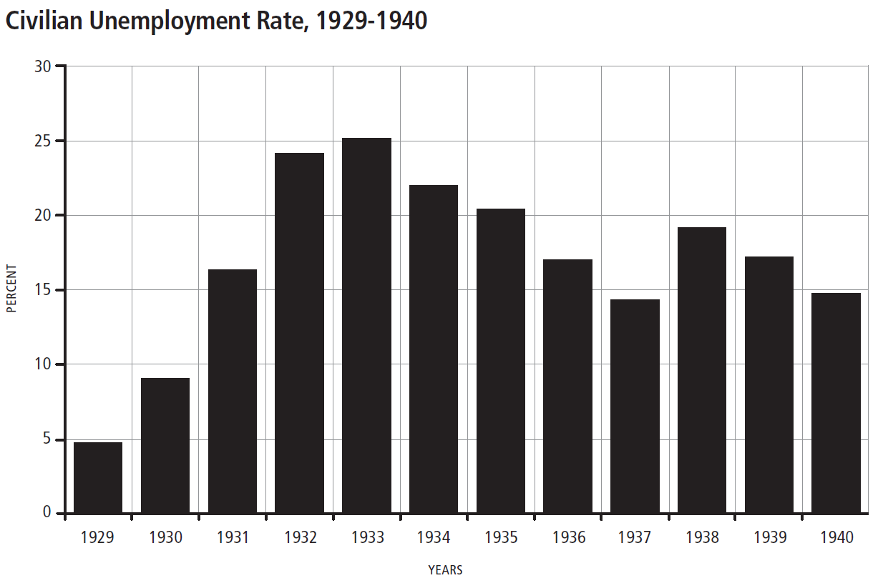

Slide 22
A depression is a period of severely declining economic activity spread across the economy (not limited to particular sectors or regions) normally visible in a decline in
·real GDP
·real income
·employment
·industrial production
·wholesale-retail credit
and the loss of overall confidence in the economy.

Slide 23
Review
What is inflation?
Inflation can be defined as a general upward price movement of goods and services in an economy. An increase in the price of one good, such as oil, does not constitute inflation; inflation occurs when an economy experiences a sustained increase in price levels. Equivalently, inflation is a period of continuously falling value of money, i.e. falling purchasing power.

Slide 24
Review
What is deflation?
Deflation can be defined as a general downward price movement of goods and services in an economy. A decrease in the price of one good, such as calculators, does not constitute deflation; deflation occurs when an economy experiences a sustained decrease in price levels. Equivalently, deflation is a period of continuously rising value of money.

Slide 25
Review
What is the CPI?
The Consumer Price Index, or CPI, is a measure of the average change over time in the prices paid by urban consumers for a market basket of consumer goods and services.
What was happening to the price level during the Great Depression?
It fell by roughly one-third, in excess of 10 percent per year.

Slide 26
Review
What is the unemployment rate?
It is the percentage of the labor force who are unemployed.
What was happening to unemployment during the Great Depression?
Unemployment rose, reaching 25 percent of the labor force.

Slide 27
Review
What is Gross Domestic Product?
It is the market value of all final goods and services produced in an economy in a year.
What was happening to GDP during the Great Depression?
GDP fell 29 percent from 1929 to 1933.

Slide 28
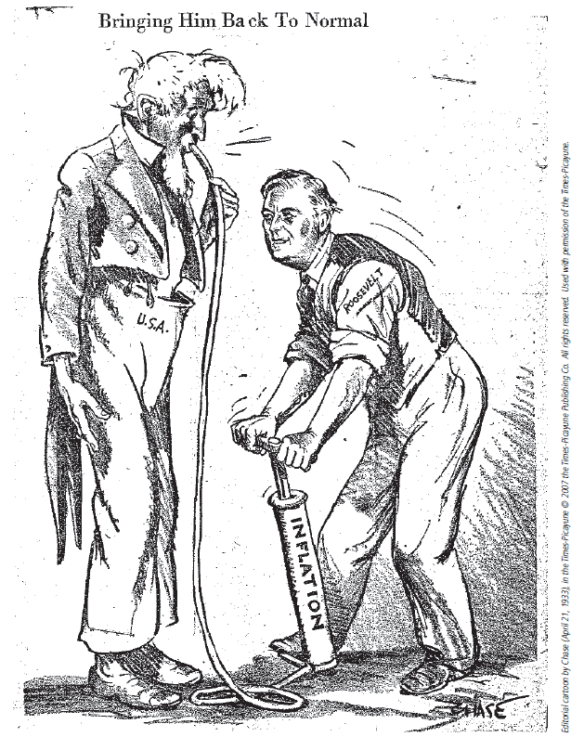

Slide 29
Response to Letter ______
Cost of living Adjustments (COLA) clauses are tied to the CPI, so your union contract causes your pay to adjust to price level changes. It's true that a 4.2 percent increase in your paycheck is a good thing; however, that's a nominal increase in your pay. If you take the inflation (increase in price level) out of your paycheck, your real paycheck is no greater than last year. So your standard of living is no higher than last year. Your paycheck may be for a larger amount of money, but the prices you pay for the things you buy on average have increased by the same amount.
Certainly the COLA clause gives you some protection against inflation in that at least you receive higher pay to compensate for higher prices in the economy, but don't go out and buy a new ski boat because you think you are better off than last year. And many people are hurt from inflation because the dollars they've saved won't buy as much today as they had planned. so those who have saved for retirement or for their children's education will find that those dollars just won't go as far. Inflation has robbed them of purchasing power.
Is this response accurate? Why or why not?

Slide 30
Response to Letter______
Although the price of gasoline may be going up, that doesn't mean that the price for all goods and services is rising. Within the economy, prices for some goods may be rising, while prices for other goods may be falling. But it's the overall price level that is measured when defining inflation. The CPI (Consumer Price Index) is a measurement of price changes in a market basket of goods and services that consumers regularly buy, including food, gasoline, clothing, medical care, education, rent, etc. Presently, the CPI is around 2 percent, which doesn't indicate that our economy is experiencing high inflation.
Is this response accurate? Why or why not?

Slide 31
Response to Letter_____
As they say, timing is everything! If you could have your choice, it would be nice to graduate during a time when the economy is expanding because lots of jobs are being created, so the demand for workers is much higher. Your professor is right: If the economy has slowed down considerably over the past nine months, businesses are seeing sluggish demand for their goods and services and are experiencing declining revenue as a result. Naturally they are going to hesitate to hire new workers under these conditions.
GDP measures the output of goods and services and is the best single barometer of the condition of the economy. If it's falling it may make job hunting a challenge in the near term. Because of the dynamic nature of an economy as large as ours, however, I'm sure there are some jobs out there for those with education, skills and a good work ethic.
Is this response accurate? Why or why not?

Slide 32
Response to Letter_____
As the saying goes, if you can read this, thank a teacher! So thank you, Beth, for the years you spent in the classroom educating our children. You asked a good question, because both inflation and deflation can have adverse effects on the economy. What we hope for is a Goldilocks economy--one with stable prices.
You are right about inflation being bad--it robs people's savings of purchasing power, among other things. Deflation may be like a wolf in sheep's clothing. At first everybody likes the idea of falling prices, until they figure out that falling prices means that demand for goods and services will decline as people delay purchasing things until the price has gone down further. Then businesses' revenues fall, so they lay off workers and/or cut pay. Of course it gets personal when I lose my job!
so the domino effect can leave people in dire straits. since you're on a fixed income, as long as the state retired teachers association can continue to pay your retirement, you may actually benefit. If your income stays the same and things get cheaper, you benefit (although many others don't). Whether you win or lose from unexpected inflation or deflation depends on your situation, but both are bad for the economy as a whole.
Is this response accurate? Why or why not?

