Slide 1
SESSION 5:
Circular Flow
Talking Points
1. In the circular flow model (CFM) of an economy, consumers trade
resources for money in resource markets. They use the money to buy
finished goods and services in product markets. Producers buy resources
in resource markets with money. Producers use the resources to produce
goods and services, which they sell in resource markets in exchange for
money. So, real things (goods and services) and money flow in opposite
directions.

Slide 2
Session 5: Talking Points, Cont’d
2. Consumers are sellers in resource markets and buyers in product markets,
while producers are buyers in resource markets and sellers in product
markets.
3. Consumers and producers have different names for the same flows in the CFM:
a. Consumers sell resources; producers buy inputs.
b. Consumers are paid income; producers incur costs.
c. Consumers buy goods and services; producers sell their outputs.
d. Consumers make expenditures; producers receive revenue.

Slide 3
Session 5: Talking Points, Cont’d
4. There are four main types of business ownership:
A. sole proprietorship
B. partnership
C. franchise
D. corporation
These types are distinguished by the ability of the owners to raise financial capital, the liability they face should the business fail, and some differences
in tax liability.

Slide 4
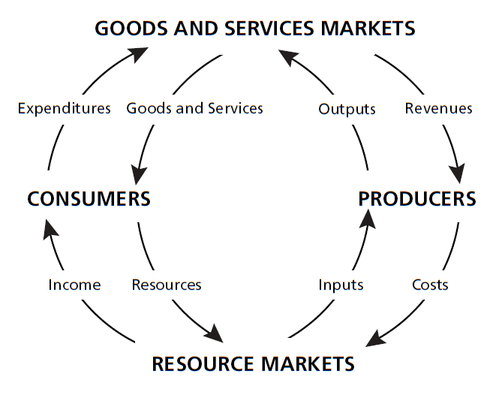
Visual 5B: Goods and Services Markets

