Slide 1
SESSION 4: DEMAND, SUPPLY, AND MARKET EQUILIBRIUM
Talking Points
Demand
Demand is the relationship between various prices and the quantities consumers are willing and able to buy during some time period. The demand curve is a picture of demand.
In general, people get less satisfaction (what economists call “utility”) from additional units of a good or service. This is due to the “law of diminishing marginal utility.” As people get more of something, they value an additional unit less and less. (This does not violate the Pig Principle because total satisfaction rises as society gets more.)

Slide 2
Session 4: Talking Points, Cont’d
Demand
Price is the amount of money buyers actually must pay for a good or service.
Buyers will buy units of a good or service as long as the amount of satisfaction the buyer gains from the purchase is greater than the price they must pay for the good. They will not buy when the opposite is true.
The demand curve reflects the law of demand: As the price of a good or service decreases, buyers buy more of it; as the price of a good or service increases, buyers buy less of it.

Slide 3
Session 4: Talking Points, Cont’d
Supply
Cost is defined as what is given up (i.e., opportunity cost).
Cost is not a single-number concept (units of a good or service will have different costs).
In general, the cost society incurs from additional units of a good rises because more of other goods or services must be given up (rising opportunity cost).
The cost curve shows the additional cost society incurs from each individual unit of the good or service (reading vertically up and then over).
Supply shows how sellers react to various prices of a good or service.

Slide 4
Session 4: Talking Points, Cont’d
Supply
Sellers will produce units of a good or service when the cost of production for one more unit is less than the price they are able to charge for that unit. They will not produce when the opposite is true. The cost curve reads horizontally over and then down. It shows the amount sellers would produce and offer for sale at various prices and, thus, is also the supply curve for the good.
The supply curve reflects the law of supply: As the price of a good or service decreases, sellers produce less of it; as the price of a good or service increases, sellers produce more of it.

Slide 5
Session 4: Talking Points, Cont’d
Market Equilibrium
Price is determined in a market by the interaction of buyers and sellers (buyers trying to pay the lowest possible price and sellers trying to sell at the highest possible price).
When there are surpluses in a market, sellers and/or buyers will have an incentive to push the price down, moving the price to where the quantity demanded equals the quantity supplied.
When there are shortages in a market, sellers and/or buyers will have an incentive to push the price up, moving the price to where the quantity demanded equals the quantity supplied.
Price is a single-number concept—all units are sold at the equilibrium price.

Slide 6
Session 4: Talking Points, Cont’d
Market Equilibrium
Market equilibrium answers two of the fundamental questions raised earlier:
The allocation question: How much of each good should be produced? The market answers with the equilibrium quantity.
The distribution question: Who receives the produced goods and services? The market answers by allowing everyone who is willing and able to pay the equilibrium price or more to purchase goods and services.
The market equilibrium quantity is the quantity of a good found to be allocatively efficient. The market demand curve accurately depicts society’s willingness to pay, and the market supply curve accurately depicts society’s costs. If markets determine price, as shown earlier, markets can produce the allocatively efficient amounts of all goods and services, thus using society’s scarce resources efficiently. Those are big “ifs,” however (which are explored further in Session 6, which address market failures).

Slide 7
Session 4: Talking Points, Cont’d
Market Equilibrium, con’t
Price is not a measure of demand or a measure of supply; it is a measure of the relative scarcity of the good (its desirability relative to its availability). It takes both demand and supply to determine price. (For example, although the demand for air is great, the price of air is zero because of its abundance—that is, at a price of zero, the quantity of air supplied is greater than the quantity demanded.)
Several factors can cause an increase or decrease in demand—that is, a shift of the demand curve to the right or left:
changes in consumer tastes/preferences,
changes in consumer income/wealth,
changes in the prices of related goods,
changes in consumer expectations, and
changes in the number of buyers.

Slide 8
Session 4: Talking Points, Cont’d
Market Equilibrium, con’t
Several factors can cause an increase or decrease in supply—that is, a shift of the supply curve to the right or left:
changes in productivity/technology,
changes in resource prices,
changes in government policies,
changes in expectations, and
changes in the number of sellers.
A change in demand or supply leads to a surplus or shortage at the initial price, which causes the price to change and the market to move to the new equilibrium price and quantity.
Price changes in one market often lead to price changes in other related markets because of goods that are substitutes or complements for one another or because one good is an input in the production of another.

Slide 9
Lesson 4.1, Visual 1: Demand
Demand: The quantity of a good or
service that buyers are willing and able to buy at all possible prices during a certain time period.

Slide 10
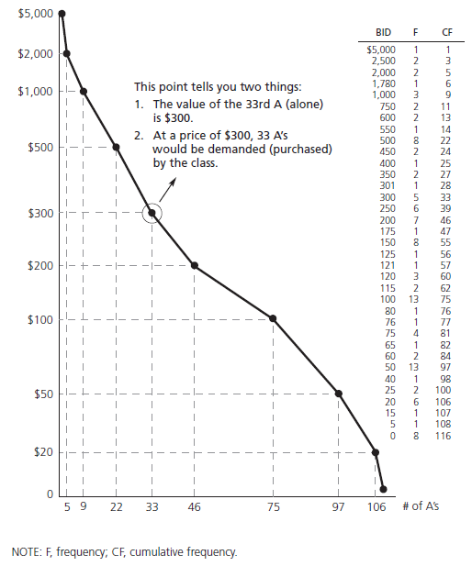
Lesson 4.1, Visual 2: Demand Curve for an A

Slide 11
Visual 4A: Steps in Market Equilibrium Change
An event occurs that changes the demand for or supply of a given good or service.
Demand and/or supply shift(s) in response to the above change.
A surplus or shortage occurs at the old equilibrium price.
The price moves: It increases if there is a shortage; it decreases if there is a surplus.
The new equilibrium price and quantity are established at the intersection of the new demand or supply curve and the original demand or supply curve.

Slide 12
Visual 4B: Shifts in Supply and Demand
Causes of Shifts (Changes) in Demand
Consumer tastes/preferences (changes in a person’s willingness to pay)
Consumer income/wealth (changes in a person’s ability to pay)
Prices of related goods (changes in the prices of substitute goods or complementary goods)
Consumer expectations about the future
The number of buyers
Causes of Shifts (Changes) in Supply
Productivity/technology (resource savings in how the good is produced)
Prices of resources used (resource prices are directly related to costs)
Government policies (changes in taxes or subsidies)
Producer expectations about the future
The number of sellers

