Slide 1
SESSION 13: REVENUES, OUTLAYS, & DEBT OF THE FEDERAL GOVERNMENT AND GOVERNMENT SPENDING & TAXES
Talking Points
Revenue, Outlays, & Debt of the Federal Government
1. The typical sources of revenue for the federal government are personal income taxes, Social Security taxes, Medicare taxes, unemployment taxes, corporate income taxes, and other taxes (custom duties, excise taxes, tariffs, and so on), and borrowing. To see the previous year’s revenue, go to http://www.usgovernmentrevenue.com/breakdown.

Slide 2
Session 13: Talking Points, Cont’d
Revenue, Outlays, & Debt of the Federal Government
2. Typically, the main spending (outlays) of the federal government are Social Security
and Medicare payments, national defense and foreign aid, social programs, physical/
human/community development, net interest on debt, law enforcement, and
general government. To see the previous year’s spending, go to
http://www.usfederalbudget.us/federal_budget_actual.
3. If government revenue is greater than its outlays, the government has a budget surplus.
4. If government revenue is less than its outlays, the government has a budget
deficit.

Slide 3
Session 13: Talking Points, Cont’d
Revenue, Outlays, & Debt of the Federal Government
5. If the government has a deficit, it must borrow funds (i.e., increase its debt).
6. The debt of the federal government (public debt) is the total amount owed
by the federal government as a result of its current and past borrowing.
7. The main historical causes for accumulated public debt have been
a. wars,
b. unanticipated downturns in the economy (recessions),
c. tax cuts with no offsetting cuts in outlays, and
d. increases in outlays with no offsetting increases in revenues

Slide 4
Session 13: Talking Points, Cont’d
Revenue, Outlays, & Debt of the Federal Government
8. Foreign investors hold just less than one-third of U.S. public debt, which represents a loss of wealth as interest payments leave the country.
9. For every debt in an economy, someone else has a credit—an IOU—a valuable asset.
10. If a borrower defaults—that is, is unable to pay their loan—the lender loses wealth (the IOU becomes worthless).

Slide 5
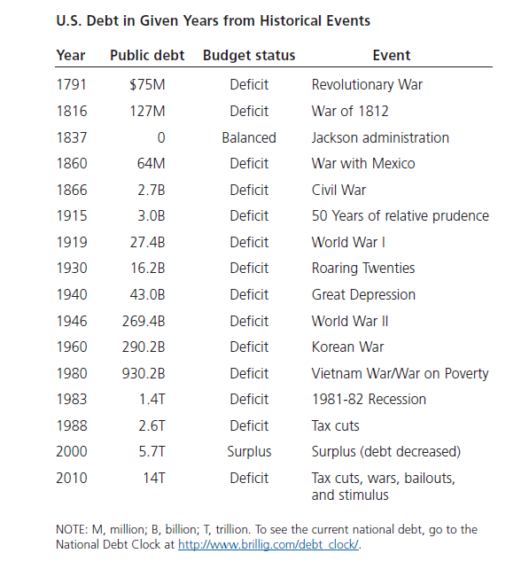
Visual 13A: A Brief History of U.S. Public Debt

