Slide 1
Building Bridges
INSERT PRESENTER INFORMATION HERE (Name, Title, Firm)
Notes:
Presenter’s introduction should include:
Greeting:
Hello and how are you doing today. I am NAME from COMPANY. I am the TITLE, which means I am responsible for AREA.
Company Profile:
My firm conducts business spanning GEOGRAPHIC FOOTPRINT and TYPE OF BUSINESS.
Responsibilities:
My responsibilities include DUTIES. A typical work day for me would start with ACTIVITY and end with ACTIVITY.
Insights:
The most challenging part of my job is … and the most exciting part of my job is …

Slide 2
Image Source: http://www.bitmondo.com/hola.png
Notes:
Presenter greets the class and reviews the objectives of the visit:
Today, we’re going to discuss how governments borrows money to fund projects.
We will also look at how individuals can use the Capital Markets to reach their long term goals.

Slide 3
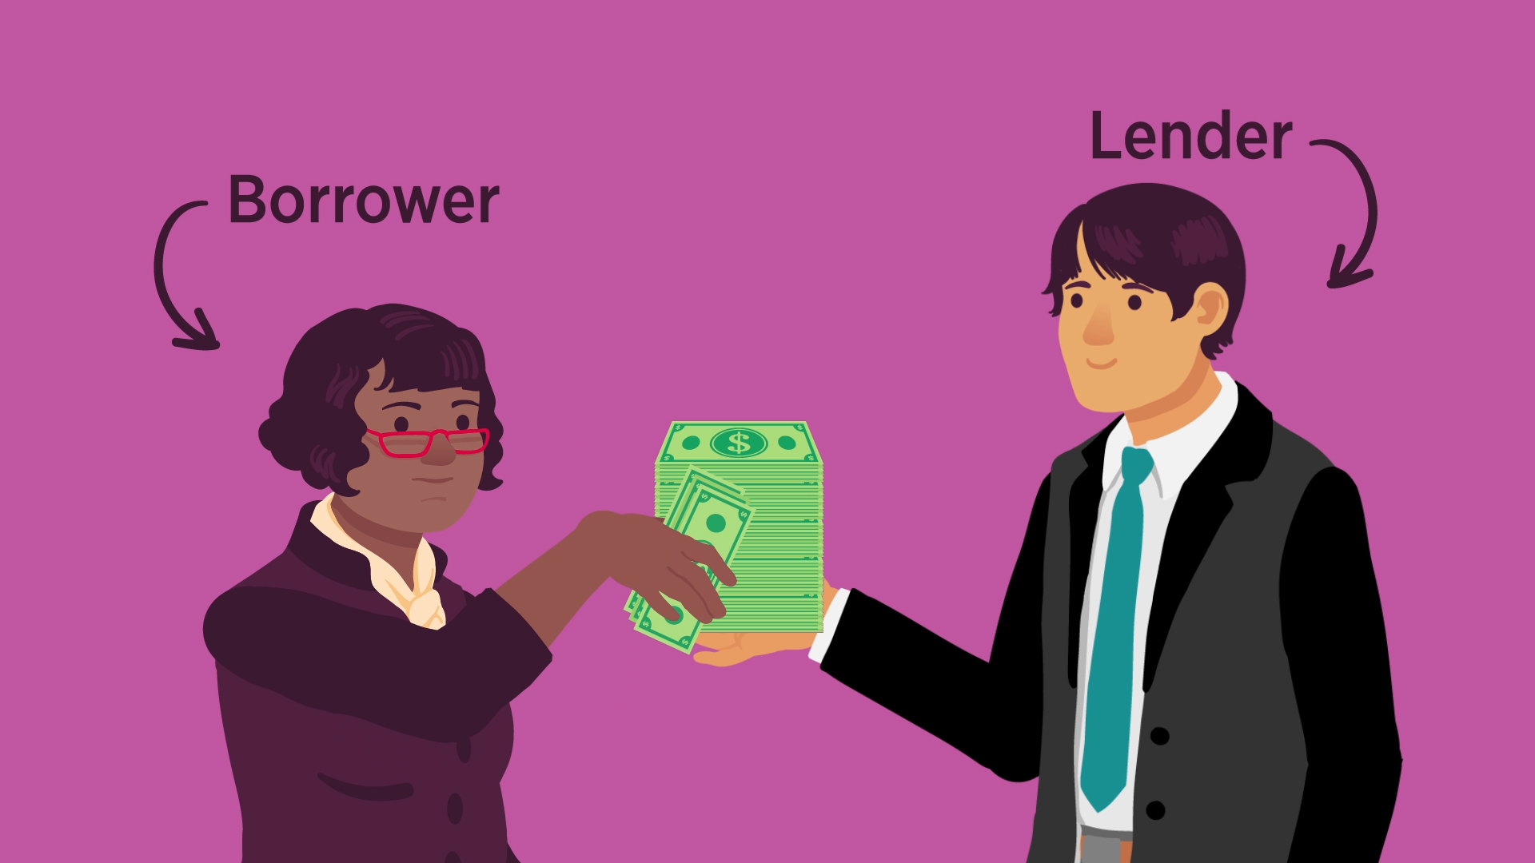
Notes:
Presenter asks: Have you ever had to borrow money?
Student responses will vary
Presenter asks: If you had a financial emergency, where would you come up with the money?
Student responses will vary, but may include savings, family, friends, banks, pawn shops, among others.
Presenter explains: Like individuals, companies and governments need to borrow funds too, and the process is not so different from anyone else. Governments have to find individuals or institutions willing to lend to them.

Slide 4
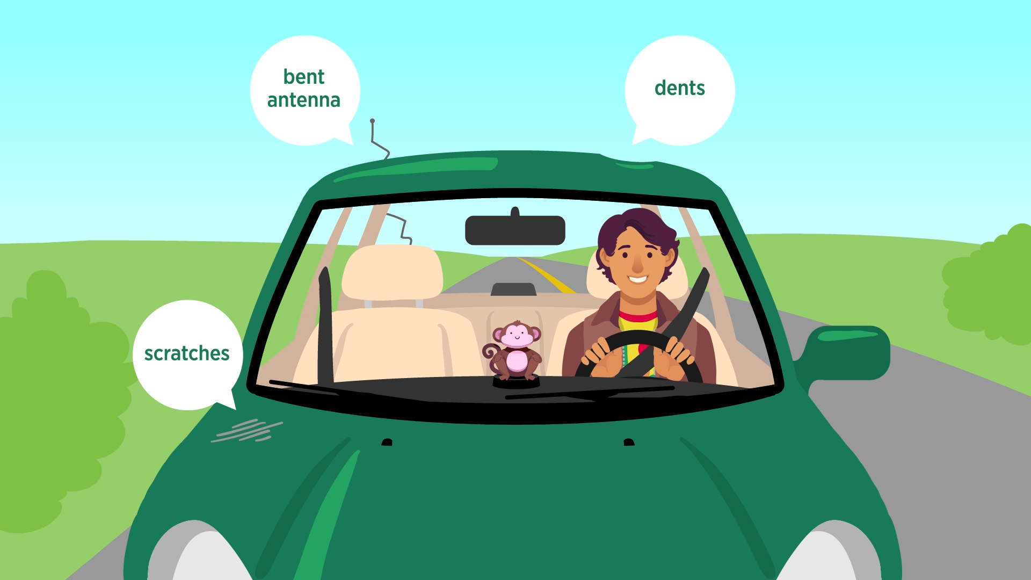
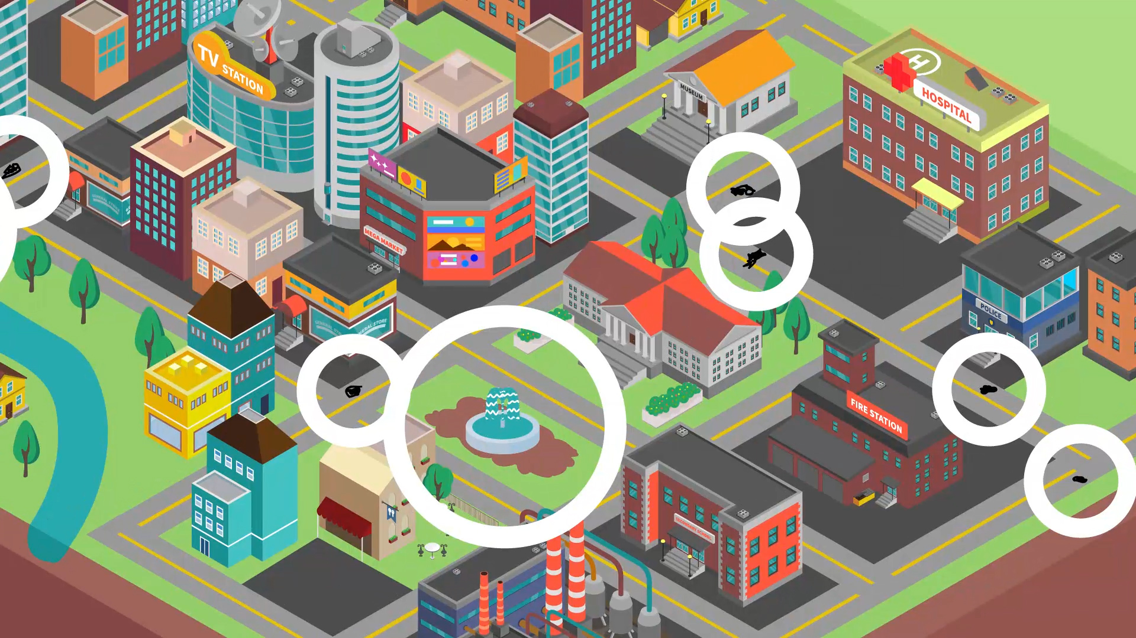
Notes:
Presenter introduces the video: Here’s a short video that uses a story to show how borrowing is used to meet objectives and how the capital markets play a role in matching borrowers and lenders. Play the video.
After the video, Presenter sums up the content: In the video, you saw that Lucas’s car was in need of repairs, but he could not afford to do all at once. His city’s mayor was facing a similar problem when she was trying to figure out how to repair the streets permanently. Lucas went to his brother, Darwin, to ask for the money and the mayor was able to issue bonds to get the needed funds. You saw that the capital markets play an important role for businesses that want to raise money. Companies can use stocks and bonds, but governments can only raise money with bonds.

Slide 5
Let’s Review
1. Where do governments go to borrow money?
2. What is the main to the city of town issuing bonds?
3. What are the four general types of bonds?
Notes:
Presenter asks: Where do governments go to borrow money?
Possible response from students:
Issue bonds
Presenter asks: What is the main benefit to a city or town issuing bonds?
Possible response from students:
Answers may vary, but may include that the funds are used for improvements in the town, benefitting many people.
Borrowing by issuing bonds means projects can begin sooner than if the town had to save up to pay for the projects.
Presenter asks: What are the four general types of bonds?
Possible response from students:
Corporate bonds - issued by companies
Municipal bonds - issued by state and local governments
Agency bonds - issued by government sponsored, but privately owned corporations and some federal government agencies
U.S. Treasury bonds - issued by the Federal government to borrow money when its expenses exceeds its revenue

Slide 6
1. Why do people and institutions buy bonds?
2. What is the difference between a “coupon” and “zero coupon bond”?
3. How do the capital markets help borrowers and lenders?
Notes:
Presenter asks:
Why do people and institutions buy bonds?
Possible response from students:
Bonds require the borrower to repay the loan with interest by a certain date.
There is a low chance that it won't be repaid.
There is no federal tax on the money earned from a municipal bond.
Presenter asks: What is the difference between a “coupon” and “zero coupon bond”?
Possible response from students:
Coupon bonds pay interest on a fixed schedule (usually annually or semi-annually).
Zero coupon bonds pay the interest you are owed when the bond matures (or when your loan period ends).
Presenter asks: How do the capital markets help borrowers and lenders?
Possible response from students:
The capital markets help companies and governments in need of funds find those who are looking for ways to earn interest through investment in stocks and bonds.
Capital markets help people with ideas become entrepreneurs and small businesses grow into big companies, while giving investors the opportunity to earn more interest (returns). Let’s review the tools and resources people in the video used to reach their goals.

Slide 7
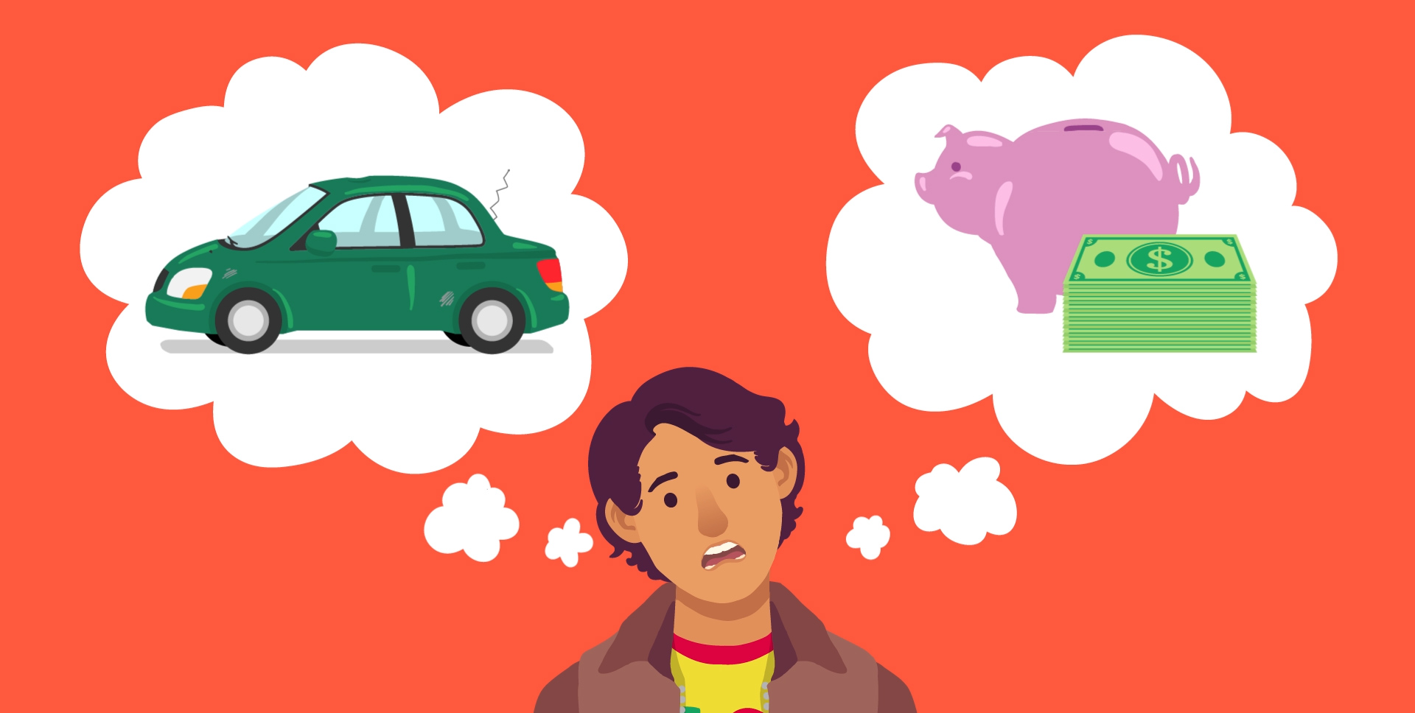
Notes:
Presenter explains: How did Lucas get his car repaired?
Possible responses from students:
His brother Darwin lent him the money.

Slide 8
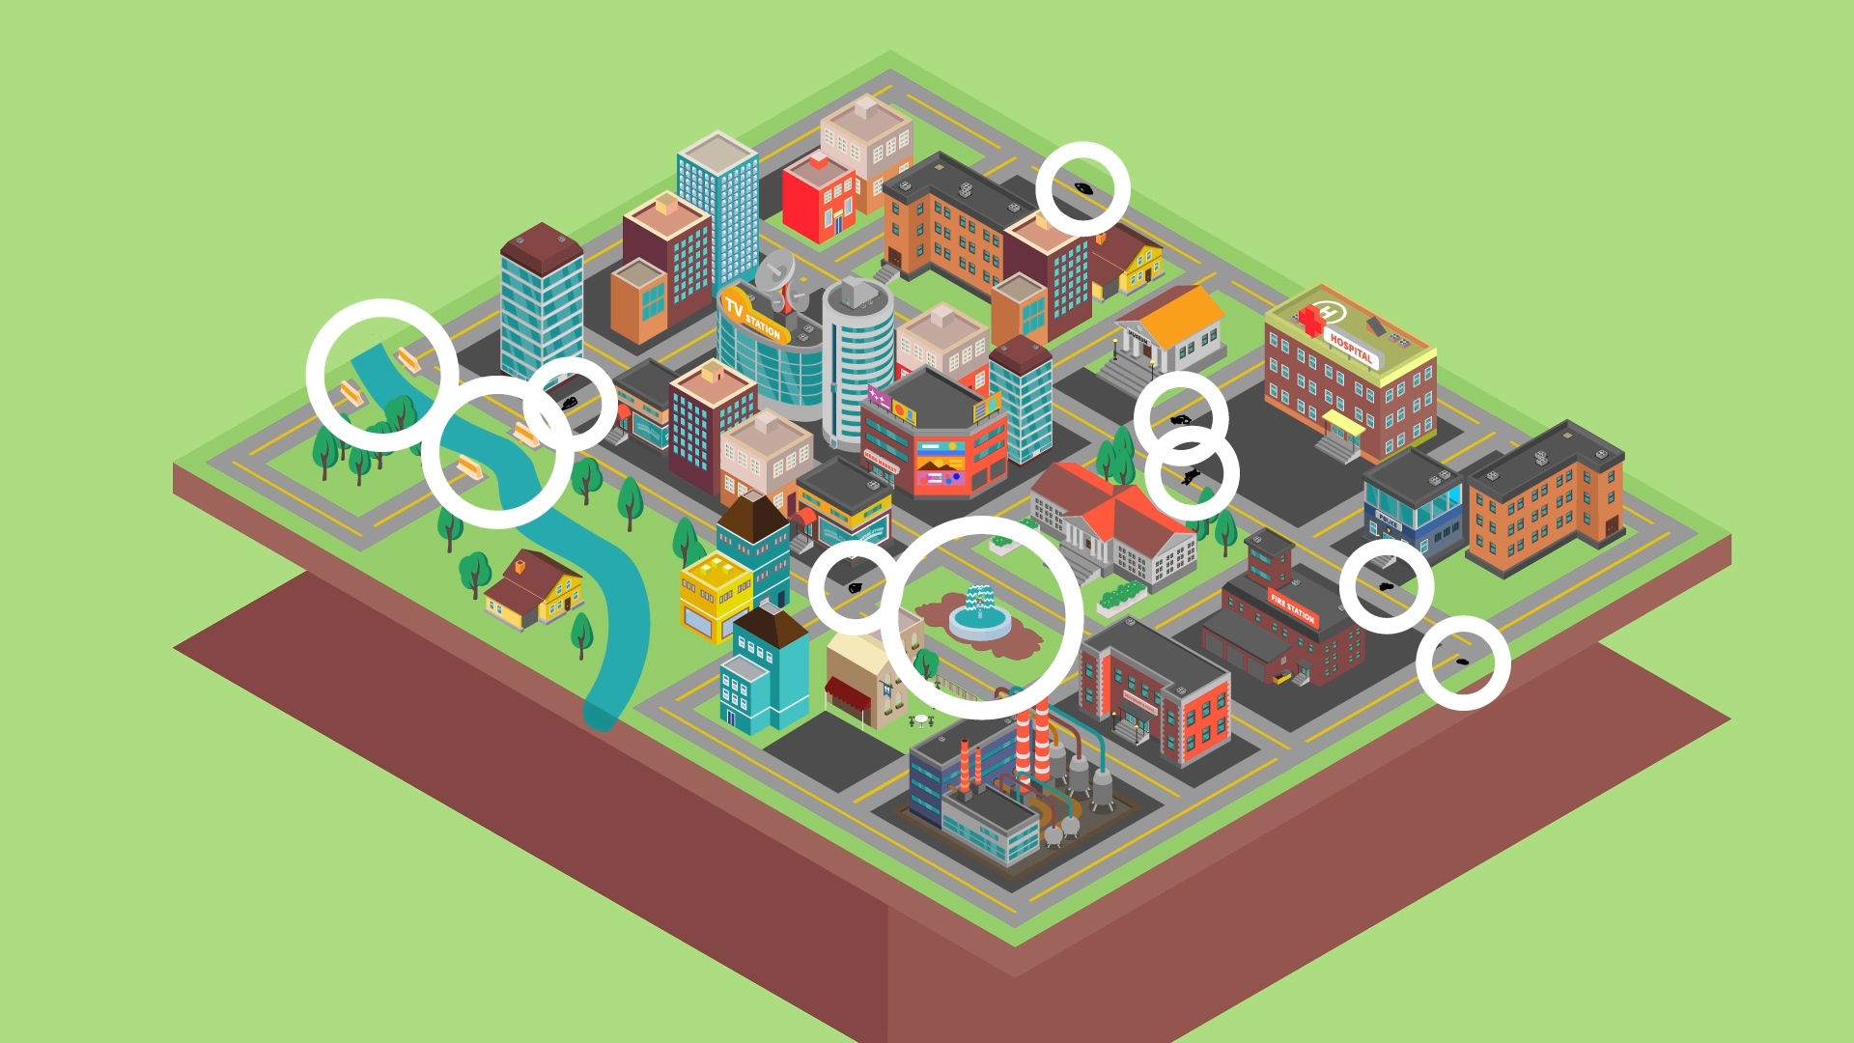
Notes:
Presenter asks: How did the town raise the money to fix the streets?
Possible responses from students:
They issued municipal bonds.

Slide 9
Notes:
The presenter wraps up: Thank you for your attention and time today.
I hope you now have a better understanding of what the capital markets are, what they do for us, and why that’s important.
I asked you a lot of questions today. Now it’s your turn to ask me questions.

Slide 10
APPENDIX reference slides to use if video is not available

Slide 11
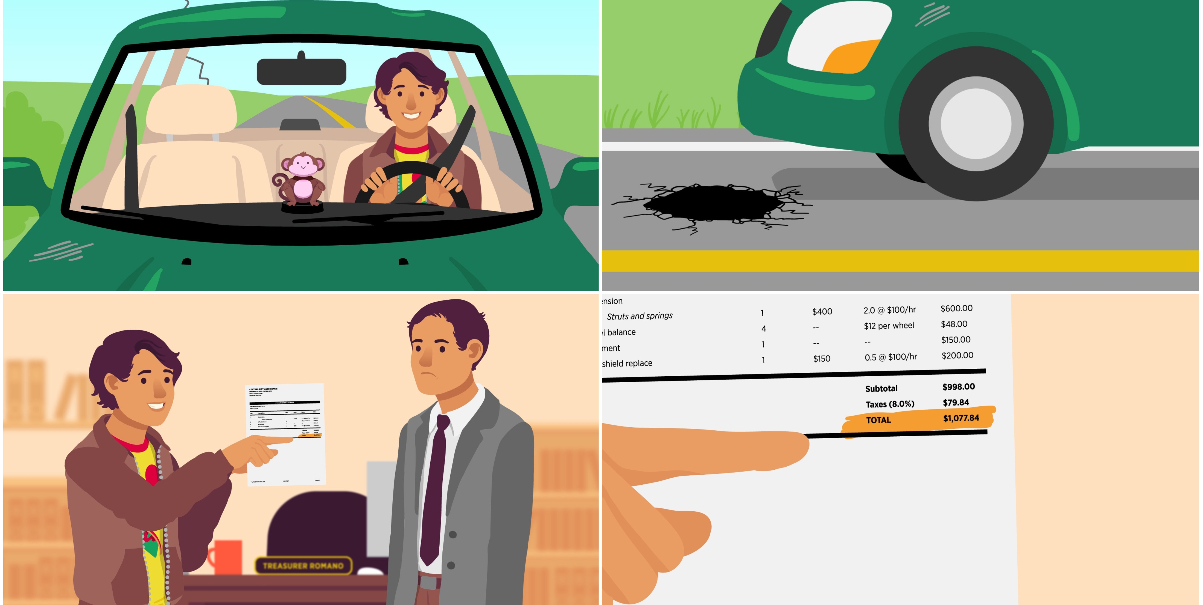
Notes:
If you did not use the video, discuss the lesson content:
Capital markets are financial markets that bring buyers and sellers together to trade stocks, bonds, currencies, and other financial assets. The capital markets include the stock market and the bond market. They help people with ideas become entrepreneurs and small businesses grow into big companies, while giving folks like you and me opportunities to save and invest for our futures. The capital markets allow companies and governments the opportunity to raise needed funds and borrow money just like individuals.
For example:
Consider a young man who loves his car even though it is a hand-me-down from his brother. The car is almost 12 years old and while it still drives well, it is showing signs of wear. Recently, he has noticed that his car doesn't drive as smoothly or as straight as it used to,. His mechanic says he needs repairs to his suspension and his wheels are out of alignment. The poor conditions of his town's streets are taking a toll on the car. More than once he has come close to crashing his car in an attempt to avoid a new pothole.
He wants to fix his car, but every time he thinks he has saved enough money, he needs more. After thinking it over, he decided to ask his brother for money to fix everything on his car all at once.

Slide 12
Notes:
(Continued) If you did not use the video, discuss the lesson content:
Like the young man, towns and cities borrow money too. The mayor of the young man’s town has also noticed the poor condition of its streets. She wants to fix them permanently, but there isn't enough money in the current budget to do more than temporarily fill potholes. She discussed the situation with the town council and together they decided it would be in the town's best interest to borrow the money needed to pay for a long-term solution to the damaged streets. It was pretty easy for the young man to borrow money from his brother, but how does a town borrow money?
When a town or city needs money for projects like building bridges, repairing roads or developing streets and parks, the town or city issues bonds. Bonds are agreements, like a loan, between a government agency or company and an investor. A bond requires the borrower (the agency or company) to repay the loan with interest to the investor by a certain date.
Companies also issue bonds, using them to pay for the creation of new products and services and the improvement of existing products and services, among other projects.

Slide 13
Notes:
(Continued) If you did not use the video, discuss the lesson content:
Financial capital is money used by entrepreneurs and businesses to buy resources and supplies to make products or provide a service to buyers. Financial capital can be raised in two ways through capital markets—by selling bonds or by selling stock.
Companies can raise money using stocks or bonds. Governments can only use bonds so they rely on issuing them to fund projects like building new schools, preserving historic landmarks, repairing bridges, worn streets and roadways.
There are four general types of bonds:
Corporate bonds - which are issued by companies
Municipal bonds - which are issued by state and local governments
Agency bonds - which are issued by government sponsored, but privately owned corporations and some federal government agencies
U.S. Treasury bonds - which are issued by the Federal government to borrow money when its expenses exceeds its revenue
Cities and towns can issue a "municipal bond" or "muni" through the bond market. The bond market is a part of the capital markets.
The bond market brings borrowers—the cities and towns—and lenders—people like you and me—together. People in the cities and towns benefit from the bond market because it helps to fund improvements to their community, like better roads, bridges and other services. The people who buy the bonds—the lenders—benefit because they receive a return (the interest they earn) on the bonds that they can use in the future.
Why do people want to buy municipal bonds? Generally it's because municipal bonds are considered a low-risk investment. That means when people buy a bond, there is a low chance that it won't be repaid—and a low chance of losing our money. However, low risk does not mean "no risk." There is a small chance that the town could fall into debt and not be able to repay the loan. This is referred to as "credit risk."

Slide 14
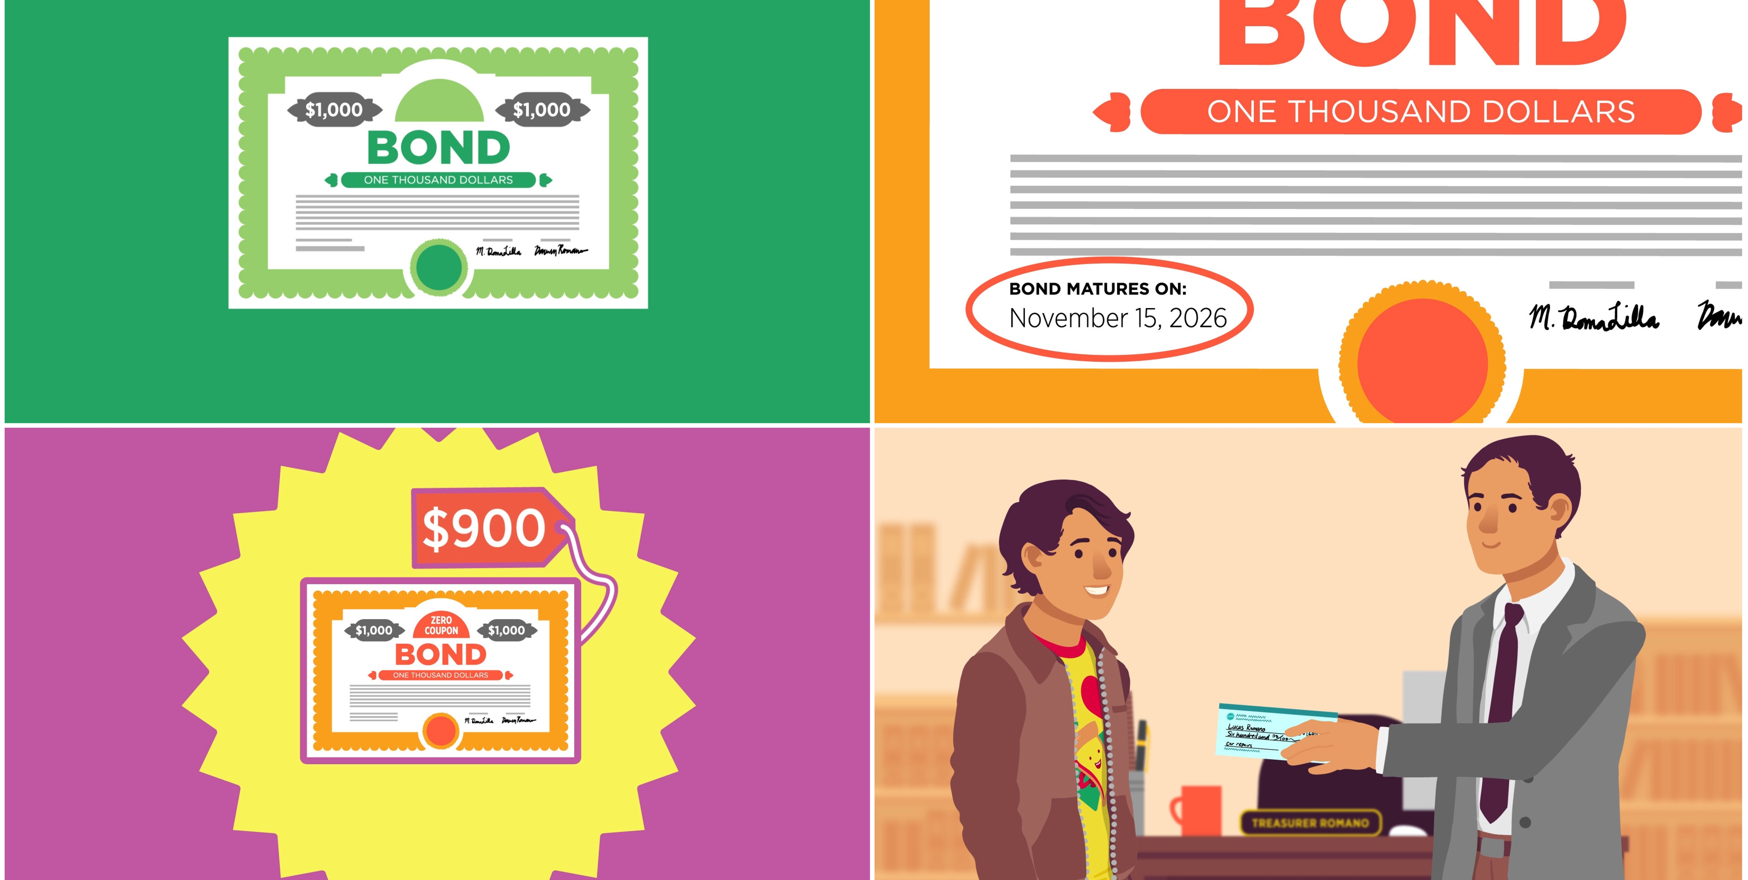
Notes:
(Continued) If you did not use the video, discuss the lesson content:
Investors buy bonds at their par or face value. This means the value written on the bond—typically $100 or $1000. Investors earn money on the bond's coupon rate. A coupon rate is the interest a bond pays on a fixed schedule (usually annually or semi-annually). Coupon payments from municipal bonds are exempt from federal taxes—in other words, the US government doesn't require people who own municipal bonds to pay tax on the money they earn from a municipal bond.
Investors may choose to buy a "zero coupon bond." A zero coupon bond does not pay interest on a fixed schedule. Instead, it pays the interest you are owed when it matures (or when your loan period ends). The maturity date of a bond is when the borrower must repay the loan plus interest. Zero coupon bonds are sold at a price below their face value. When the bond matures, the person who owns the bond receives the face value of the bond. The difference between the price the bond owner paid and the amount they receive when the bond matures is their interest payment.
If the young man’s agrees to lend the money to fix his car and the town raises enough money from investors by selling municipal bonds to fix the streets, the car will soon be driving better—and so will the other cars driving the streets in the town!

Slide 15
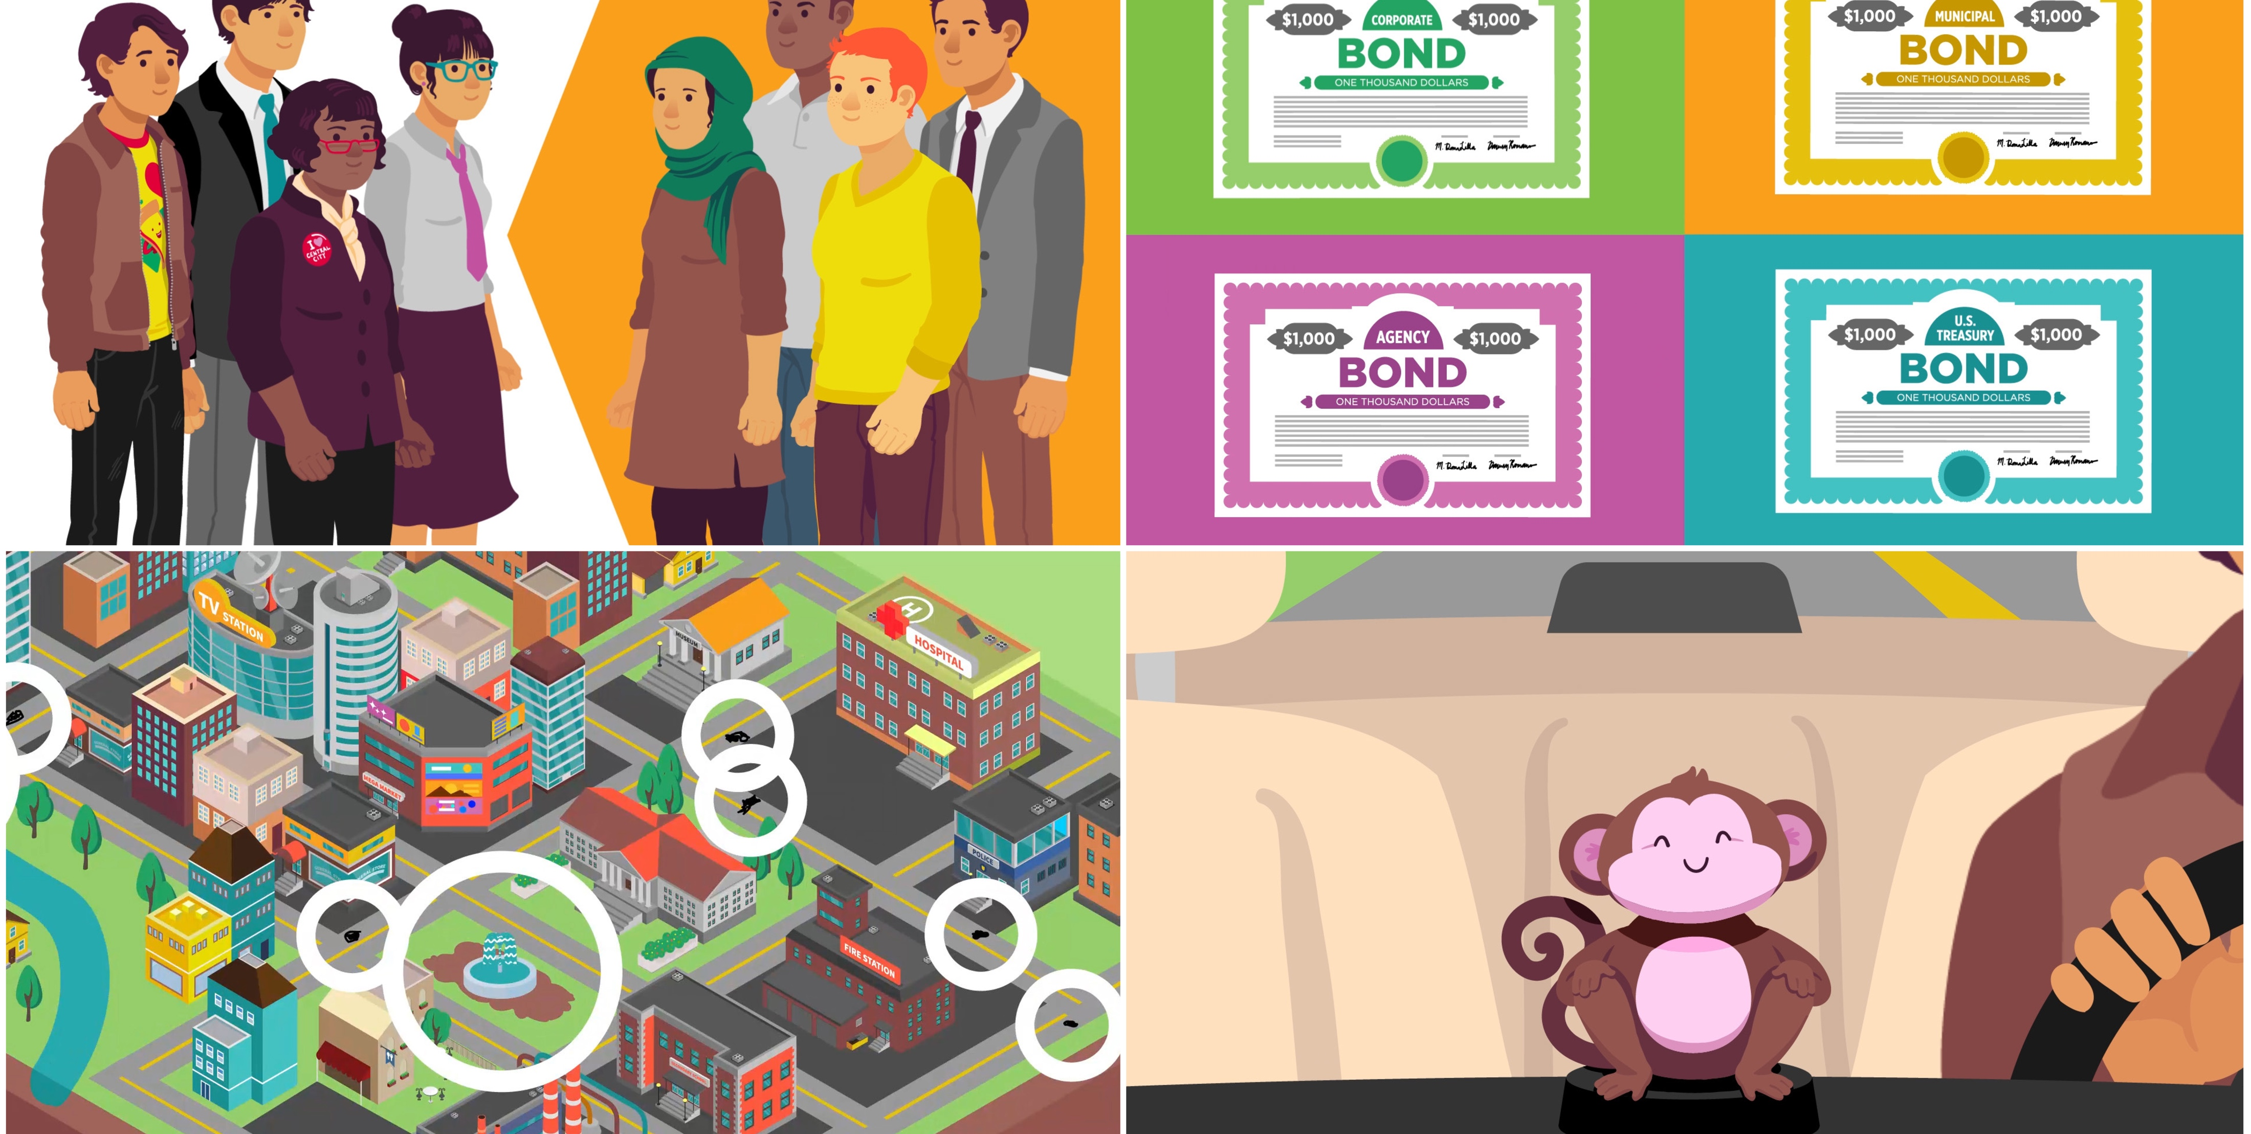
Notes:
Conclusion:
Capital markets bring borrowers and lenders together in efficient ways and help channel resources to create a healthy national and global economy. This includes starting or expanding a business, or providing investment opportunities for people planning for their future, or providing a source of funds to governments and companies through bonds.
They provide essential funding that affects people's lives in many ways.
Capital markets enable traders to buy and sell stocks, and bonds, and enable businesses to raise financial capital to grow. Businesses and governments know they can turn to reliable, regulated markets where they can get funding, and this reduces their risk. They also reduce their expenses because they don’t have to go out looking for funders—they know where to find the capital markets and the markets are there to match them with the best funding source.

