Slide 1
Understanding Capital Markets
INSERT PRESENTER INFORMATION HERE (Name, Title, Firm)
Notes:
Presenter’s introduction should include:
Greeting:
Hello and how are you doing today. I am NAME from COMPANY. I am the TITLE, which means I am responsible for AREA.
Company Profile:
My firm conducts business spanning GEOGRAPHIC FOOTPRINT and TYPE OF BUSINESS.
Responsibilities:
My responsibilities include DUTIES. A typical work day for me would start with ACTIVITY and end with ACTIVITY.
Insights:
The most challenging part of my job is … and the most exciting part of my job is …

Slide 2
Image Source: http://www.bitmondo.com/hola.png
Notes:
Presenter greets the class and reviews the objectives of the visit:
Today, we’re going to discuss the capital markets.
We will look at what they are and how they help to maintain a healthy economy.
We will also look at how individuals play a role in maintaining healthy capital markets.

Slide 3
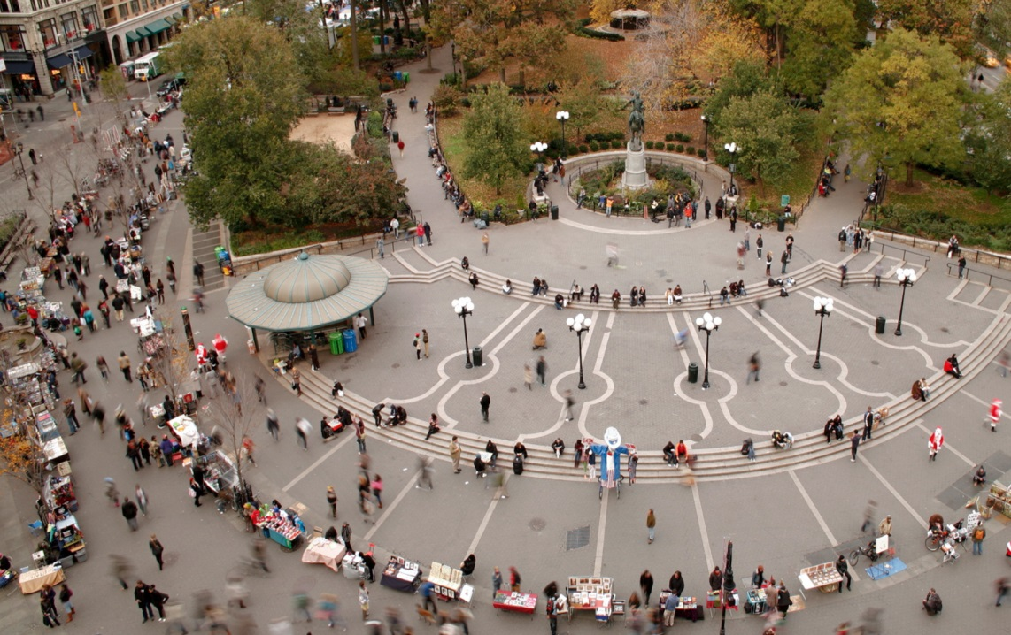
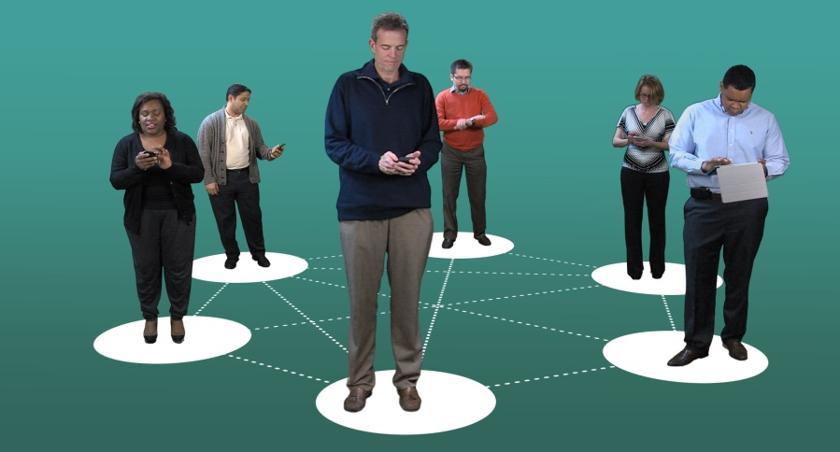
Markets allow buyers and sellers to meet.
Markets can be physical places
Markets can be virtual.
Notes:
Presenter asks: What comes to mind when you hear the word “markets?”
Student responses should include examples like grocery stores, mall shops, etc.
Presenter explains: Here’s an example of some markets and how they function. This morning, I left for work very, very early and I really wanted a cup of coffee. Fortunately, I had a few minutes to stop by my favorite coffee shop (the seller), where I, the buyer, ordered my favorite extra large, extra hot coffee. The cashier rang up my order, took my money, and in return, gave me a very valuable good --my coffee. We were both very happy! The seller got a buyer and the buyer (that’s me) got a much-needed hot drink. Another example of a buyer and seller coming together in a market would be if I purchased gas for my car at a gas station.
Presenter explains: Markets can be physical and they can also be virtual.
Examples of PHYSICAL markets are a car dealership, grocery store, coffee shop, clothing stores, shopping malls, etc.
Examples of VIRTUAL markets include ebay.com, Amazon.com, Overstock.com, etc.
Presenter asks: What markets do you participate in regularly?
Student responses should include: grocery stores, movie theaters, restaurants, clothing stores, purchasing apps on a tablet or phone, etc.

Slide 4
Initial Public Offerings
(IPO)
Understanding Capital Markets http://bcove.me/p42mvueu
Bonds
New Businesses
Goods and Services
Stocks
Notes:
Presenter introduces the video: Here’s a short video that highlights how the capital markets work for businesses and their investors. Play the video.
After the video, Presenter sums up the contents: In the video, you saw how buyers and sellers came together to help a small business expand. You learned how an interested investor could become a partial owner of a company or make a loan to a company or government and potentially earn money through this loan, or investment, in the form of interest or dividends. You learned how the markets have made it much easier for investors and those seeking financial capital, such as entrepreneurs, to find each other.
Presenter asks students to:
Give an example from the video of a buyer (Answer: the customers who are eating his ice cream; OR the investors who purchase stock so the company can grow)
Give an example from the video of a seller (Answer: Jack, the ice cream entrepreneur; OR the broker pitching the IPO)
Give an example of why a buyer would want a seller and why a seller would want a buyer. (Answer: the buyer wants a “good” such as ice cream or a “financial asset” such as a stock or a bond; the seller wants to earn profit through the sale of a good or service—like Jack who was selling ice cream—or the seller wants to obtain cash, also known as financial capital)
If you do not use the video, discuss this using the slide in the Appendix.

Slide 5
Let’s Review
What are capital markets?
Who provides financial capital in these markets?
How do businesses, entrepreneurs, and governments obtain financial capital through these markets?
Notes:
Presenter asks: What are capital markets?
Possible responses from students:
The capital markets are financial markets that bring buyers and sellers together to trade stocks, bonds, currencies, and other financial assets.
The capital markets include the stock market and the bond market.
They help people with ideas become entrepreneurs and they help small businesses grow into big companies.
They give people like you and me opportunities to save and invest for our futures.
Presenter asks: Who provides financial capital in these markets?
Possible response from students.
Savers who want to buy financial assets with the hope of earning a higher return than they would in a savings account.
Presenter asks: How do businesses, entrepreneurs, and governments obtain financial capital through these markets?
Possible response from students.
Businesses, entrepreneurs, and governments obtain financial capital by selling financial assets in the capital markets. Let’s move onto our next slide to explain this in more detail.

Slide 6
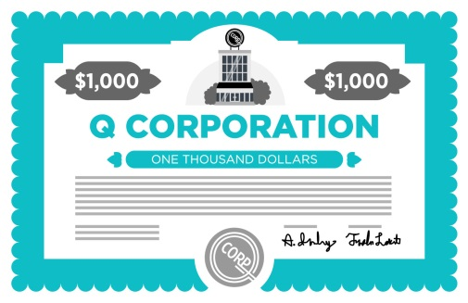
Let’s Review
1. What’s a stock?
2. What’s a bond?
Notes:
Presenter explains: As I just mentioned, businesses, entrepreneurs, and governments obtain financial capital by selling financial assets in the capital markets. These assets include stocks and bonds.
Presenter asks: What is a stock?
Companies issue stock as a way of raising money to fund the development of new products and services or to fund the maintenance of existing products and services.
People buy stock because they believe the value of the stock will go up and that eventually they can sell stocks to another buyer at a higher price than the initial purchase price.
The risk is that the stock price could also go down.
When you buy stock you become part owner of the company that issued it.
Presenter asks: What is a bond?
A bond is a loan made by investors to a company or government.
A company might issue bonds instead of stock because they do not wish to have any more owners (decision-makers).
Governments also issue bonds to fund large projects.
Unlike stockholders, bond purchasers are not company owners. Instead, they receive interest payments and are repaid the loan amount at a future date.
Businesses issue bonds and so do federal, state, and local governments.
Bonds often help pay for big projects, such as new schools and hospitals, road repairs, and renovations to public buildings and parks.

Slide 7
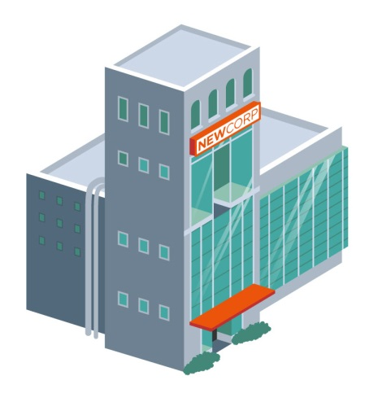
With capital markets
Capital investment for business growth
Without capital markets
Notes:
Presenter asks: What would happen if we had no capital markets?
Without markets for stocks and bonds, business owners would have fewer options to bring their ideas to life or to expand their businesses.
They would have to save up enough cash to get to that point, which could take lots of time.
With healthy capital markets, business owners can obtain the needed financial capital. They can build successful companies and expand existing businesses to create new jobs and strengthen the economy.

Slide 8
Notes:
The presenter wraps up: Thank you for your attention and time today.
I hope you now have a better understanding of what the capital markets are, what they do for us, and why that’s important.
I asked you a lot of questions today. Now it’s your turn to ask me questions.

Slide 9
APPENDIX reference slides to use if video is not available

Slide 10
Initial Public Offerings
(IPO)
Bonds
Stocks
Notes:
If you did not use the video, discuss the lesson content:
Capital markets are financial markets that bring buyers and sellers together to trade stocks, bonds, currencies, and other financial assets. The capital markets include the stock market and the bond market. They help people with ideas become entrepreneurs and small businesses grow into big companies, while giving folks like you and me opportunities to save and invest for our futures.
For example: You have an idea for a new business—delicious, healthy ice. You saved your money in the bank, earned interest, and used that to start your business. Now you test the market, and BOOM, your product is a hit. You can't fill ice cream cones fast enough; the business is growing! You need to hire people to help you produce, sell, and deliver your ice cream. You need more ingredients from your suppliers, like the fruit seller and the cone baker. You don't have the money to pay for all of this right now, but according to your business plan and test market results, you’re going to make millions in the first year. Enter: the capital markets.
Financial capital is money used by entrepreneurs and businesses to buy resources and supplies to make products or provide a service to buyers. Financial capital can be raised in two ways through capital markets—as a bond, which is like a loan that you will repay at a later date with interest; or by selling stock, which is done in exchange for partial ownership of your business.
Issuing or selling stock takes place through an IPO or initial public offering, in which the price is determined by the amount buyers are willing to spend and sellers want to make. Unlike a loan, which has to be repaid, "going public" allows others to buy a share or a portion of your business and become a partial owner. The person or institution with the most shares at any time is the company's main owner. Many small businesses have conducted IPOs and earned money to become a large company. These companies expanded across the country, created thousands of jobs, stimulated new businesses related to supplies, production and delivery, and provided a good or service that consumers value. People buy stock because they believe the value of the stock will go up and that eventually they can sell stocks to another buyer at a higher price than the initial purchase price. The risk is that the stock price could also go down.

Slide 11
Initial Public Offerings
(IPO)
Understanding Capital Markets http://bcove.me/p42mvueu
New Businesses
Goods and Services
Notes:
(Continued) If you did not use the video, discuss the lesson content:
A company might issue bonds instead of stock. A bond is a loan made by investors to a company or government. Unlike stockholders, bond purchasers are not company owners. Instead, they receive interest payments and are repaid the loan amount at a future date. Businesses issue bonds and so do federal, state, and local governments. Bonds often help pay for big projects, such as new schools, new hospitals, road repairs, and renovations to public buildings and parks.
Without markets for stocks and bonds, business owners would have fewer options to bring their ideas to life or expand their businesses; they would have to save up enough cash to do this. With healthy capital markets, business owners can obtain capital to build successful companies and expand their business, which in turn create new jobs and strengthen the economy. Capital markets also reduce the cost of doing business by providing the global economy with a reliable source of cash or liquidity.
Conclusion:
Capital markets bring borrowers and lenders together in efficient ways and help channel resources to create a healthy national and global economy.
They provide essential funding that affects people's lives in many ways: starting a business, expanding a current one, or providing investment opportunities for people planning for their future.
Capital markets enable traders to buy and sell stocks, and bonds, and enable businesses to raise financial capital to grow. Businesses know they can turn to reliable, regulated markets where they can get funding, and this reduces their risk. They also reduce their expenses because they don’t have to go out looking for funders—they know where to find the capital markets and the markets are there to match them with the best funding source.
One day, you might have an idea that you want to turn into a business—like healthy ice cream. Capital markets will be there to help make it happen.

