Slide 1
Market Structures
Perfect Competition
Perfect Competition

Slide 2
Table of Contents
Perfect Competition Collection
Slides 3-7 depict a perfectly competitive market and a firm in that market. The progression shows the areas of total revenue (TR), total cost (TC), and profit.
Slides 8-11 illustrate a decrease in demand and how the new market price reduces TR and causes the firm to operate at a loss. The decrease drives the price below the ATC of the firm, which decreases total revenue and produces a loss for the firm. The firm is covering its variable costs and part of its fixed costs and does not shut down.
Slides 12-15 illustrates a further decrease in demand, reducing the price for the firm to a point below the AVC curve. The slides indicate even greater loss. At this point, the firm will shut down as it cannot cover variable costs, but it will still be obligated to its fixed costs.
The table could be printed so that students would have it handy while viewing the graphs. For best results, print the table in "landscape" orientation.
Perfect Competition

Slide 3
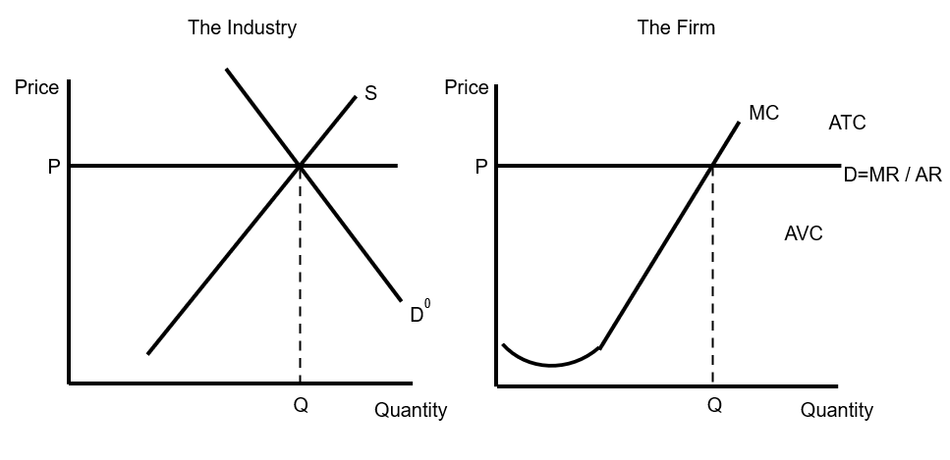
Step 1: Profit maximizing quantity for industry is where supply meets demand
Profit maximizing quantity for firm is where MR = MC
Perfect Competition

Slide 4
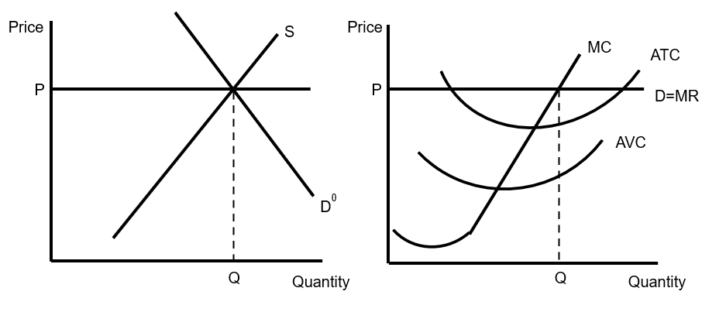
Step 2: To determine profit/loss for firm, Average Variable Cost & Average
Total Cost must be added
Perfect Competition

Slide 5
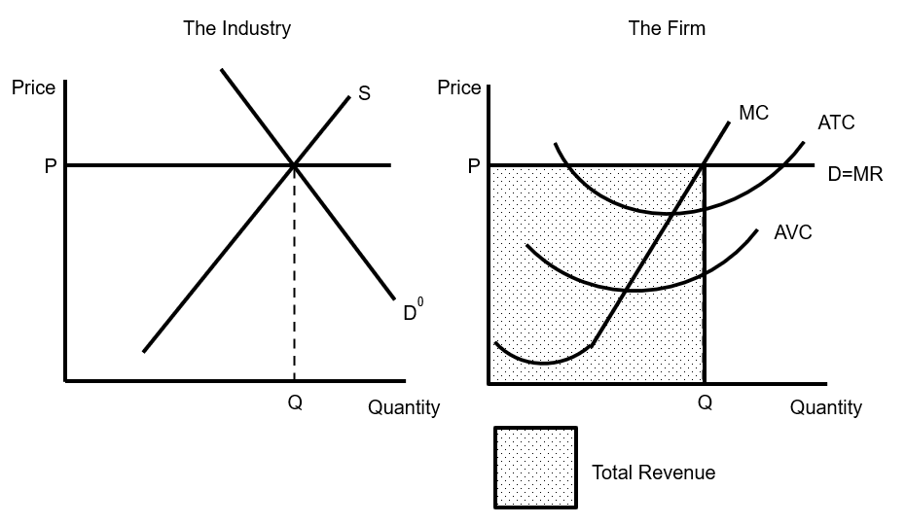
Step 3: Total Revenue is price x profit maximizing quantity
Perfect Competition

Slide 6
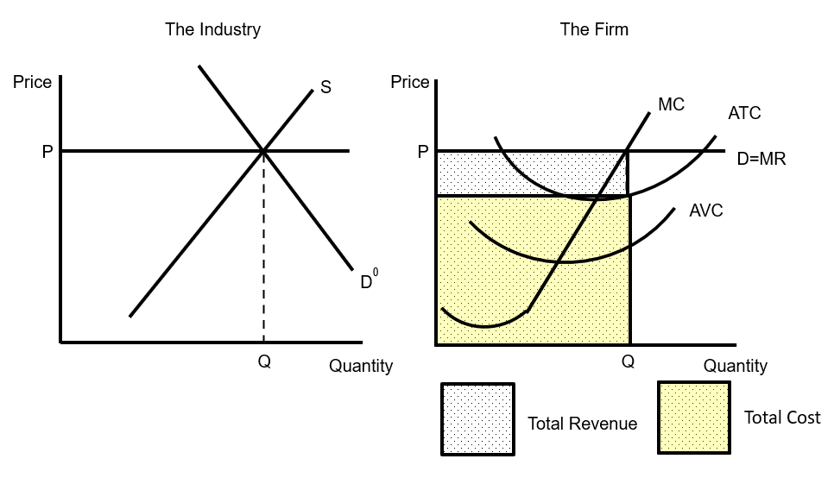
Step 4: Total Cost is the area BELOW Average Total Cost crosses Quantity
Perfect Competition

Slide 7
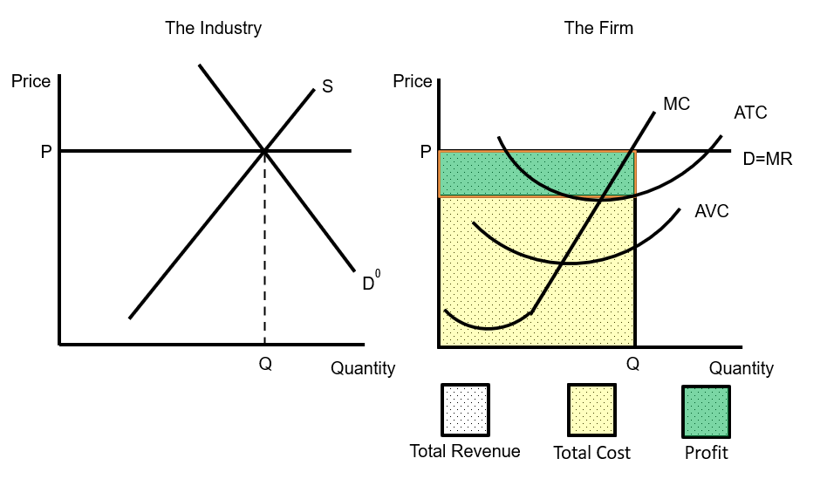
Step 5: Total Profit is area ABOVE Average Total Cost crosses quantity to market price
Perfect Competition

Slide 8
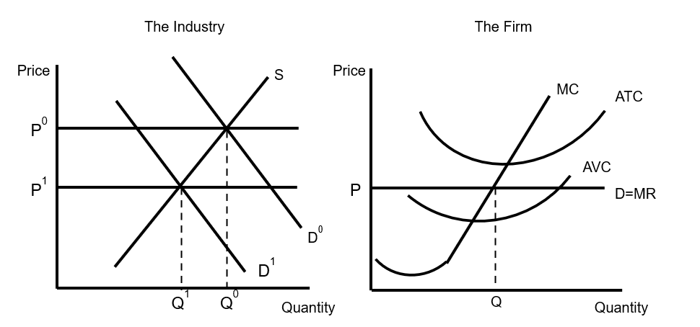
Step 6: Assume demand shifts left, decreasing price and quantity
Perfect Competition

Slide 9
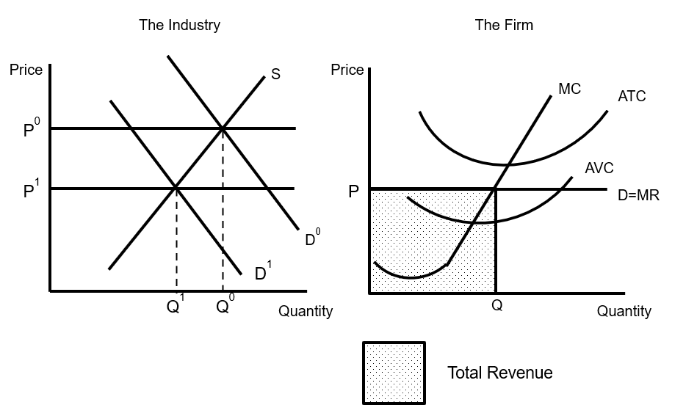
Step 7: Total Revenue is price x profit maximizing quantity
Perfect Competition

Slide 10
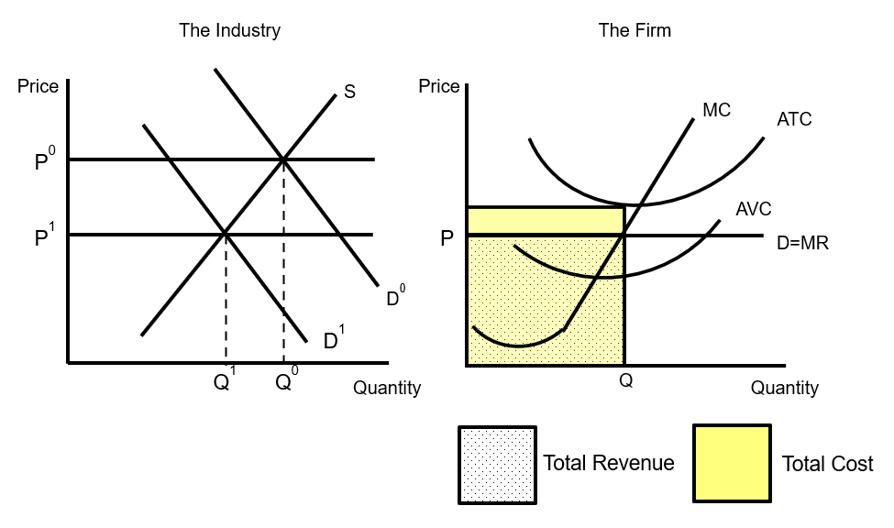
Step 8: Total Cost is the area BELOW Average Total Cost crosses Quantity
Perfect Competition

Slide 11
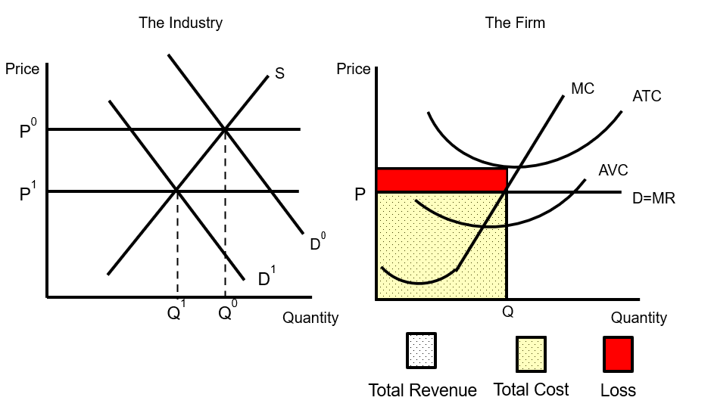
Step 9: Loss is area between Average Total Cost crosses quantity
ABOVE Price. Firm loses money in short run but does NOT shut down
Perfect Competition

Slide 12
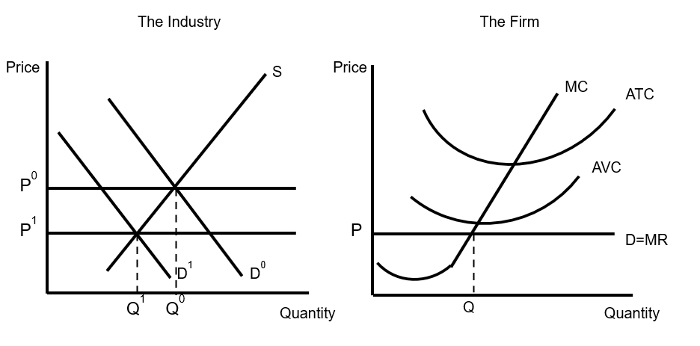
Step 11: Assume further demand shift to left decreases price and quantity demanded
Perfect Competition

Slide 13
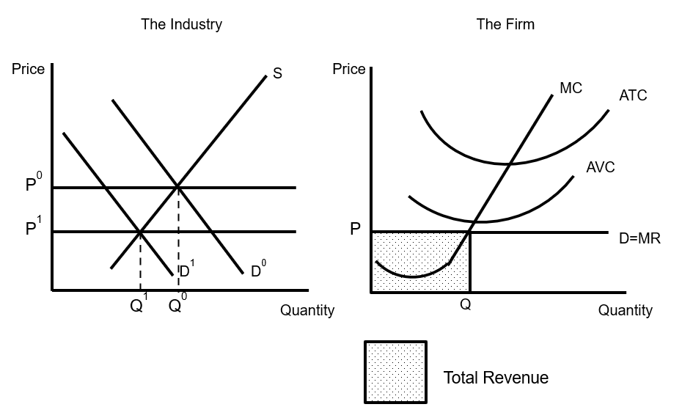
Step 12: Total Revenue is price x profit maximizing quantity
Perfect Competition

Slide 14
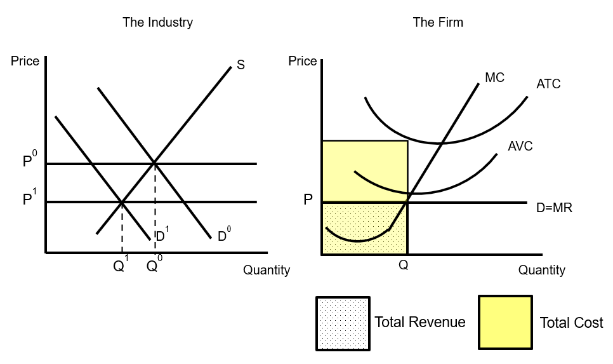
Step 13: Total Cost is the area BELOW Average Total Cost crosses Quantity
Perfect Competition

Slide 15
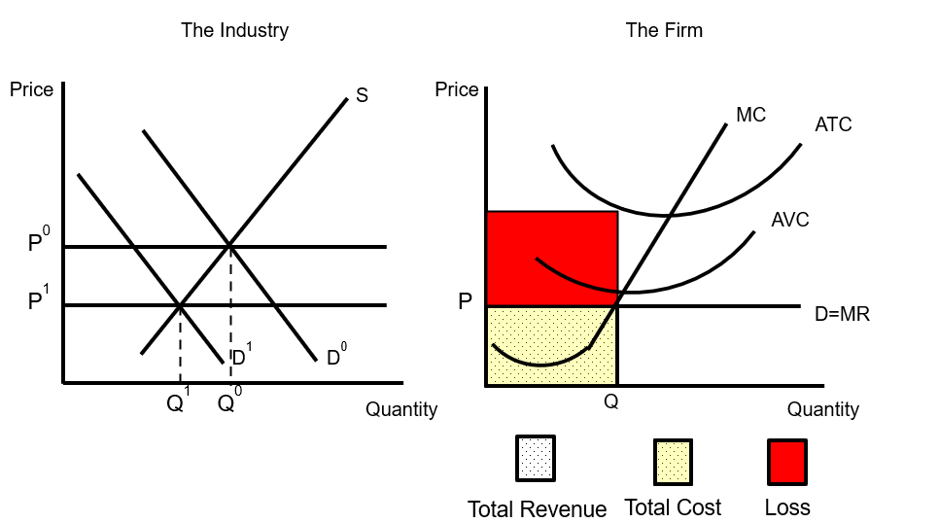
Step 14: Loss is area between Average Total Cost crosses quantity
ABOVE Price. Firm cannot cover Average Variable Cost and
SHUTS DOWN
Perfect Competition

