Slide 1
Market Structures
Monopoly

Slide 2
Table of Contents
Slide 3 presents a table that can be printed for each student. For best results, use "landscape" page orientation.
Slides 4 through 12 plots and draws marginal revenue, marginal cost, average total cost, and average revenue (demand), respectively.
Slide 13 presents the profit maximizing output and price for the monopolist.
Slide 14 presents the total revenue received by the monopolist.
Slide 15 presents the economic profit received by the monopolist.
Slide 16 presents the total costs for the monopolist.
Slide 17 presents deadweight loss
Monopoly

Slide 3
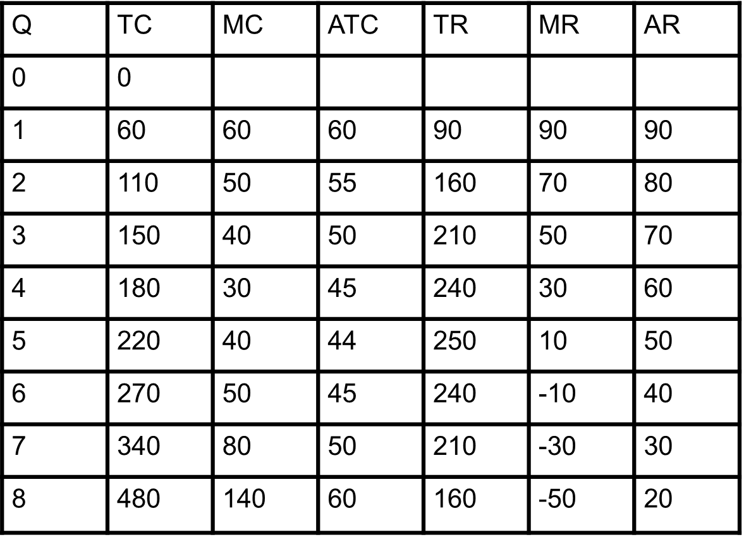
Quantity / Cost / Revenue Schedule
Monopoly

Slide 4
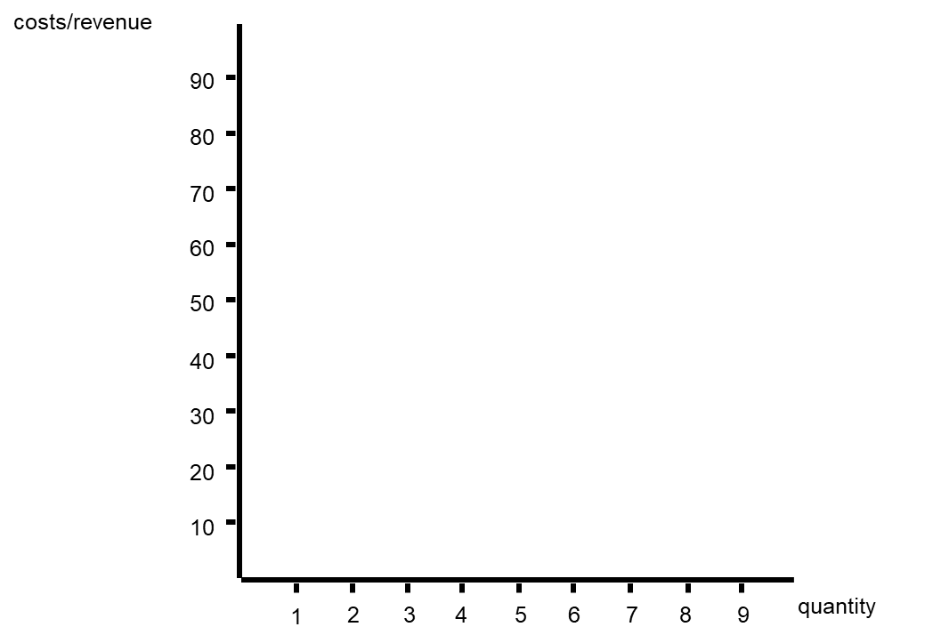
Step 1: Create Market Graph with the following:
Quantity on X-Axis
Cost/Revenue on Y-Axis
Monopoly

Slide 5
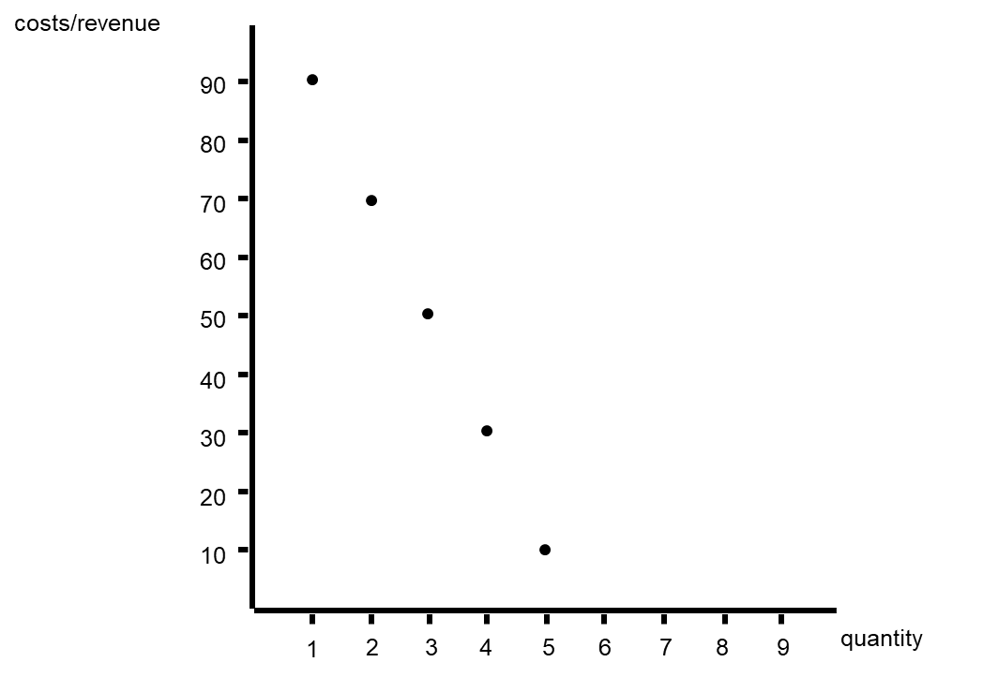
Step 2: Plot Marginal Revenue
(NOTE: It is necessary to draw MR line below X-Axis, but not required to plot points below X-Axis)
Monopoly

Slide 6
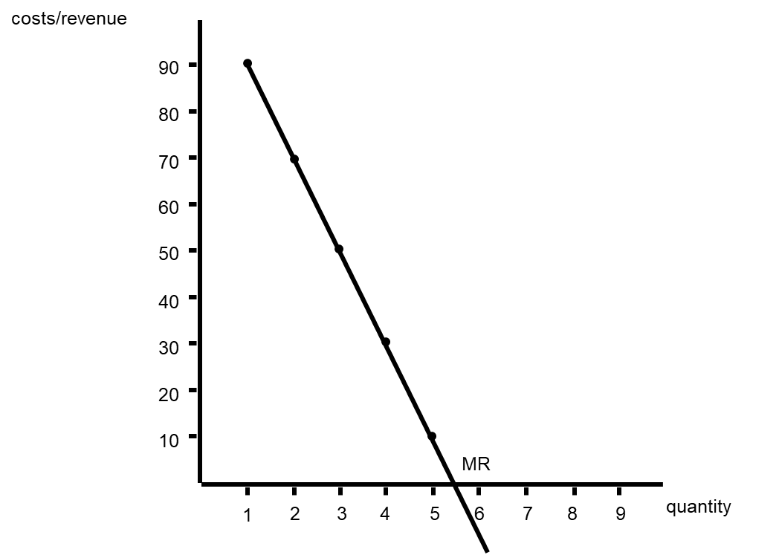
Marginal Revenue
Monopoly

Slide 7
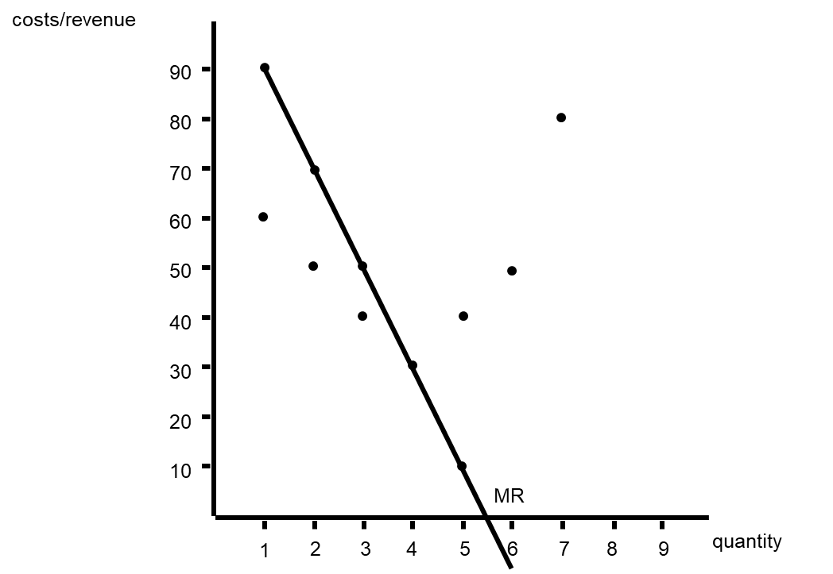
Step 3: Plot Marginal Cost
Monopoly

Slide 8
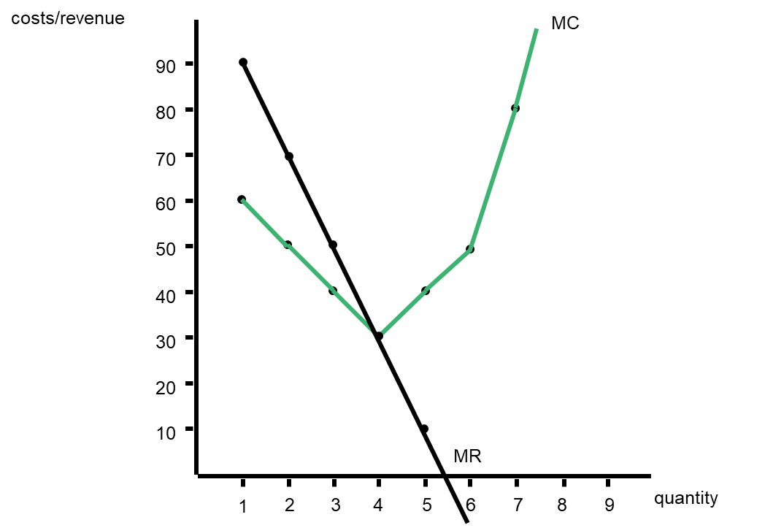
Marginal Cost
Monopoly

Slide 9

Step 4: Plot Average Total Cost
Monopoly

Slide 10
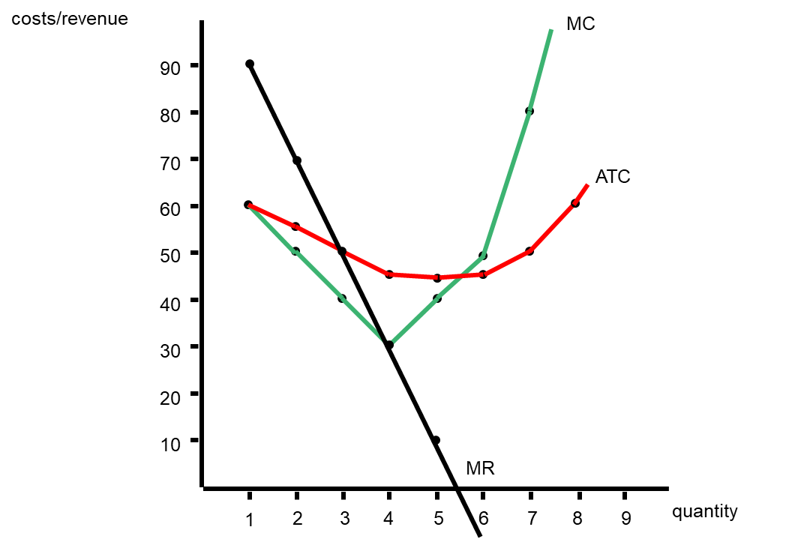
Average Total Cost
Monopoly

Slide 11

Step 5: Plot Average Revenue
Monopoly

Slide 12
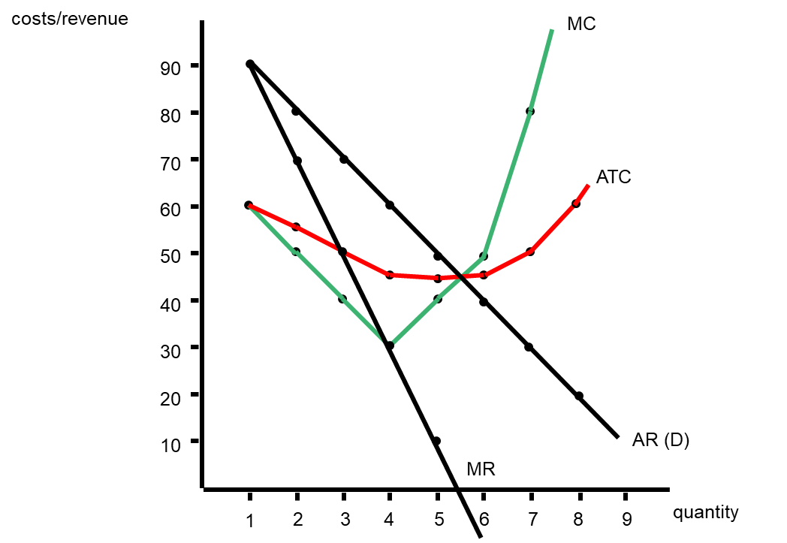
Average Revenue = Demand Curve
Monopoly

Slide 13
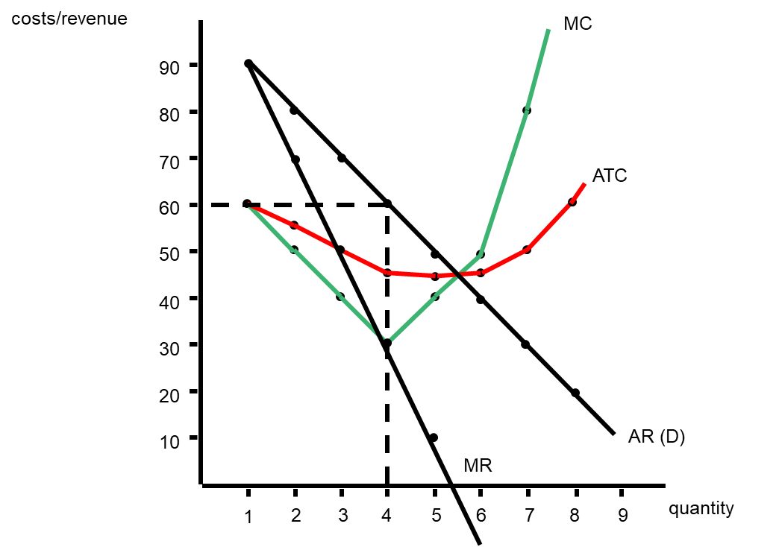
Step 6: Determine Profit Maximizing Output / Price
Find where MR intersects w/ MC (Quantity 4)
Price where quantity intersects w/ AR-D ($60)
Monopoly

Slide 14
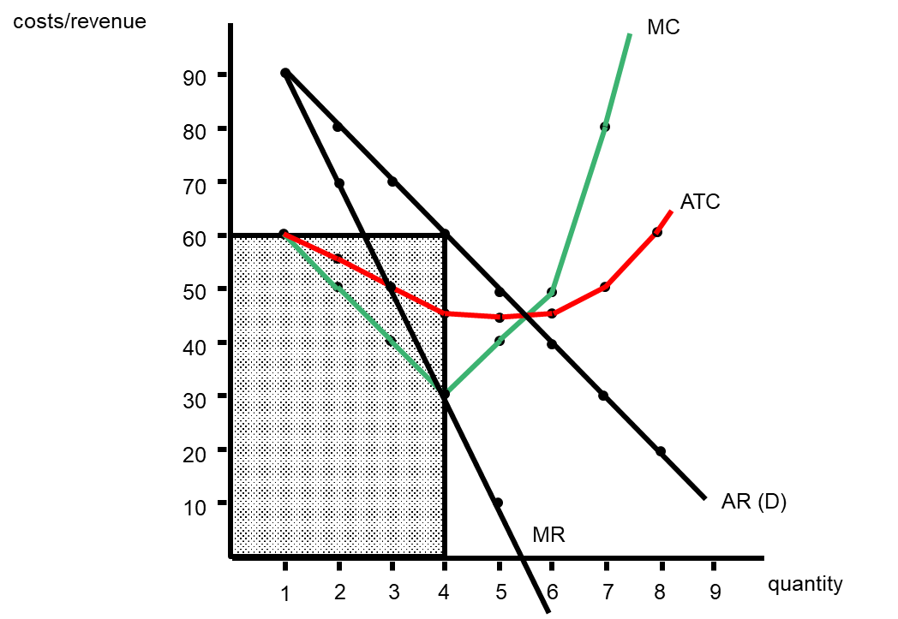
Step 7: Determine Total Revenue of Monopolist
$60 x 4 = $240
Monopoly

Slide 15
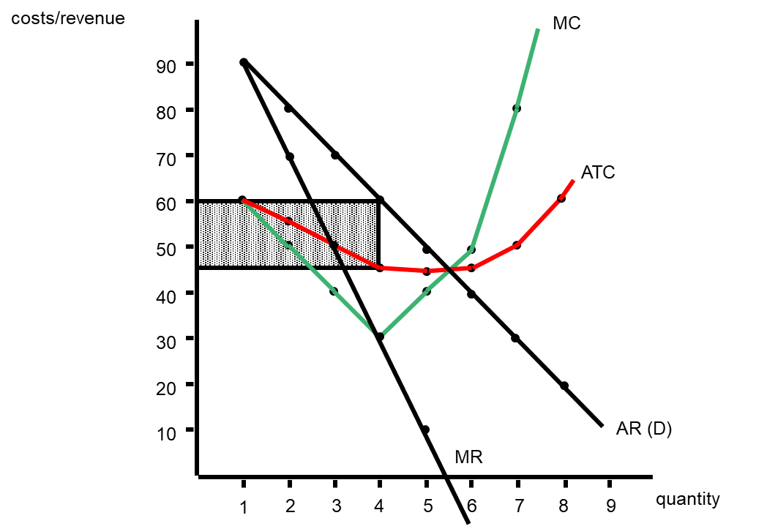
Step 8: Determine Total Profit of Monopolist
$15 x 4 = $60
Monopoly

Slide 16
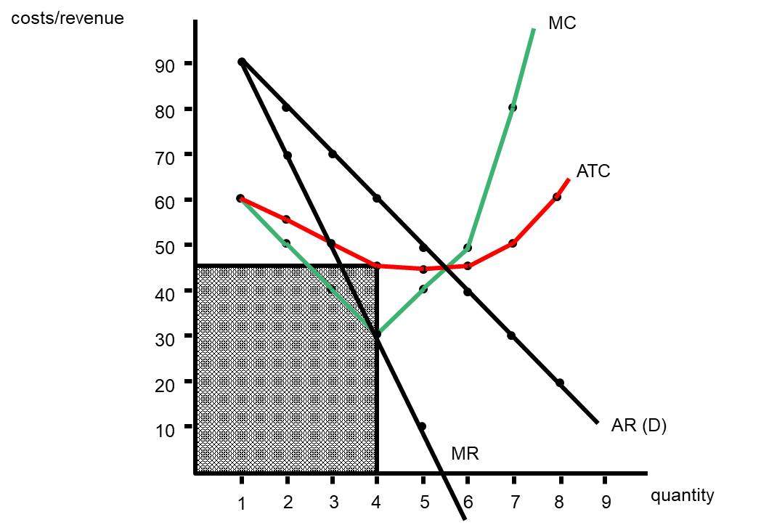
Step 9: Determine Total Cost of Monopolist
$45 x 4 = $180
Monopoly

Slide 17
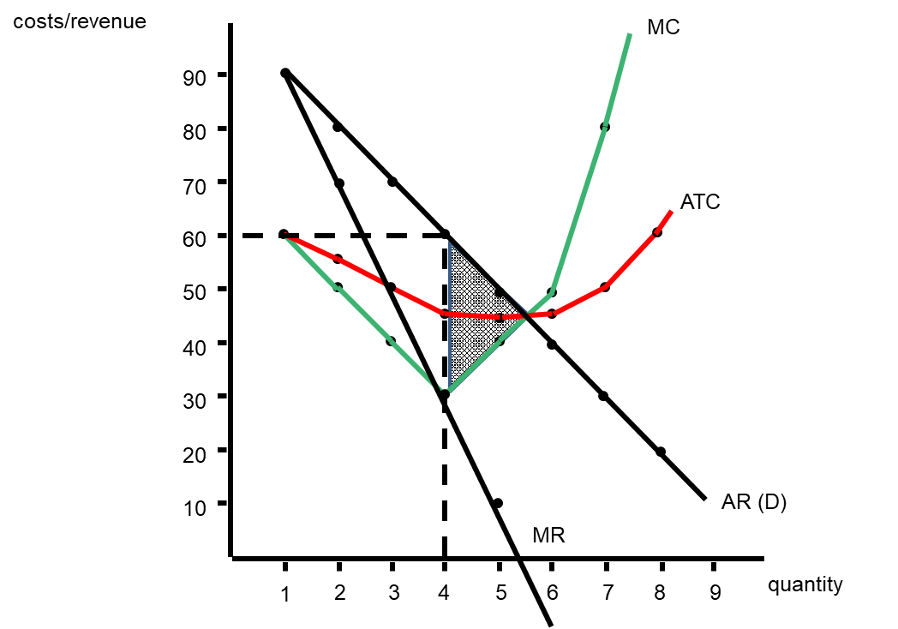
Step 10: Determine Deadweight Loss
Area of triangle between profit maximizing quantity for firm & socially optimal quantity
Monopoly

