Slide 1
Market Structures
Monopolistic Competition

Slide 2
Table of Contents
Slide 3 - 4 presents the quantity of output for a firm under monopolistic competition.
Slide 5 explains the firm's pricing decision.
Slide 6 illustrates total revenue.
Slide 7 illustrates the firm's total costs as the firm's ATC x quantity of product.
Slide 8 illustrates the area of total revenue above the firm's total costs. This area represents the firm's profit.
Slides 9 -18 review concepts
Monopolistic Competition

Slide 3
Step 1: Locate intersection of Marginal Revenue (MR) & Marginal Cost (MC)
Monopolistic Competition

Slide 4
Step 2: Draw a line through this intersection from Demand Curve (D) to X-Axis to find maximized quantity of output
Monopolistic Competition

Slide 5
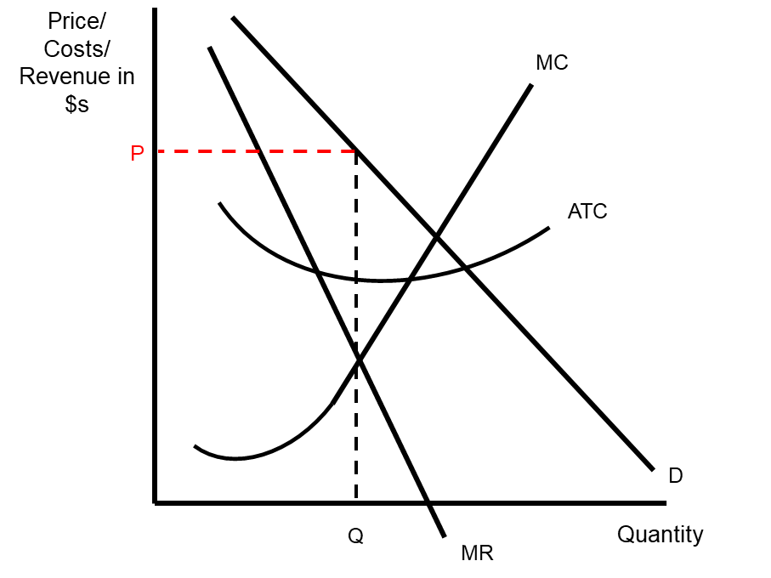
Step 3: Draw a line from Demand Curve (D) to Y-Axis to find price the firm will charge
Monopolistic Competition

Slide 6
Step 4: Total Revenue (TR) is quantity of product multiplied by price charged
Monopolistic Competition

Slide 7
Step 5: Total Cost (TC) is area BELOW Average Total Cost (ATC) curve at quantity produced
Monopolistic Competition

Slide 8
Step 6: Profit is area ABOVE Average Total Cost (ATC) curve at quantity produced
Monopolistic Competition

Slide 9
Review 1: What is the profit maximizing quantity produced?
O
Monopolistic Competition

Slide 10
Review 1: What is the profit maximizing quantity produced? Answer: J
O
Monopolistic Competition

Slide 11
Review 2: What is the price the firm will charge?
O
Monopolistic Competition

Slide 12
Review 2: What is price the firm will charge? Answer: E
O
Monopolistic Competition

Slide 13
Review 3: What is the area of the Total Revenue for the firm?
O
Monopolistic Competition

Slide 14
Review 3: What is the area of the Total Revenue for the firm? Answer: OEFJ
O
Monopolistic Competition

Slide 15
Review 4: What is the area of the Total Cost for the firm?
O
Monopolistic Competition

Slide 16
Review 4: What is the area of the Total Cost for the firm? Answer: OCHJ
O
Monopolistic Competition

Slide 17
Review 5: What is the area of profit/loss for the firm?
O
Monopolistic Competition

Slide 18
Review 5: What is the area of profit/loss for the firm? Answer: Profit is area CEFH
O
Monopolistic Competition

