Slide 1
Historical Inquiry with 75 Years of American Finance
Notes:
The lettering was done by Ruth Rose and the book was reproduced by the B.K. Elliott Company of Cleveland, Ohio and Pittsburg, PA most known for manufacturing drawing materials used by architects and engineers

Slide 2
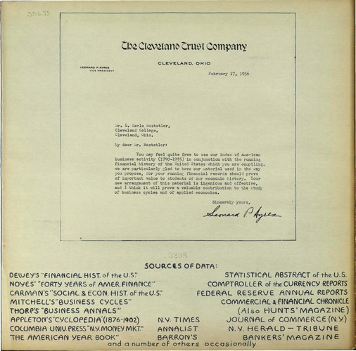
75 Years of American Finance
L. Merle Hostetler
Professor — Western Reserve University
Research Director — Federal Reserve Bank of Cleveland
View all 85 feet of the timeline online at
https://fraser.stlouisfed.org/75years/presentation_only.php
Sources
Notes:
Leonard P. Ayres collected stats of U.S. battle deaths in WWI and WWII and became Chief of Statistics Service. He wrote numerous books and earned his Ph.D. from Boston U. where he applied statistical methods to educational studies. He went on to work for the Cleveland Trust Company and edited the bank’s “Business Bulletin.”

Slide 3
75 Years of American Finance
This document is a graphic presentation of events from 1861-1935 done in 1936
The years 1936-1938 were added in 1939
The graphic is a detailed timeline
Notes:
The lettering was done by Ruth Rose and the book was reproduced by the B.K. Elliott Company of Cleveland, Ohio and Pittsburg, PA most known for manufacturing drawing materials used by architects and engineers

Slide 4
75 Years of American Finance
Divide students into 16 groups
Distribute handouts 1 and 2
Focus on handout 1 items 1- 16
Discuss your number in your group
Find your number on 75 Years page
Each group reports to the rest of the class
Notes:
Allow groups to discuss first their number then look at the other numbers. Check for understanding. If you have fewer than 16 groups combine numbers 12 and 13 and or numbers 15 and 16. Students will jigsaw the material and become experts on their particular numbers.

Slide 5
75 Years of American Finance
Notes:
Report out questions from groups

Slide 6
75 Years of American Finance
Notes:
Now go to the General Arrangement and Legend handout and find your number on the page. Answer any questions regarding what they are looking for on the page. Go through each number and have the groups report out that they 1) understand what they are looking for and 2) where they are to find it.

Slide 7
75 Years of American Finance

Slide 8
75 Years of American Finance
Notes:
Application of historical questioning skills- Look at handout 2 and read the questions keeping in mind the number in which your group is the expert. Will the information to answer the question likely come from your number? What will these questions help me understand about a particular year in U.S. history? Are there others I would like to ask?

Slide 9
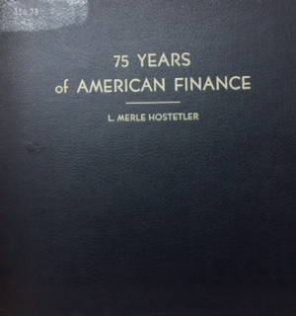
Historical Inquiry with 75 Years of American Finance
https://fraser.stlouisfed.org/75years/presentation_only.php
Notes:
Book is hyperlinked to the actual 75 Years of American Finance. Select a year to have them investigate. Perhaps begin with 1861. Ask each group to look at the historical inquiry questions under each heading- observe, reflect, question and see how the information in their number applies. Discuss among groups. Students would be required to write down best answers for the group from each heading. Report out/ share answers then ask them to all move on to the analyze section and with their group answer the question(s) selected.

Slide 10
75 Years of American Finance
Notes:
What do you see listed in 1933 that might be unknown to your students especially if you have not studied this time period yet? The acronyms of the alphabet soup are often confusing to students. Next, I will share with you one of the many activities that are included in our Great Depression Curriculum Unit. Our Great Depression Curriculum Unit is the Britannica of Great Depression Curriculum.

