Slide 1
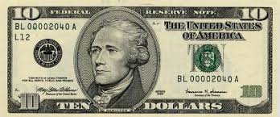
Hamilton’s National Bank
How do banks promote economic growth?
Notes:
Compelling question- How do banks promote economic growth?

Slide 2
Lesson Objectives
Students will-
Define banks, capital formation, capital resources, collateral, gross domestic product (GDP), loan, risk, risk-reward relationship and usury.
Explain the meaning of capital formation and its role in economic growth;
Assess the role of banks in capital formation;
Compare the views of Jefferson and Hamilton regarding banks.

Slide 3
Who was Alexander Hamilton?
Discuss-
Banks
Usury
Bubbles
What happened to people who could not pay their debts in the 1790s?
Notes:
Hamilton was the 1st secretary of the treasury among many other things. He was the “keeper of the books for the US government. See procedures for more details.

Slide 4
Building the Wealth of a Nation
  What does it take?
  Capital resources: Goods that are used over and over again to make another good or service.
  Capital formation: Making more capital resources (e.g., tools, machines etc.) for future production of goods and services. It provides an income stream and usually contributes to increases in the standard of living.
  How do we measure growth?
  Gross domestic product (GDP): The total market value, expressed in dollars, of all final goods and services produced in an economy in a given year.

Slide 5
Building the Wealth of a Nation
  Application
  If you are a stylist or barber what capital resources would you use?
  Is a haircut an example of a good or service?
  If you worked at a salon owned by someone else and want to open your own shop what would you need?
Notes:
Capital resources possible answers- scissors, clippers, combs, mirrors, blow dryers- note not shampoo. Haircut is a service. You would need your own capital resources- i.e. shop, chairs, scissors, sinks, clippers, etc.

Slide 6
Words to know and understand-
  Banks: Businesses that accept deposits and make loans.
  Savings: The accumulation of money set aside for future spending.
  Collateral: Property required by a lender and offered by a borrower as a guarantee of payment on a loan.
  Loan: A sum of money provided temporarily on the condition that the amount borrowed be repaid, usually with interest.
  Risk: The chance of loss.
  Risk-reward relationship: The direct relationship between the risk of a person not repaying a loan and the amount of interest that person must pay.

Slide 7
United States in the 1790s
Role play life in the 1790s
There will be 2 rounds

Slide 8
Role Play Round 1
1. Review your card
2. Determine if you are a borrower or lender
3. Savers/lenders are seeking high interest
4. Borrowers/spenders- low interest
5. Take handout 2 and record any transaction you are able to make.
6. Debrief round 1
7. *Corn sold for $.56-$1.00 per bushel in 1795
Notes:
Pass out cards to students and transaction sheets to each student. Review objectives for borrowers and lenders. Note they must figure out who potential lenders/borrowers are. Do not color code the cards. Allow 3-5 minutes for transactions to take place. Call time and debrief. Few students have likely made a transaction. Person with corn must find a buyer/ not a liquid asset.

Slide 9
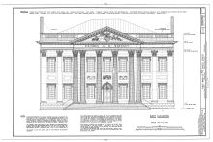
Role Play Round 2
Select 3 lenders & 3 borrowers to become bankers
Exchange their cards for loan/deposit forms
Declare the bank is now open let round 2 begin!
Notes:
Explain that now there is a bank in town. Collect the cards from 3 lenders and 3 borrowers. They now have become bankers. Line the bankers accepting deposits up on one side and those making loans on the other. Declare the bank open. Allow the bank to remain open for 5-10 minutes depending on class size so that any person desiring to make a transaction may complete it.

Slide 10
Compare Round 1 and 2
From the borrowers point of view-
Which round had more transactions?
What were borrowers going to buy with the money they borrowed?
How would this impact capital formation?
Which round had more potential capital formation?
Notes:
Remember capital goods are those things that can be used over and over again to create goods or services and generate revenue for the owner and wealth for the nation.

Slide 11
Compare Round 1 and 2
From the saver/lenders point of view-
Which round had more transactions?
What were savers/lenders going to do with their earnings?
What impact would savings have on capital formation?
Notes:
Savers were looking to earn interest on their savings and have more money to spend in the future. Savings is necessary to provide funds for those who want to borrow to allow capital formation to take place.

Slide 12
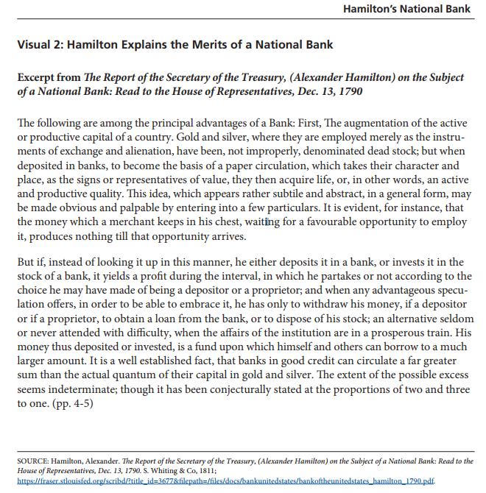
Notes:
Discussion questions are on the next slide.

Slide 13
Understanding Hamilton
What did he mean by saying gold and silver were dead stock, but when deposited in banks acquire life?
How would depositing in a bank or investing in stock of a bank yield profit?
How do borrowers benefit from a bank?
Notes:
1.Gold or silver sitting in a chest is gathering dust not interest. By using gold and silver to back paper currency it creates money to circulate and promote more growth. 2. The investor earns interest. 3. Borrowers benefit by having access to get a loan.

Slide 14
Take a Stand
Distribute copies of both Hamilton’s list of advantages of a national bank and Jefferson’s opposition either electronically or paper.
Give 10 minutes reading time
Designate one side of the room as Hamilton and the other as Jefferson and have students move to the side that they most agree with.
Discuss
Notes:
Have all students who have formed an opinion to take a stand on either Hamilton’s or Jefferson’s side of the room. If any students are undecided, have students from each side explain why they choice the side they are on and try and persuade those in the middle. If some students remain unmoved have them explain why they are not compelled by the evidence given by either side. Use discussion questions on the next slide to summarize.

Slide 15
Discussion Questions
What were Jefferson’s main concerns about creating a national bank?
What were Hamilton’s main reasons to support the creation of a national bank?
Why was it important to put branch banks throughout the United States?
Notes:
Not constitutional, benefit businesses more than farmers, national banks would have an unfair advantage over state banks
2. Efficient way to collect taxes and pay the bills of the national government, common currency would facilitate trade and capital formation creating wealth for the citizens, Government could borrow in times of emergencies, allows for public debt to pay for the common defense
3. Branches throughout would ease the tax collection and bill paying process, no region would feel left out

Slide 16
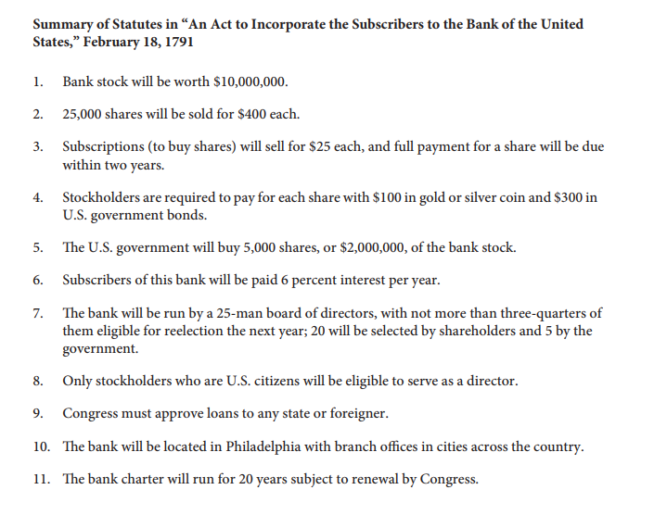
Notes:
Look at a summary of the law and see if some of your discussion points were addressed. What are safeguards in the list above? (Sunset on charter after 20 years, Congressional approval of loans to states or foreigners, citizenship required to be a director, limits on terms for directors, amount of interest to be paid stated up front)

Slide 17
How do banks promote economic growth?
Review vocabulary-
What is capital formation and why does it matter?
Why do people save?
How do banks reward saving and facilitate borrowing?
What is the risk-reward relationship?
How does having collateral affect the amount of interest a borrower is charged?
Notes:
To bring closure and review

Slide 18
1790s Banking in the US
Only 4 cities in North America had banks
Philadelphia
New York
Boston
Baltimore
What advantages did Hamilton see in creating a national bank?
Why did Jefferson oppose the national bank?
Notes:
To put banking in context note there were only 4 banks. Hamilton’s advantages-Common currency, branches in major cities across the US, more capital to lend, the government could borrow from the bank in emergencies, bank would hold government monies, collect taxes. Jefferson’s opposition- competition for state banks, promote growth of cities rather than farms, he did not trust banks, strict view of Constitution.

