Slide 1

Evaluating and Contextualizing Authority With Data
Exercise 1
Let’s practice using the Evaluation Rubric to score and evaluate four information sources presented in the following slides.
Each information source references the same dataset available via FRED®. How can we start to assess the credibility and authority of different information sources when they all use the same data to make their point?
We’ll find out together!
© 2023, Federal Reserve Bank of St. Louis. Permission is granted to reprint or photocopy this presentation in its entirety for educational purposes provided the user credits the Federal Reserve Bank of St. Louis, www.stlouisfed.org/education.

Slide 2
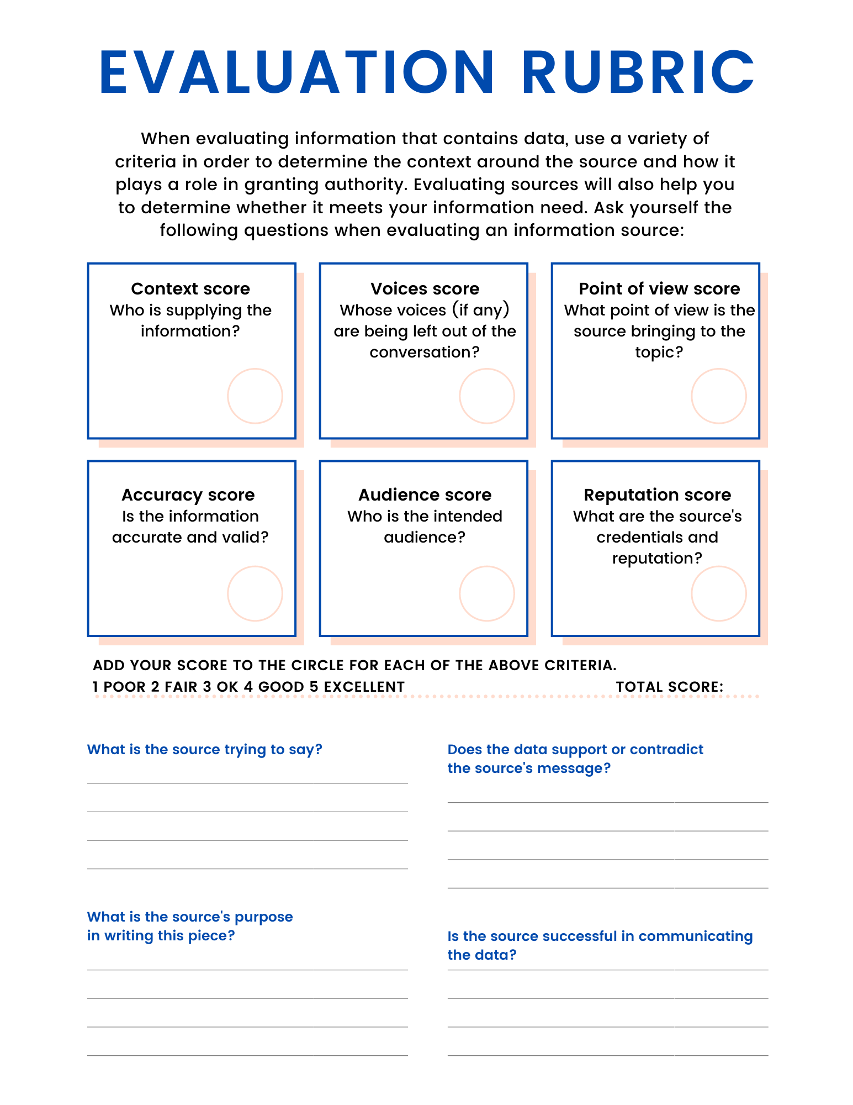

© 2023, Federal Reserve Bank of St. Louis. Permission is granted to reprint or photocopy this presentation in its entirety for educational purposes provided the user credits the Federal Reserve Bank of St. Louis, www.stlouisfed.org/education.

Slide 3
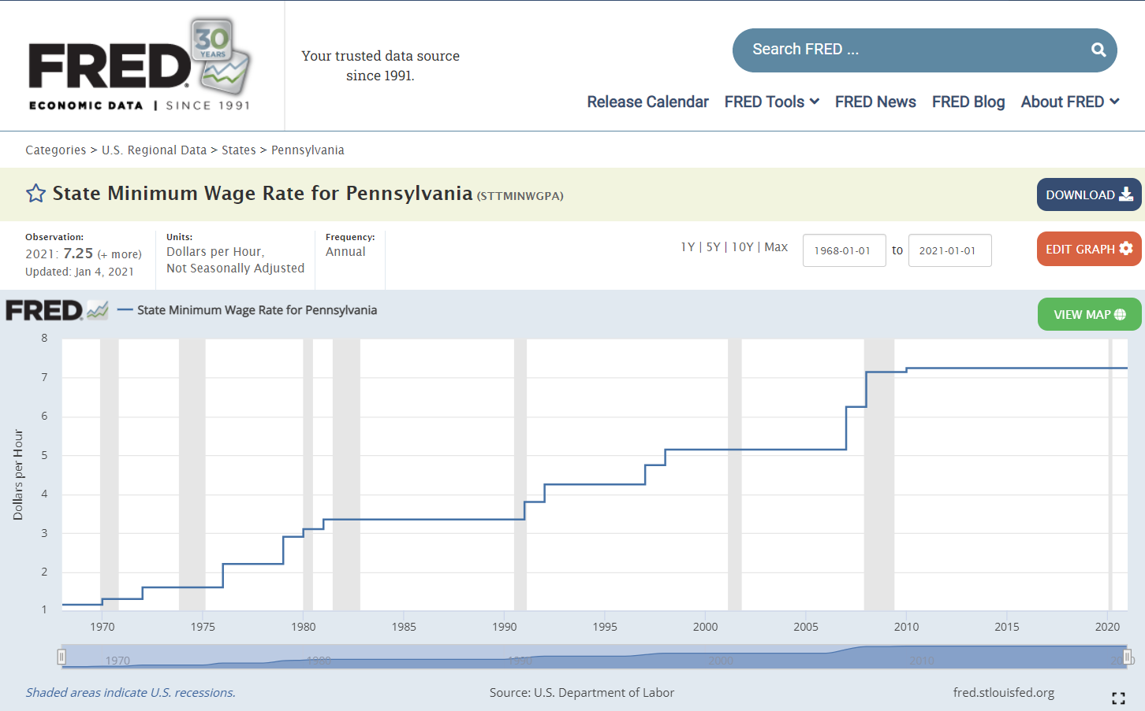
The original dataset
State Minimum Wage Rate for Pennsylvania: https://fred.stlouisfed.org/series/STTMINWGPA
© 2023, Federal Reserve Bank of St. Louis. Permission is granted to reprint or photocopy this presentation in its entirety for educational purposes provided the user credits the Federal Reserve Bank of St. Louis, www.stlouisfed.org/education.

Slide 4
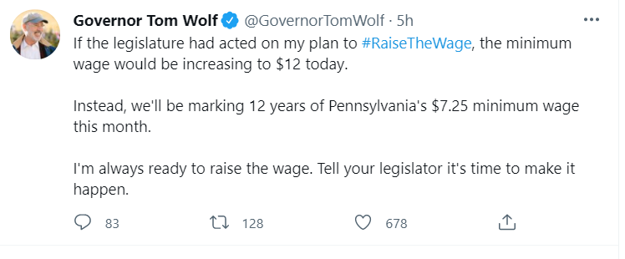
Example 1
Tweet: https://twitter.com/GovernorTomWolf/status/1410568872411996165
© 2023, Federal Reserve Bank of St. Louis. Permission is granted to reprint or photocopy this presentation in its entirety for educational purposes provided the user credits the Federal Reserve Bank of St. Louis, www.stlouisfed.org/education.

Slide 5
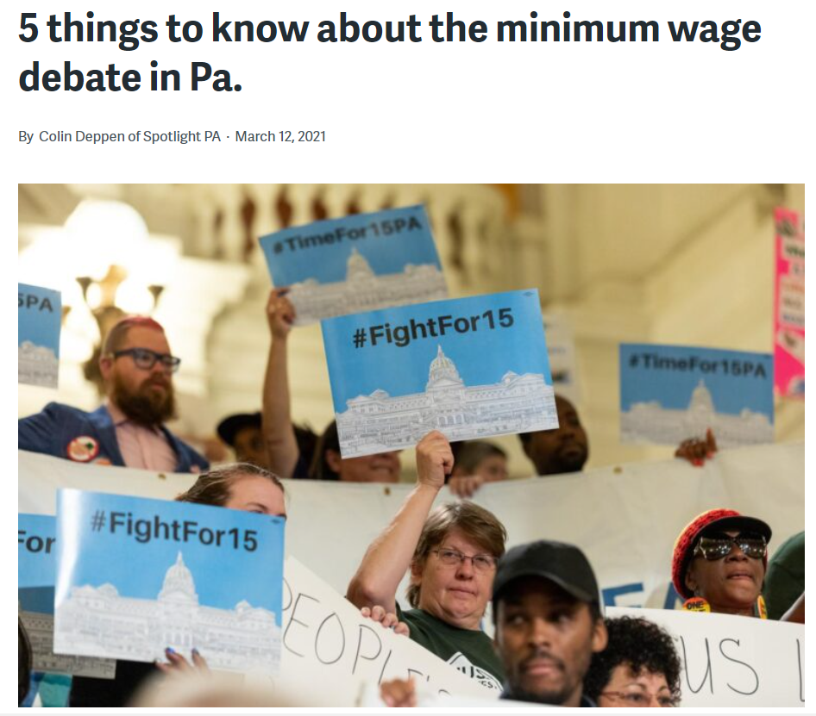
Example 2
NPR article: https://whyy.org/articles/5-things-to-know-about-the-minimum-wage-debate-in-pa/
© 2023, Federal Reserve Bank of St. Louis. Permission is granted to reprint or photocopy this presentation in its entirety for educational purposes provided the user credits the Federal Reserve Bank of St. Louis, www.stlouisfed.org/education.

Slide 6
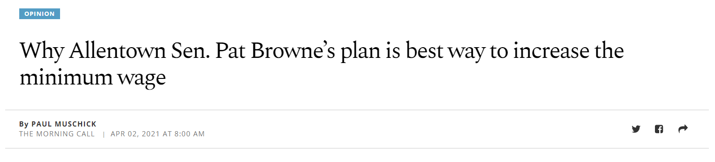
Example 3
Morning Call opinion piece: https://www.mcall.com/opinion/mc-opi-pa-minimum-wage-increase-pat-browne-muschick-20210402-4zfoczdjpne5hei7bgouohqgle-story.html
© 2023, Federal Reserve Bank of St. Louis. Permission is granted to reprint or photocopy this presentation in its entirety for educational purposes provided the user credits the Federal Reserve Bank of St. Louis, www.stlouisfed.org/education.

Slide 7
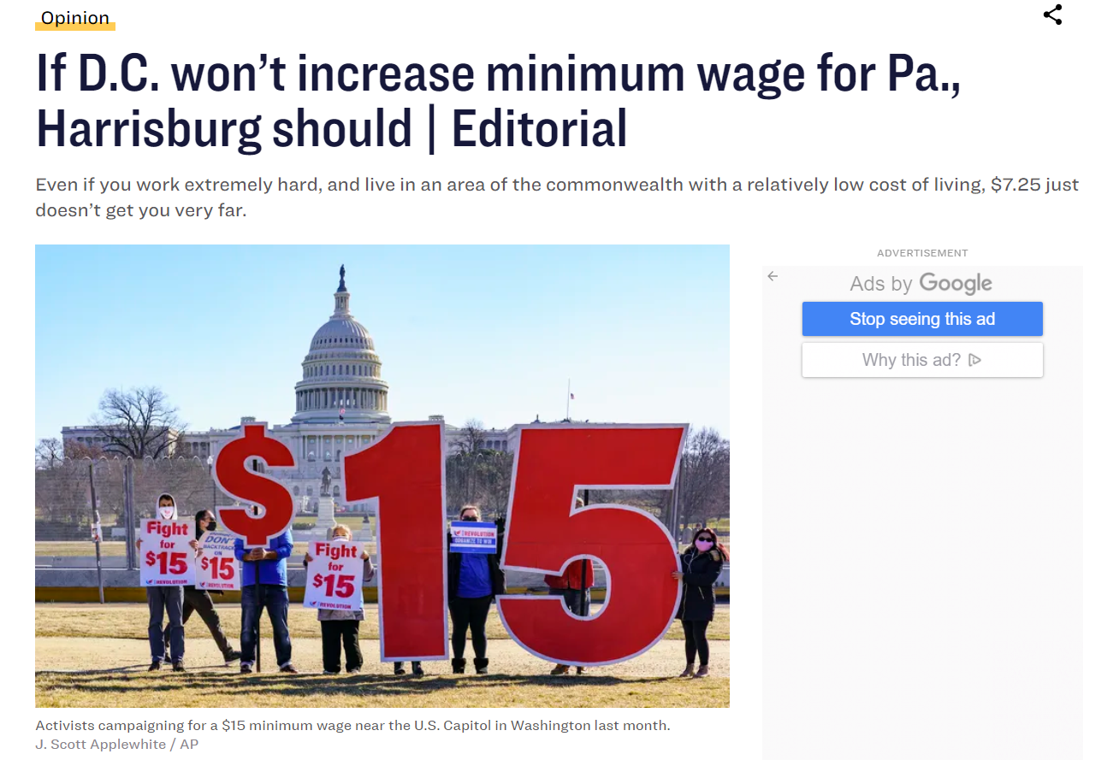
Example 4
Philadelphia Inquirer: https://www.inquirer.com/opinion/editorials/minimum-wage-pennsylvania-2021-republicans-philadelphia-20210303.html
© 2023, Federal Reserve Bank of St. Louis. Permission is granted to reprint or photocopy this presentation in its entirety for educational purposes provided the user credits the Federal Reserve Bank of St. Louis, www.stlouisfed.org/education.

Slide 8
Evaluating and Contextualizing Authority With Data
Exercise 2
Now try the same exercise on your own (or working in a group).
Using the Evaluation Rubric, try and evaluate the authority of four more information sources utilizing the same dataset.
© 2023, Federal Reserve Bank of St. Louis. Permission is granted to reprint or photocopy this presentation in its entirety for educational purposes provided the user credits the Federal Reserve Bank of St. Louis, www.stlouisfed.org/education.

Slide 9
Activity Instructions (Exercise 2)
Work through the following steps to learn how to evaluate the authority of information sources that contain data. You may work alone or with a group. Take some time to first review the four information sources, examples A-D, used in this activity. Then use the Evaluation Rubric (Handout 1) to help you record your evaluation and complete the activity. One member from each group will present your final evaluation scores and reasoning to the class.
Take a look at the four provided sources.
While they are different media types, each source is referring to the same dataset available through FRED®.
In this activity we’re looking at Total Nonfarm Employment Payroll data & Unemployment Rate (Seasonally Adjusted).
Use the Evaluation Rubric to score each source in the six criteria: Context, Voices, Point of View, Accuracy, Audience, and Reputation.
If you finish early, use the additional four questions at the bottom of the Handout 1 to help you evaluate the source even further.
Add up your total score for each source.
Present your final scores and a brief summary of how you came up with them to the class.
© 2023, Federal Reserve Bank of St. Louis. Permission is granted to reprint or photocopy this presentation in its entirety for educational purposes provided the user credits the Federal Reserve Bank of St. Louis, www.stlouisfed.org/education.

Slide 10
Evaluating and Contextualizing Authority with Data
Information Sources for Exercise 2
The original FRED® data:
  Total Nonfarm Private Payroll Employment: https://fred.stlouisfed.org/series/NPPTTL Unemployment Rate (Seasonally Adjusted): https://fred.stlouisfed.org/series/UNRATE
Information sources to evaluate:
  Tweet: https://twitter.com/KEBroady/status/1400820960484339719
  Bureau of Labor Statistics Economic News Release−Employment Situation Summary (May 2021): https://www.bls.gov/news.release/empsit.nr0.htm
  New York Times article: https://www.nytimes.com/2021/06/04/business/economy/jobs-report-may-2021.html
  Tweet: https://twitter.com/AZGOP/status/1400916560697458690
© 2023, Federal Reserve Bank of St. Louis. Permission is granted to reprint or photocopy this presentation in its entirety for educational purposes provided the user credits the Federal Reserve Bank of St. Louis, www.stlouisfed.org/education.

Slide 11
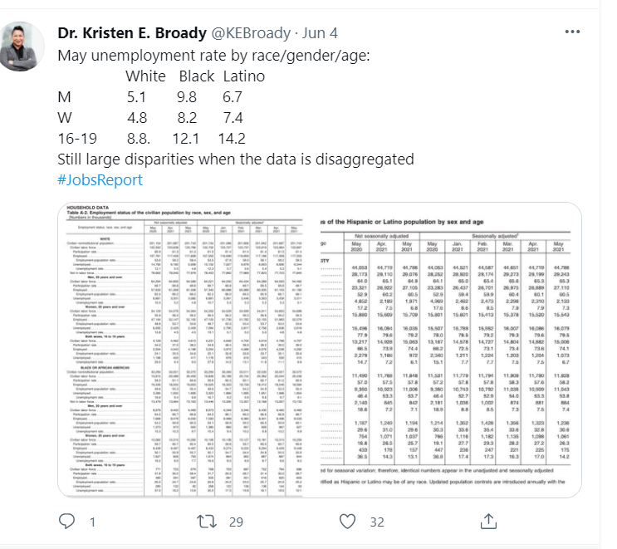
Example A
Tweet:
https://twitter.com/KEBroady/status/1400820960484339719
© 2023, Federal Reserve Bank of St. Louis. Permission is granted to reprint or photocopy this presentation in its entirety for educational purposes provided the user credits the Federal Reserve Bank of St. Louis, www.stlouisfed.org/education.

Slide 12
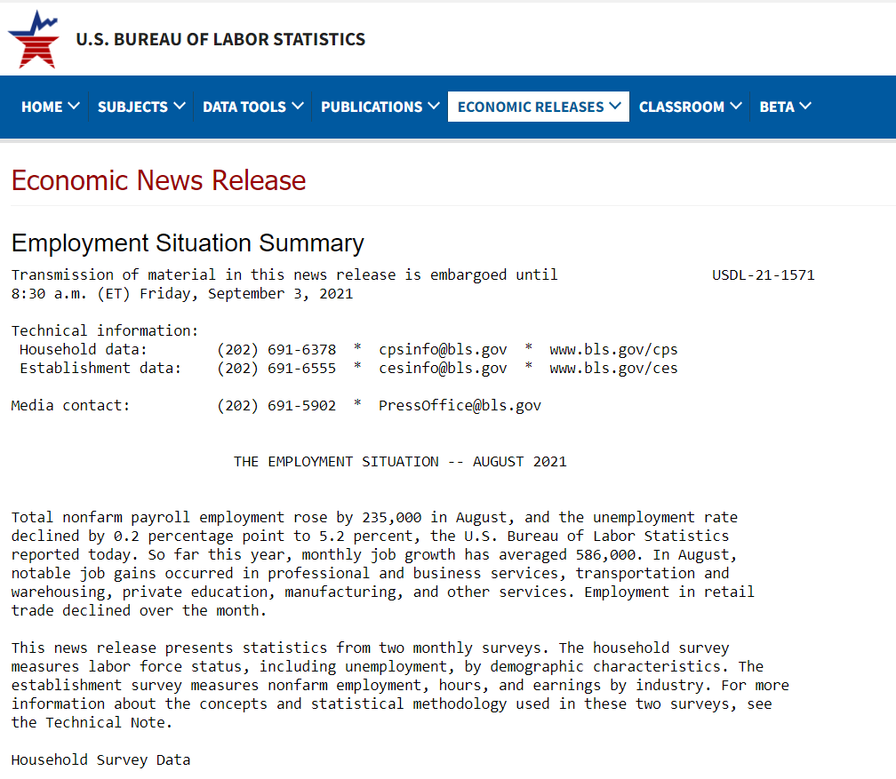
Example B
Bureau of Labor Statistics Economic News Release - Employment Situation Summary (May 2021)
https://www.bls.gov/news.release/empsit.nr0.htm
© 2023, Federal Reserve Bank of St. Louis. Permission is granted to reprint or photocopy this presentation in its entirety for educational purposes provided the user credits the Federal Reserve Bank of St. Louis, www.stlouisfed.org/education.

Slide 13
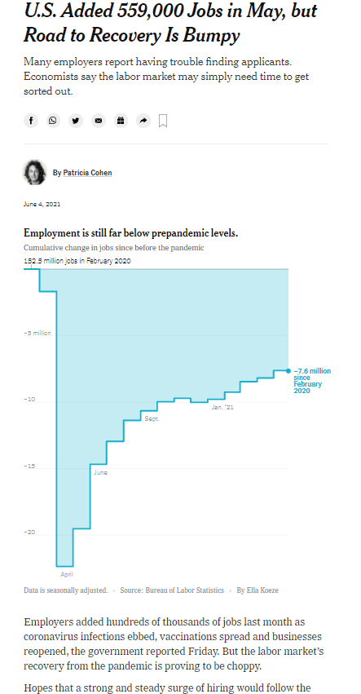
Example C
New York Times article: https://www.nytimes.com/2021/06/04/business/economy/jobs-report-may-2021.html
© 2023, Federal Reserve Bank of St. Louis. Permission is granted to reprint or photocopy this presentation in its entirety for educational purposes provided the user credits the Federal Reserve Bank of St. Louis, www.stlouisfed.org/education.

Slide 14
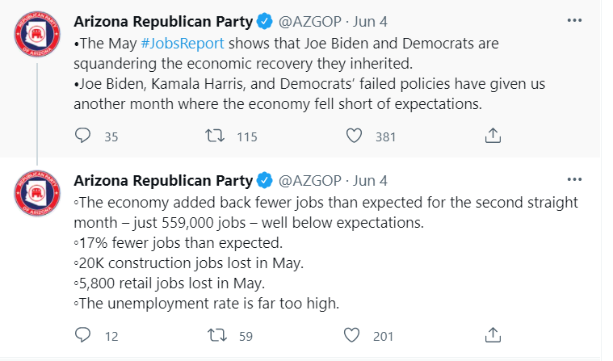
Example D
Tweet:
https://twitter.com/AZGOP/status/1400916560697458690
© 2023, Federal Reserve Bank of St. Louis. Permission is granted to reprint or photocopy this presentation in its entirety for educational purposes provided the user credits the Federal Reserve Bank of St. Louis, www.stlouisfed.org/education.

