Slide 1
Market Structures
Cost Curves
Perfect Competition

Slide 2
Table of Contents
Cost Curve Collection
Slides 3 - 18 could be considered a set with two separate tasks.
Slide 3: Cost Curve Schedule
Slides 4 - 10: Total & Fixed Cost Curves
Slides 11 - 18: Marginal & Average Cost Curves
The slide 3 table could be printed so that students would have it handy while viewing the graphs. For best results, print the table in "landscape" orientation.
Perfect Competition

Slide 3
General Cost Curve Schedule
Perfect Competition

Slide 4
Step 1: Plot Total Cost
Perfect Competition

Slide 5
Total Cost
Perfect Competition

Slide 6
Step 2: Plot Fixed Cost
Perfect Competition

Slide 7
Fixed Cost
Perfect Competition

Slide 8
Step 3 Plot Variable Cost
Perfect Competition

Slide 9
Variable Cost
Perfect Competition

Slide 10
NOTE: The distance between Variable Cost & Total Cost Curves is ALWAYS the Fixed Cost
Perfect Competition

Slide 11
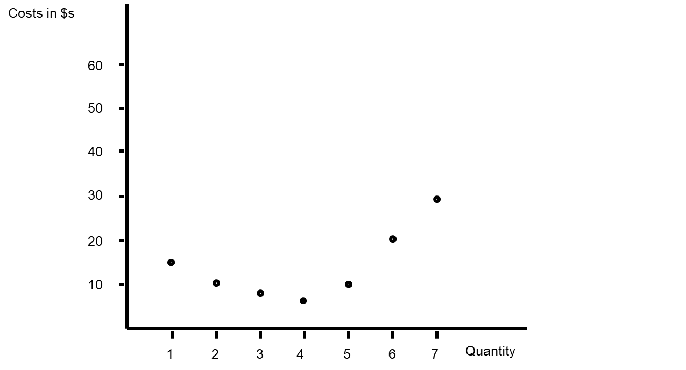
Step 1: Plot Marginal Cost
Perfect Competition

Slide 12
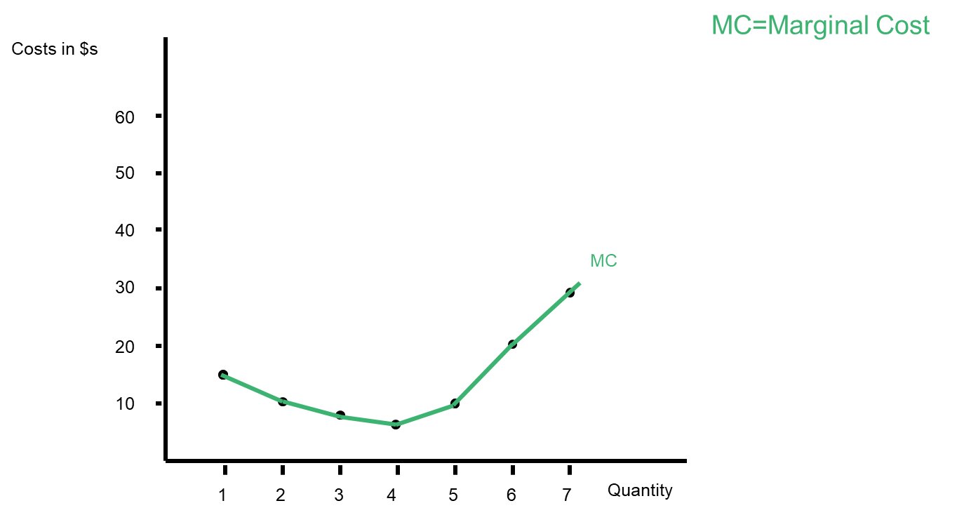
Marginal Cost
Perfect Competition

Slide 13
Step 2: Plot Average Fixed Cost
Perfect Competition

Slide 14
Average Fixed Cost
Perfect Competition

Slide 15
Step 3: Plot Average Variable Cost
Perfect Competition

Slide 16
Average Variable Cost
Perfect Competition

Slide 17
Step 4: Plot Average Total Cost
Perfect Competition

Slide 18
Average Total Cost
Perfect Competition

