Slide 1
Data Literacy:
The Composition Effect
© 2020, Federal Reserve Bank of St. Louis. Permission is granted to reprint or photocopy this presentation in its entirety for educational purposes provided the user credits the Federal Reserve Bank of St. Louis, www.stlouisfed.org/education.

Slide 2
Visual 1: Who is counted as unemployed?
Who does the Bureau of Labor Statistics (BLS) classify as unemployed?
Does this include someone who does not have a job?
Does this include someone who has actively looked for work in the prior four weeks?
Does this include someone who is currently available for work?
Does this include someone waiting to be recalled to a job from which they had been temporarily laid off?
Does this include someone receiving benefits from the Unemployment Insurance (UI) program?
© 2020, Federal Reserve Bank of St. Louis. Permission is granted to reprint or photocopy this presentation in its entirety for educational purposes provided the user credits the Federal Reserve Bank of St. Louis, www.stlouisfed.org/education.

Slide 3
Visual 2: Definition of an unemployed person
A person is considered unemployed if she or he
is 16 years of age or older and does not have a job;
has actively looked for work in the prior four weeks; and
is currently available for work.
Also, someone waiting to be recalled to a job from which they had been temporarily laid off is considered unemployed.
Note that receiving benefits from the Unemployment Insurance (UI) program has no bearing on whether a person is classified as unemployed.
© 2020, Federal Reserve Bank of St. Louis. Permission is granted to reprint or photocopy this presentation in its entirety for educational purposes provided the user credits the Federal Reserve Bank of St. Louis, www.stlouisfed.org/education.

Slide 4
Visual 3: Definition of the unemployment rate
It is the number of persons unemployed as a percent of the labor force.
Unemployment rate = Number of persons unemployed / Labor force
Labor force = Number of persons employed + Number of persons unemployed
© 2020, Federal Reserve Bank of St. Louis. Permission is granted to reprint or photocopy this presentation in its entirety for educational purposes provided the user credits the Federal Reserve Bank of St. Louis, www.stlouisfed.org/education.

Slide 5
Visual 4: Labor force demographic characteristics available from the Current Population Survey (CPS)
Age Certifications and licenses Disability Educational attainment Families and marital status Foreign-born workers Older workers | Race and Hispanic ethnicity School enrollment Veterans Volunteering Women Youth
© 2020, Federal Reserve Bank of St. Louis. Permission is granted to reprint or photocopy this presentation in its entirety for educational purposes provided the user credits the Federal Reserve Bank of St. Louis, www.stlouisfed.org/education.

Slide 6
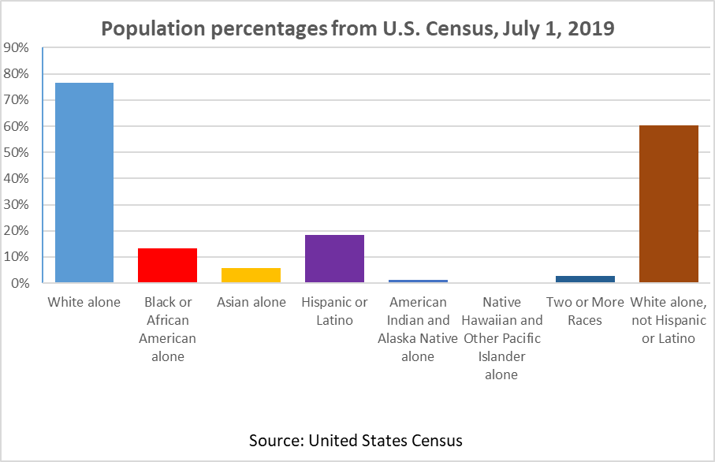
Visual 5: Population percentages
A. Population percentages from U.S. Census
© 2020, Federal Reserve Bank of St. Louis. Permission is granted to reprint or photocopy this presentation in its entirety for educational purposes provided the user credits the Federal Reserve Bank of St. Louis, www.stlouisfed.org/education.

Slide 7
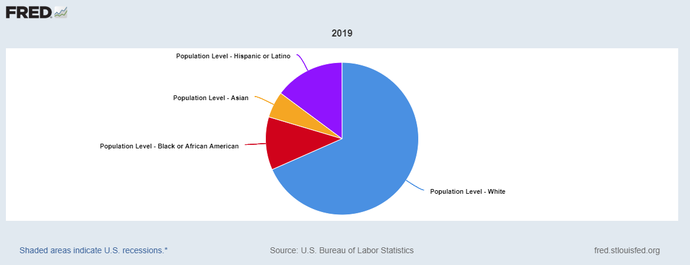
Visual 5: Population percentages
B. Labor force percentages from the Current Population Survey (CPS)
SOURCE: U.S. Bureau of Labor Statistics via FRED®, Federal Reserve Bank of St. Louis
© 2020, Federal Reserve Bank of St. Louis. Permission is granted to reprint or photocopy this presentation in its entirety for educational purposes provided the user credits the Federal Reserve Bank of St. Louis, www.stlouisfed.org/education.

