Slide 1
Name or nickname of building
template
Short summary of the building and its history. In about 100 words (5-8 sentences), explain:
why the building was built in your community
when it was built
why it was built – for what purpose
what it’s used for today
anything else that’s important to understand the building and its history
1-3 sources with citations or links
map (optional)
picture

Slide 2
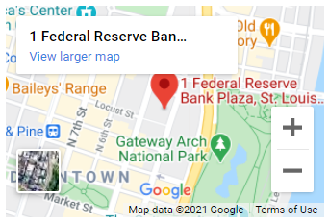
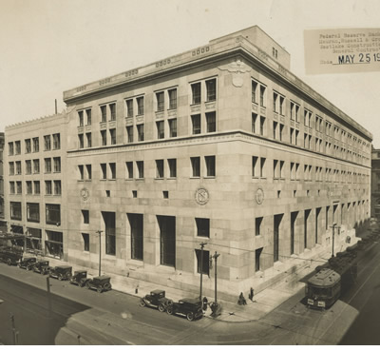
Federal Reserve Bank of St. Louis
sample
The building at 1 Federal Reserve Bank Plaza was built 1924 and opened for business in June 1925.
Before this building was built, the Federal Reserve Bank of St.
Louis had offices in the National Bank of Commerce Building down the street. The current building is the third location of the St. Louis Fed. All the Federal Reserve Banks began operation in November of 1914. St. Louis was a major banking center at the time.
It was built because the Fed needed a secure building for cash operations and its other business as the “bankers’ bank” and a large enough building to house its growing staff.
The building is still used today for the same purpose.
Sources:
https://www.stlouisfed.org/annual-report/2013/symbol
https://fraser.stlouisfed.org/timeline/st-louis-fed-centennial#9
https://www.stlouisfed.org/about-us

Slide 3
Analysis Questions
1. Is the purpose the building was created for still needed? If the purpose is still needed but not conducted in this building, where is it done and why?
2. What does the building say about your town/community at the time it was built? What was the population? What were the main industries?
3. How has your town/community changed since the building was built?
4. Is there controversy about this building or was there in the past? Were there members of the community that supported or opposed this building?

