Slide 1
Beyond the Bet: Sports Betting
©2025, Nebraska Council on Economic Education, with funding from the Nebraska Commission on Problem Gambling. Developed in partnership with the Federal Reserve Bank of St. Louis. Permission is granted to reprint or photocopy this lesson in its entirety for educational purposes, provided the user credits the Nebraska Council on Economic Education.

Slide 2
“Craziest Endings in Sports History” Video
https://youtu.be/OFfIG3LE2CI?si=DusSC_gRO67aOpuM

Slide 3
Discussion
“Craziest Endings in Sports History”
Why do people enjoy watching sports?
What emotions did you feel while watching the video?

Slide 4
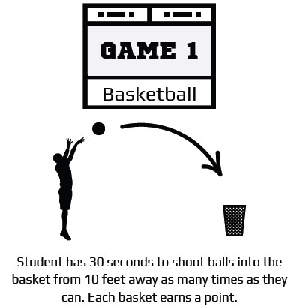
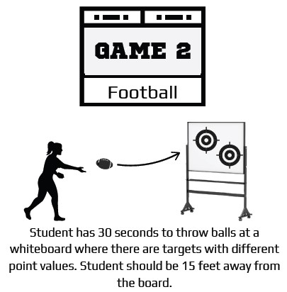
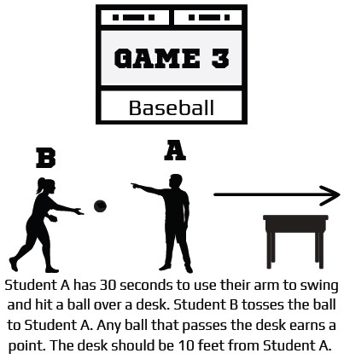
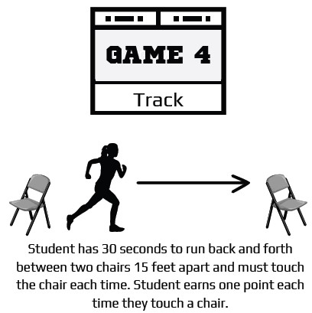
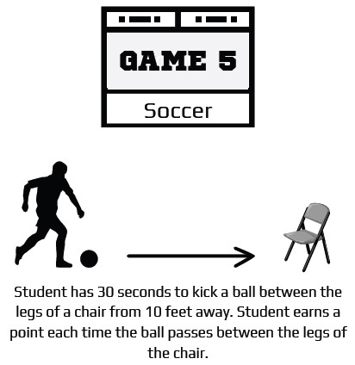

Slide 5
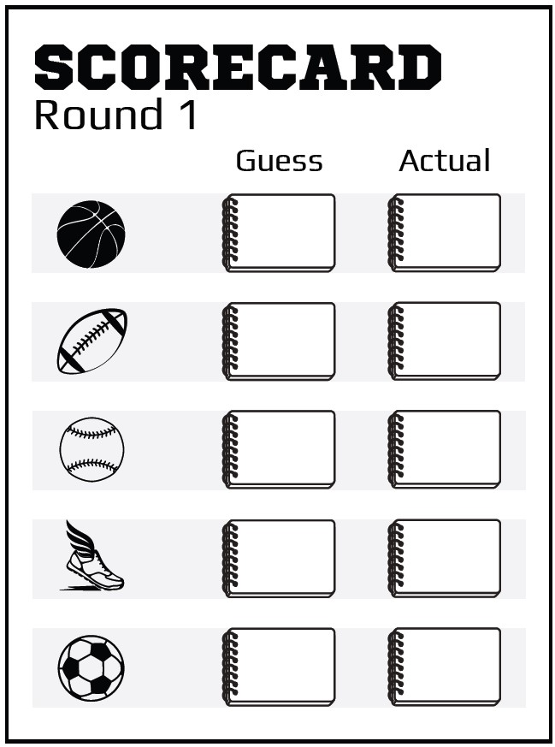
Fill out your guess for each game played.
Basketball: Number of baskets made
Football: Number of times targets are hit
Baseball: Number of balls hit over the desk
Track: Number of times the athlete touches each chair
Soccer: Number of times the ball goes between the chair legs
How did you make your predictions?

Slide 6
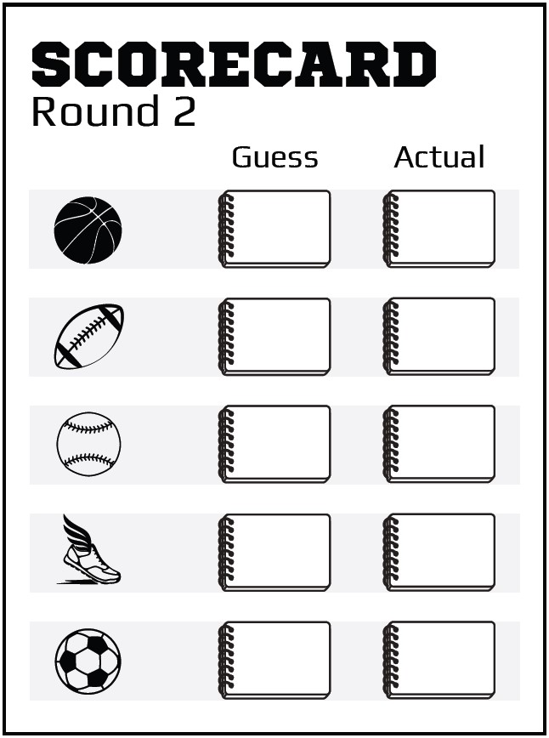
Fill out your guess for each game played.
Basketball: Number of baskets made
Football: Number of times targets are hit
Baseball: Number of balls hit over the desk
Track: Number of times the athlete touches each chair
Soccer: Number of times the ball goes between the chair legs
How did you make your predictions?

Slide 7
What is gambling?

Slide 8
Definitions
Gambling: Risking money on the chance of winning more money.
Problem gambling: When gambling negatively interferes with everyday life; that is, gambling more than you have; experiencing feelings of remorse, compulsivity, or being out of control; or when others question your gambling.
Sports gambling / sports betting: The activity of predicting sports results and placing a wager on the outcome.
Do you think what we did today was gambling?
What are some types of sports gambling that you see in your daily life?

Slide 9
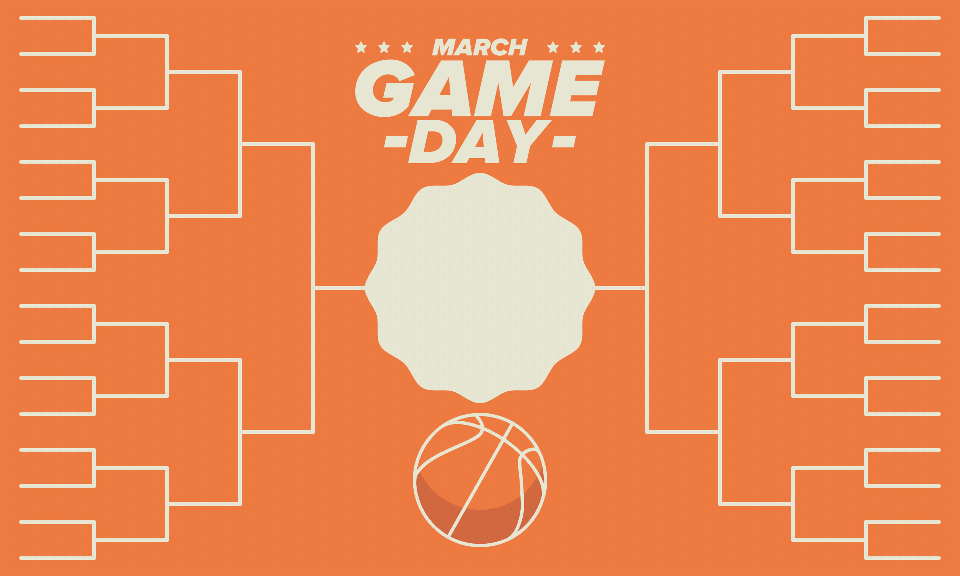
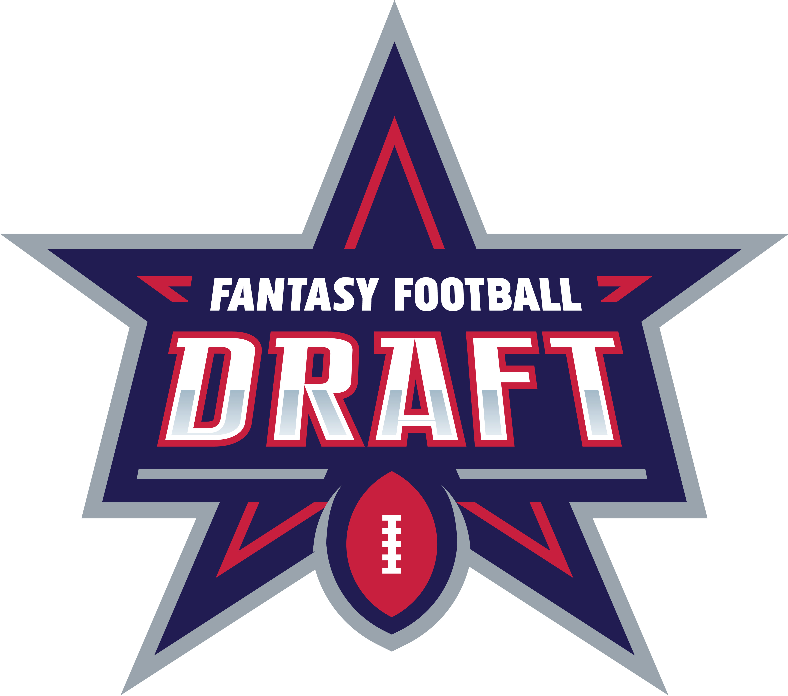
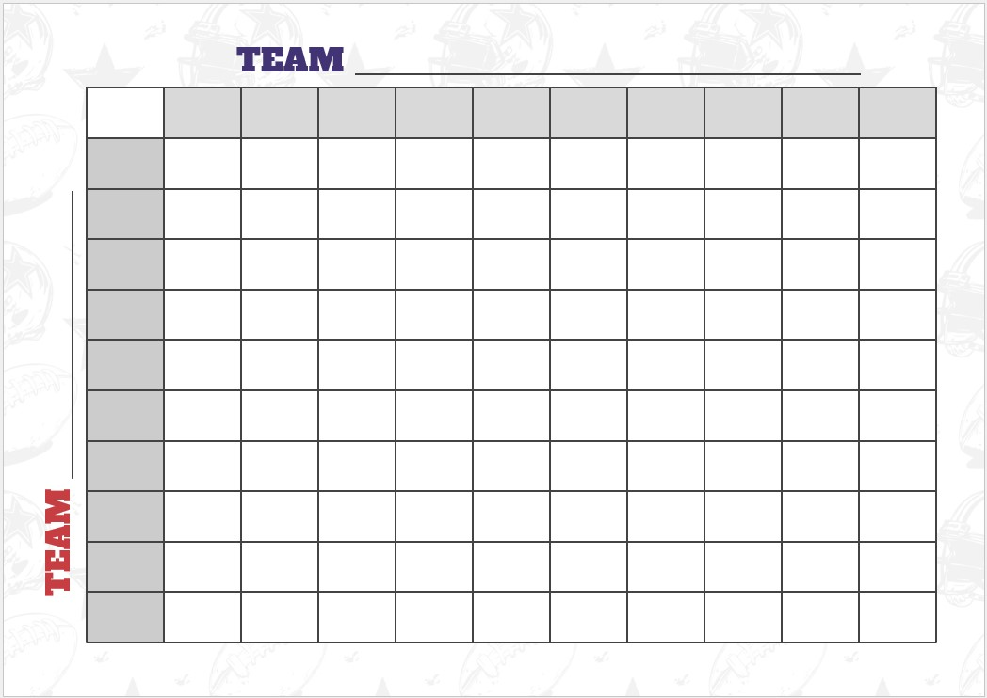
Sports Betting Examples

Slide 10
An incentive in economics is a factor, often a monetary reward or advantage, that encourages people to do something.
What was your incentive to participate today?
Who won? Raise your hand.
Who lost? Raise your hand.
Today you did not have to pay anything to participate, but suppose you had to pay $10 to make your guesses; how many people would have lost money?

Slide 11
Chad’s Story
Over the last few years, Chad has lost hundreds of thousands of dollars. At his worst, he gambled $50,000 in just 24 hours. Chad explains the negative impacts of sports betting on his life in the Legalized Sports Betting documentary by Real Sports:
“Before, you just placed a bet on the game before it started. Where now, you pick up your smartphone and you can bet mid game. I feel that the majority [of people] who are sports fans are now betting on sports. When I think about what it’s done to me, I wouldn’t want anybody to have to experience that.”
Chad’s compulsive gambling has put a huge strain on his marriage. His wife eventually asked for a divorce. According to Chad: “She said, ‘This has gone on too long. I cannot live with a liar. I cannot live with a manipulator. I cannot live with someone who puts themselves before a family,’ and that’s what I’ve done.”
He explains how he became gripped by sports betting: “It’s needing that adrenaline. It’s needing the action where you fill your boredom time with it. You fill your insecurities with it. It’s just like any addiction. It seems harmless and it’s fun until it progresses.”
The revenue from sports gambling in 2023 was $11 billion. (American Gaming Association)
Eighteen percent of Americans say they have lost money sports betting that was meant for other financial obligations. (Siena College Research Institute)
Betting with friends and family is the most commonly reported form of sports gambling in the U.S. (Pew Research)
The first gambling activity selected by problem gamblers is sports betting. (Nebraska Problem Gambling Assistance Program 2022 Annual Report)

Slide 12
Steven’s Story
Steven started betting on fantasy sports in 2007 with casual games against friends. However, by 2019 he had become addicted to sports betting. He describes how it nearly ruined his life:
“It was all very accessible from my phone. I started doing it compulsively. I would win $5,000 and say, ‘Now I know what I am doing.’ So then I would bet bigger and bigger. I would lose big and start chasing to get it back. It was like two people in my brain. Now I realize it was the addiction trying to fight against whoever I really am. I’d stop. Then I would say to myself, ‘I have to get this money back. I have to get back to zero before my wife finds out and my family finds out.’”
At first, Steven found it easy to hide his compulsive behavior. His wife Kelly had no idea what he was doing on his phone. However, everything changed when she read an email about his account from a casino site. He described that moment as “a relief.” It meant he could stop lying, admit he had problems, and commit to counseling. He has since started a podcast that helps other gambling addicts turn their lives around.
Scott’s Story
“I was putting $250 down on games I knew nothing about. Betting on what the teams had done the previous nights. I got down, needed the money back, went at it again. Stupid. Lost more. Tried to hide it from my wife. She found out when I didn’t have a good answer for her card getting declined at the checkout in the mall where she was buying the kids clothes. She had three cards declined. I was busted. We missed a tuition payment and a car payment.”
Samantha’s Story
“My 23-year-old, grown-up child came home in his car with all of his things packed in unannounced. His Dad and I were like, ‘What’s wrong?’ He said he and his roommate got into it and he couldn’t stay there anymore. We get his mail. We could see the amount of debt piling up. Three months later, he’s in jail for destroying property in a drunken stupor at a bar after his bet didn’t hit. Yes, I need help trying to navigate this. He’s in denial, we’re in distress.”

Slide 13
Questions
Why do you think sports betting is so popular?
Why do you think sports betting can be so problematic?
What makes winning a sports bet so difficult?
Using cost/benefit analysis, do you think the costs outweigh the benefits when it comes to sports betting? Explain.
How can sports betting impact family and close friends?

Slide 14
Incentives Matter
If your teacher offered you $500 to get an “F” in class, would you take it? Would that incentive be enough to change your behavior?
What if you are a student who is expected to get huge scholarships in college next year? Would failing a class (which would forfeit those scholarships) be worth $500?
Costs and benefits are different for everyone. Incentives can be positive or negative, and they matter.

Slide 15
Break into groups of FIVE. Each student will read ONE of the five articles and report a short summary to your group. You’ll have 5-10 minutes.
https://go.unl.edu/sportsbetting

Slide 16
Small Group Discussion
What incentive did the player or referee have to change the outcome of an event?
How do these articles make you feel about sports betting?
Can you predict outcomes in sports when it comes to betting?
What do you think are the risks of sports betting?

Slide 17
Closure
What is gambling?
Is sports betting considered gambling? Why or why not?
What are incentives?
What are the incentives in sports betting?
What do you think are the risks of sports betting?
Can you predict outcomes in sports when it comes to betting?

