Slide 1
Checking account – An account held at a bank, credit union, or other financial institution in which account owners deposit funds.
Account owners have the privilege of using debit cards, using automated teller machine (ATM) cards, and writing checks on their accounts to access funds.

Slide 2
Savings account – An account at a bank, credit union, or other financial institution in which account owners deposit funds.
Account owners are paid interest on the amount deposited in their accounts.
Account owners can withdraw funds but do not write checks on these accounts.
The number of withdrawals in a given period may be limited.

Slide 3
Thumbs-Up or Thumbs-Down?
a
People can make deposits to and withdrawals from both savings accounts and checking accounts.
b
Check-cashing services charge minimal fees for cashing checks.

Slide 4
Thumbs-Up or Thumbs-Down?
c
People with a savings or checking account are usually able to cash checks for free or a small fee (less than a few dollars a month) at the bank where they have an account.
d
There are fees or costs associated with a checking account.

Slide 5
Thumbs-Up or Thumbs-Down?
e
Savings accounts pay interest on the balance in the account.
f
It isn’t legal for companies to require employees to use direct deposit.
With a checking account, you can use a debit card for transactions; make electronic payments for bills; use an ATM to access funds; or go old-school and write checks.
g

Slide 6
Thumbs-Up or Thumbs-Down?
h
There are no fees associated with savings accounts.
i
You may use an ATM or a debit card with both savings and checking accounts.

Slide 7
Thumbs-Up or Thumbs-Down?
j
Check-cashing services are open more hours than banks and credit unions and have convenient locations.
k
Banks and credits unions are safe places to keep your money.
l
You must go to a bank or credit union to make deposits, withdraw money, or pay bills.

Slide 8
What would you do if your employer didn’t require direct deposit? Would you open a checking or savings account, or would you use a check-cashing service? Why?
Suppose your company requires direct deposit and you open a checking account. How will you know how much money is in the account, particularly as you begin to withdraw, spend, and make additional deposits?

Slide 9
If you want to keep track of the money in your account, what information do you need?
You need to know the amount and date of each
deposit,
withdrawal (including from ATMs),
automatic payment,
purchase made with an electronic payment app or a debit card, and
check written.

Slide 10
How could you keep track of the money moving in and out of your account—that is, your financial transactions?
Possibilities include the following:
Computer spreadsheet
Computer program
Phone app
Notepad

Slide 11
Bank account register – A table in which account holders record their financial transactions to keep track of their money.
Online banking services – Services that allow account holders to transfer money electronically and view all the financial transactions recorded for their accounts, including all deposits and withdrawals.

Slide 12
Deposits – These include cash and payments deposited to an account by the customer and direct deposits—the electronic transfer of funds to an account. Deposits are credited, or added, to an account.
Withdrawals – Whether cash withdrawals or bill payments, withdrawals are debits to an account; they are subtracted from an account.

Slide 14
Bank Account Register
Check Number | Date | Transaction | Payment (Debit) |  | Fee (Debit) | Deposit (Credit) | Balance
 |  |  |  |  |  |  | $250.73
127 | 12/31 | Mom Dough | $50.00 |  |  |  | $199.73
 | 01/01 | Paycheck |  |  |  | $1,256.83 | $1,456.56
Online | 01/08 | Safe Gecko (pmt on 1/17) | $79.00 |  |  |  | $1,377.56
ATM | 01/10 | Cash (out of network) | $60.00 |  | $1.50 |  | $1,316.06
Debit | 01/11 | Tasty Treats | $12.53 |  |  |  | $1,303.53
Auto pay | 01/16 | Metro Health payment | $105.00 |  |  |  | $1,198.53

Slide 15
John Dough's Online Bill Payment Center

Slide 16
John Dough’s Online Recent Transactions List

Slide 17
John Dough's Bank
Account Register

Slide 18
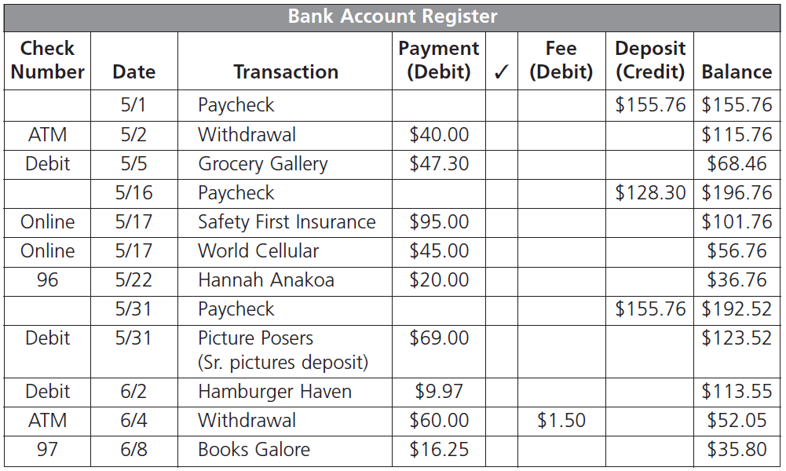
Handout 3.4: What’s the Balance?—Answer Key

Slide 19
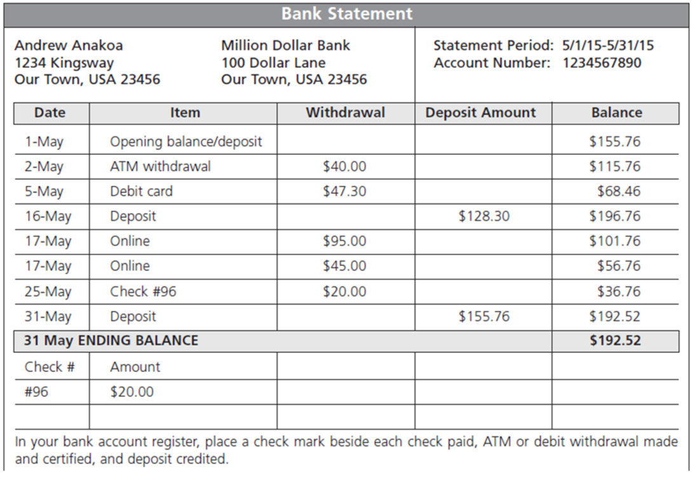
Balancing Andrew Anakoa’s Bank Account

Slide 20
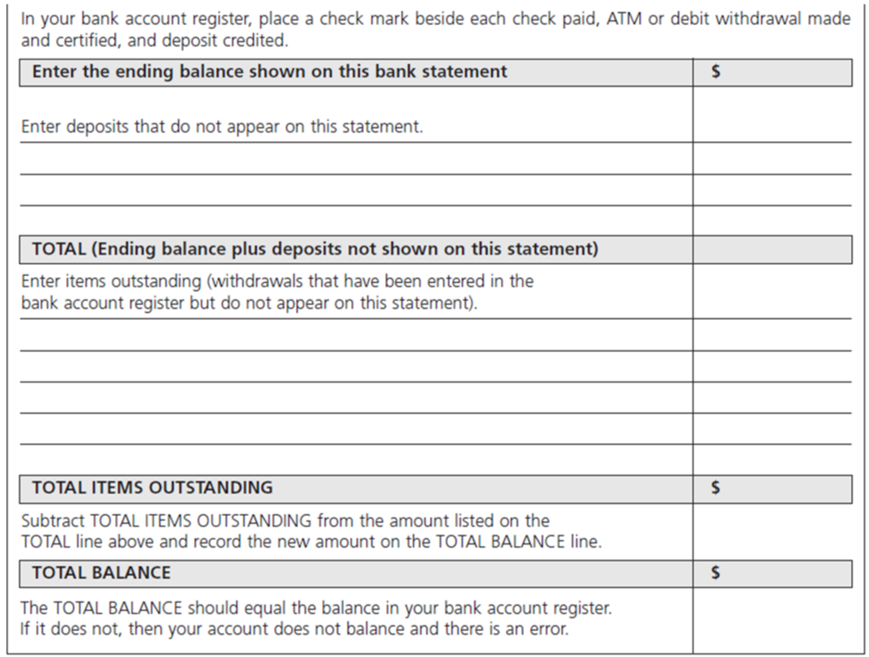
Balancing Andrew Anakoa’s Bank Account (cont.)

Slide 21
What are some advantages of having a checking or savings account?
Money is safe in a bank.
Money deposited may earn interest depending on the type of account.
There are low or no fees for cashing checks.
Banks provide a record of transactions.
You likely have 24-hour access to your money through ATMs.

Slide 22
What is a disadvantage of using check-cashing services?
Their fees are very high.
What are direct deposits?
Direct deposits are monies deposited electronically and directly into a payee’s bank account from a payer’s bank account. For example, the company you work for deposits your monthly paycheck into your account from theirs.

Slide 23
What are electronic payments?
These are payments made electronically from an account online. Payment is withdrawn (debited) from your account and deposited into someone else’s account to pay a bill or pay for a purchase.
What are checks?
Checks are printed forms directing a bank to withdraw money from an account and pay it to another account.

Slide 24
Why is it important to maintain account records and keep track of bank account balances?
To avoid paying overdraft fees, to make certain the records are accurate and show the correct balance, and to know where your money is going

