Slide 1
Income – The payment people receive for providing resources in the market.
Wages – The income for providing human resources (labor).

Slide 2
John Dough is 16 years old and recently started his first job at ABC Mart. This is his first pay stub for his first two weeks of work.
ABC Mart | John A. Dough | Earnings
SSN | 123-45-6789 |  | This Period | YTD
Employee ID | 98765 | Regular Pay
 |  | Overtime Pay | $0.00 | $0.00
Pay Period | 1/1/XX to 1/14/XX | Holiday Pay | $0.00 | $0.00
Pay Date | 2/3/20XX | Total Pay
Allowances |  | Deductions
Federal | 1 |  | This Period | YTD
State | 1 | Federal Income Tax | $21.40 | $21.40
 |  | Social Security Tax (FICA) | $22.32 | $22.32
Hourly Rate | $15.00 | Medicare Tax (FICA) | $5.22 | $5.22
 |  | State Income Tax | $1.00 | $1.00
 |  | Medical Insurance | $0.00 | $0.00
 |  | Retirement [401(k)] | $0.00 | $0.00
 |  | Total Deductions | $49.94 | $49.94
Hours Worked this Pay Period |  | Net Pay
Regular | 24 |  | This Period | YTD
Overtime | 0 | Gross Pay | $360.00 | $360.00
Holiday | 0 | Total Deductions | $49.94 | $49.94
 |  | Net Pay | $310.06 | $310.06

Slide 3
Income tax – A tax on the amount of income people earn.
How much federal income tax was withheld from John's check?
$21.40
What percentage of his income was withheld for federal income tax?
$21.40 ÷ $360.00 = 0.059 = 5.9%
John works in a state that has a state income tax.
How much was withheld for state income taxes?
$1.00

Slide 4
FICA – Federal Income Contributions Act. The FICA tax is a U.S. payroll tax used to fund Social Security and Medicare.
Social Security – A federal program that provides benefits for retirees, the disabled, and the minor children of deceased workers.
Medicare – A federal program that provides health insurance for people 65 years of age or older and people under 65 with certain disabilities.

Slide 5
Deductions
 | This Period | YTD
Federal Income Tax | $21.40 | $21.40
Social Security Tax (FICA) | $22.32 | $22.32
Medicare Tax (FICA) | $5.22 | $5.22
State Income Tax | $1.00 | $1.00
Medical Insurance | $0.00 | $0.00
Retirement [401(k)] | $0.00 | $0.00
Total Deductions | $49.94 | $49.94
Net Pay
 | This Period | YTD
Gross Pay | $360.00 | $360.00
Total Deductions | $49.94 | $49.94
Net Pay | $310.06 | $310.06

Slide 6
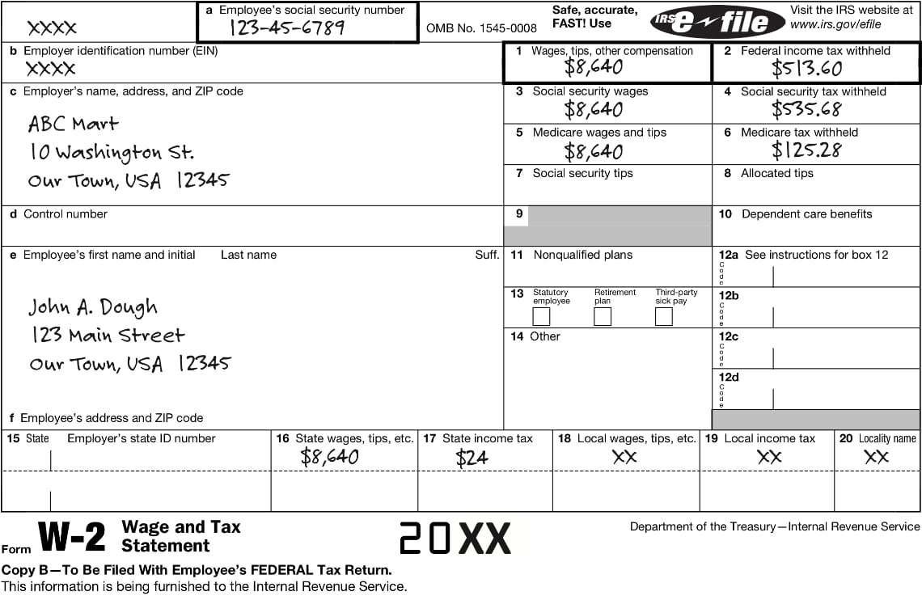

Slide 7
Taxes are collected on a "pay as you go" principle.
Many people, therefore, try to adjust the amount of money they have withheld so that they pay the correct amount of taxes for each paycheck.
Some people, however, prefer to receive a refund each year, so they purposely pay more than they need to pay per pay period.
The government does not pay you interest on your
overpayment.

Slide 8
What are some goods and services the federal government provides for citizens?
Police protection
State parks
Federal government provides goods and service
Public education
State troopers
National defense
Streetlights
National parks
Fire protection
Interstate highways
State roads

Slide 9
What are some goods and services state governments provide for citizens?
Police protection
State parks
State
government provides goods and service
Public education
State troopers
National defense
Streetlights
National parks
Fire protection
Interstate highways
State roads

Slide 10
What are some goods and services local governments provide for citizens?
Police protection
State parks
Local
government provides goods and service
Public education
State troopers
National defense
Streetlights
National parks
Fire protection
Interstate highways
State roads

Slide 11
What are wages?
Wages are a form of income people
receive for work they do.

Slide 12
What income?
Income is payment people receive
for providing resources in the market.

Slide 13
What are taxes?
Taxes are government fees on business
and individual income, activities, products, and property that people are required to pay.

Slide 14
What is gross pay?
Gross pay is the amount people earn
in a pay period before any deductions
or taxes are taken out.

Slide 15
What is net pay?
Net pay is take-home pay; it is the
amount received after taxes and
deductions have been taken out of gross pay.

Slide 16
What is the FICA tax?
The FICA tax is a tax resulting from the Federal Insurance Contributions Act.

Slide 17
What does the FICA tax fund?
The FICA tax funds Social Security
and Medicare.

Slide 18
Who pays the FICA tax?
Both employees and employers pay
the FICA tax.

Slide 19
What is Form W-4 and for what is it used?
Form W-4 is a form that must be completed by an employee before starting a job. It is used by the employer to determine the amount of income tax to withhold for the employee.

Slide 20
What is Form W-2?
Form W-2 is a form employers must
provide to employees shortly after year-end to report annual income and
withholding for an employee's tax return.

