Slide 1
Unit 6: Saving
Lesson 6A: Time Preference–
Why It Is Hard To Save
©2017, Minnesota Council on Economic Education. Developed in partnership with the Federal Reserve Bank of St. Louis.

Slide 2
Compelling Question
How do costs and benefits influence saving?
Lesson 6A

Slide 3
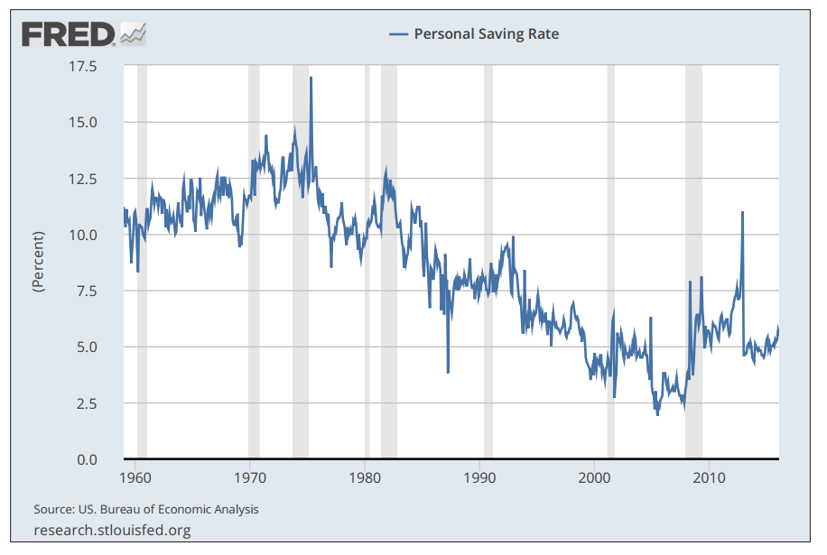
Visual 6A.1: Personal Saving Rate (1959-2016)
NOTE: Gray bars indicate recessions as determined by the National Bureau of Economic Research. For the most recent data, go to https://fred.stlouisfed.org/series/PSAVERT.
SOURCE: FRED®, Federal Reserve Bank of St. Louis.
Lesson 6A

Slide 4
Visual 6A.2: The Timing of Benefits and Costs
Activity | Now or later? BENEFITS COSTS
Eating junk food
Exercising
Staying up late
Smoking
Practicing a musical instrument
Studying
Borrowing money
Saving
Lesson 6A

