Slide 1
Unit 3: Earning Income
Lesson 3A: Investing in Yourself
©2017, Minnesota Council on Economic Education. Developed in partnership with the Federal Reserve Bank of St. Louis.

Slide 2
Compelling Question
How are knowledge and skills related to income and unemployment?
Lesson 3A

Slide 3
Visual 3A.1: Wages by Occupation (2015 Median Pay)
Slide 1 of 4
Occupation | Median hourly wage | Median annual income*
Physician | $90.00 | $187,200
Dentist | $76.11 | $158,310
Pharmacist | $58.41 | $121,500
Lawyer | $55.69 | $115,820
Mechanical engineer | $40.19 | $83,590
Physical therapist | $40.40 | $84,020
Computer programmer | $38.24 | $79,530
NOTE: *Based on 2,000 hours (50 weeks @ 40 hours/week). SOURCE: Bureau of Labor Statistics, Occupational Outlook Handbook; http://www.bls.gov/ooh/; www.bls.gov/ncs/ocs/sp/ncbl0831.pdf.
Lesson 3A

Slide 4
Visual 3A.1: Wages by Occupation (2015 Median Pay)
Slide 2 of 4
Occupation | Median hourly wage | Median annual income*
High school teacher | $35.75** | $57,200
Registered nurse | $32.45 | $67,490
Accountant/auditor | $32.30 | $67,190
Librarian | $27.35 | $56,880
Electrician | $24.94 | $51,880
Plumber/pipefitter | $24.34 | $50,620
Firefighter | $22.53 | $46,870
NOTE: *Based on 2,000 hours (50 weeks @ 40 hours/week). **Based on 1,600 hours (40 weeks @ 40 hours/week).
SOURCE: Bureau of Labor Statistics, Occupational Outlook Handbook; http://www.bls.gov/ooh/; www.bls.gov/ncs/ocs/sp/ncbl0831.pdf.
Lesson 3A

Slide 5
Visual 3A.1: Wages by Occupation (2015 Median Pay)
Slide 3 of 4
Occupation | Median hourly wage | Median annual income*
Carpenter | $20.24 | $42,090
Truck driver | $19.36 | $40,260
Actor | $18.80 | $37,600*
Welder | $18.34 | $38,150
Automotive technician/mechanic | $18.20 | $37,850
Secretary/administrative asst. | $17.55 | $36,500
Construction laborer/helper | $14.85 | $30,890
NOTE: *Based on 2,000 hours (50 weeks @ 40 hours/week).
SOURCE: Bureau of Labor Statistics, Occupational Outlook Handbook; http://www.bls.gov/ooh/; www.bls.gov/ncs/ocs/sp/ncbl0831.pdf.
Lesson 3A

Slide 6
Visual 3A.1: Wages by Occupation (2015 Median Pay)
Slide 4 of 4
Occupation | Median hourly wage | Median annual income*
Bank teller | $12.70 | $26,410
Barber/hairdresser/cosmetologist | $11.40 | $23,710
Janitor | $11.27 | $23,440
Food preparer | $9.70 | $20,180
Bartender | $9.39 | $19,530
Cashier | $9.28 | $19,310
Waiter/Waitress | $9.25 | $19,250
NOTE: *Based on 2,000 hours (50 weeks @ 40 hours/week).
SOURCE: Bureau of Labor Statistics, Occupational Outlook Handbook; http://www.bls.gov/ooh/; www.bls.gov/ncs/ocs/sp/ncbl0831.pdf.
Lesson 3A

Slide 7
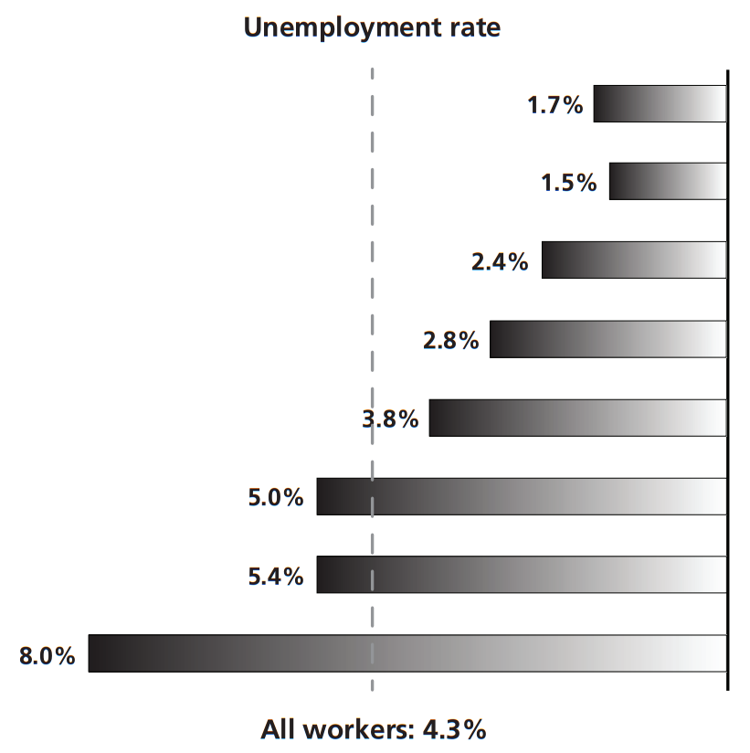
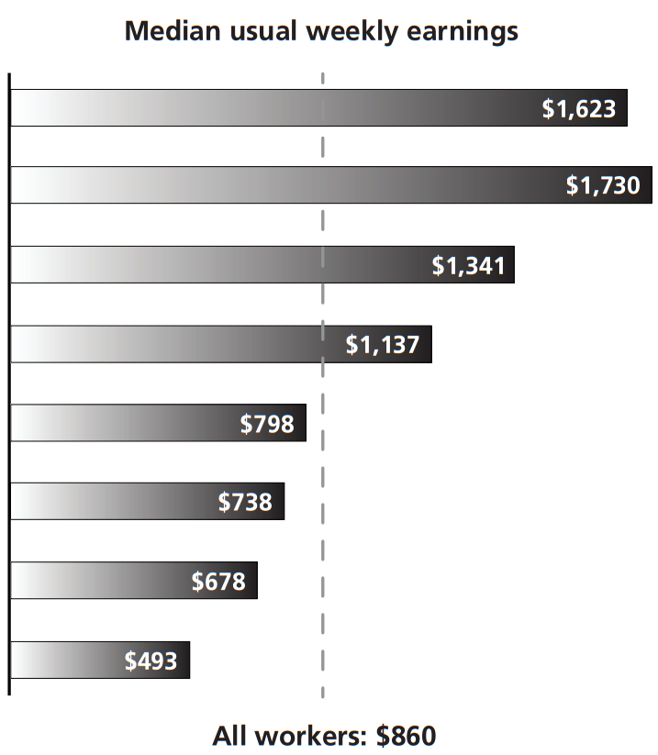
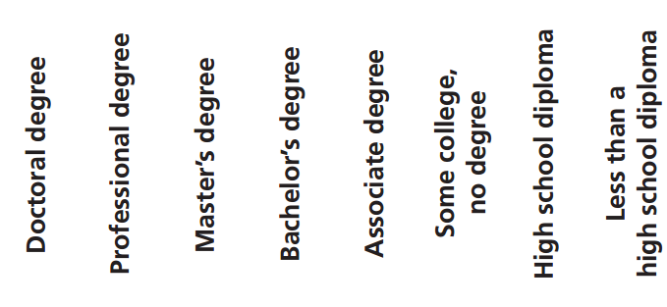
Visual 3A.2: Earning and Unemployment by Education Level (2015)
Lesson 3A
NOTE: Data are for persons 25 years of age and older. Earnings are for full-time wage and salary workers.
SOURCE: Bureau of Labor Statistics Current Population Survey; http://www.bls.gov/emp/ep_chart_001.htm, accessed June 1, 2016.

