Slide 1
Unit 1: Thinking Economically
Lesson 1B: Making Choices and Identifying Costs
©2017, Minnesota Council on Economic Education. Developed in partnership with the Federal Reserve Bank of St. Louis.

Slide 2
Compelling Question
How can a decisionmaking process
help you make informed decisions?
Lesson 1B

Slide 3
Visual 1B.1: PACED Decisionmaking Model
Step 1: P—Define the Problem. Why must you make a choice?
Step 2: A—List the Alternatives. What are your possible options?
Step 3: C—Determine the Criteria. What standards are important to you?
Step 4: E—Evaluate the Alternatives. How well does each alternative meet
each criterion?
Step 5: D—Make the Decision. Which option has the most favorable
trade-offs?
Lesson 1B

Slide 4
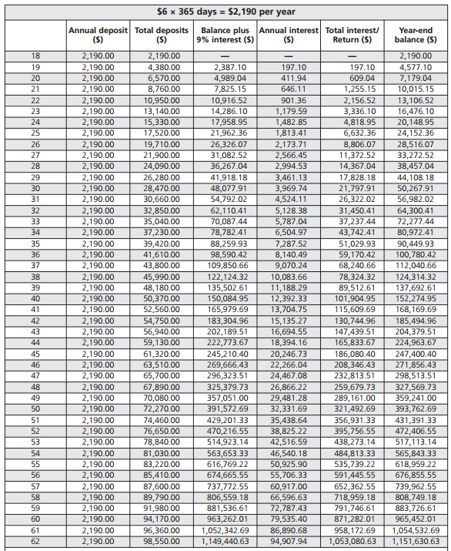
Visual 1B.2: Smoke or Be a Millionaire?
Age | Annual deposit ($) | Total deposit ($) | Annual 9% interest ($) | Total interest/ Return ($) | Year-end balance ($)
18 | 2,190.00 | 2,190.00 | — | — | 2,190.00
19 | 2,190.00 | 4,380.00 | 197.10 | 197.10 | 4,577.10
20 | 2,190.00 | 6,570.00 | 411.94 | 609.04 | 7,179.04
27 | 2,190.00 | 21,900.00 | 2,566.45 | 11,372.52 | 33,272.52
60 | 2,190.00 | 94,170.00 | 79,353.40 | 871,282.01 | 965,452.01
61 | 2,190.00 | 96,360.00 | 86,890.68 | 958,172.69 | 1,054,532.69
62 | 2,190.00 | 98,550.00 | 94,907.94 | 1,053,080.63 | 1,151,630.63
NOTE: APR, annual percentage rate. As of April 1, 2016, the average price of cigarettes was $5.96 per pack. The average stock market return over the past 50 years (1966-2015) was 9.61 percent.
SOURCE: Cigarette prices: https://www.tobaccofreekids.org/research/factsheets/pdf/0202.pdf, accessed April 1, 2016. Stock return average: http://pages.stern.nyu.edu/~adamodar/New_Home_Page/datafile/histretSP.html, accessed April 1, 2016.
Lesson 1B

